Slide 1
HARVARD SCIENCE CENTER TOWNHALL
June 11th and 12th, 2024

Slide 2
Project Updates
Expectations over the next month
Progress Photos
Summer Building use/noise discussion
Website & Notifications Reminder!
Q&A
AGENDA

Slide 3
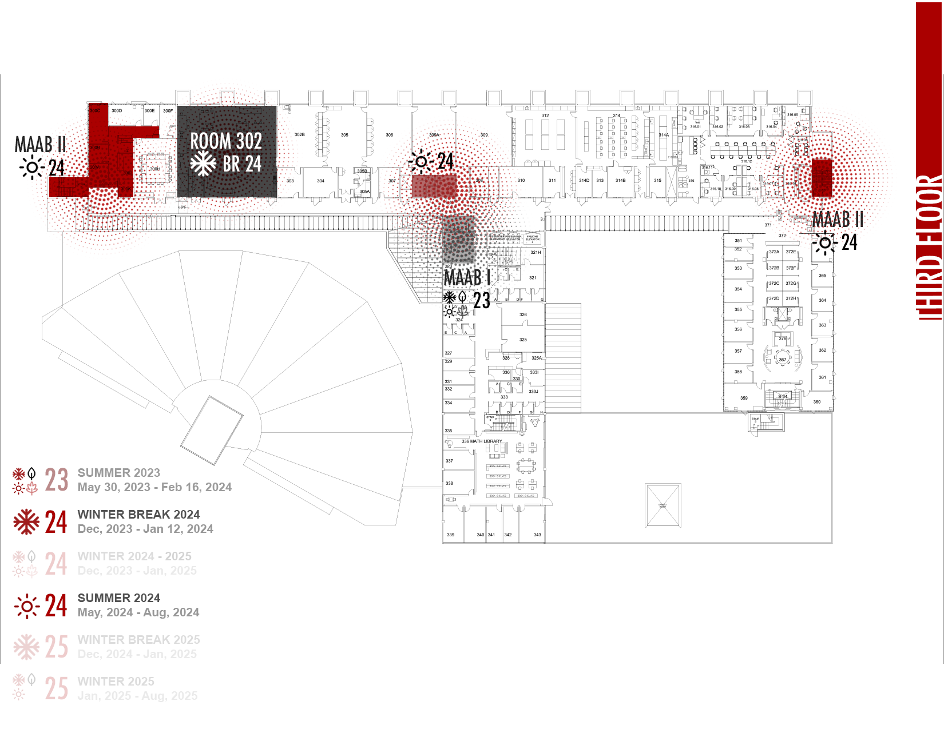
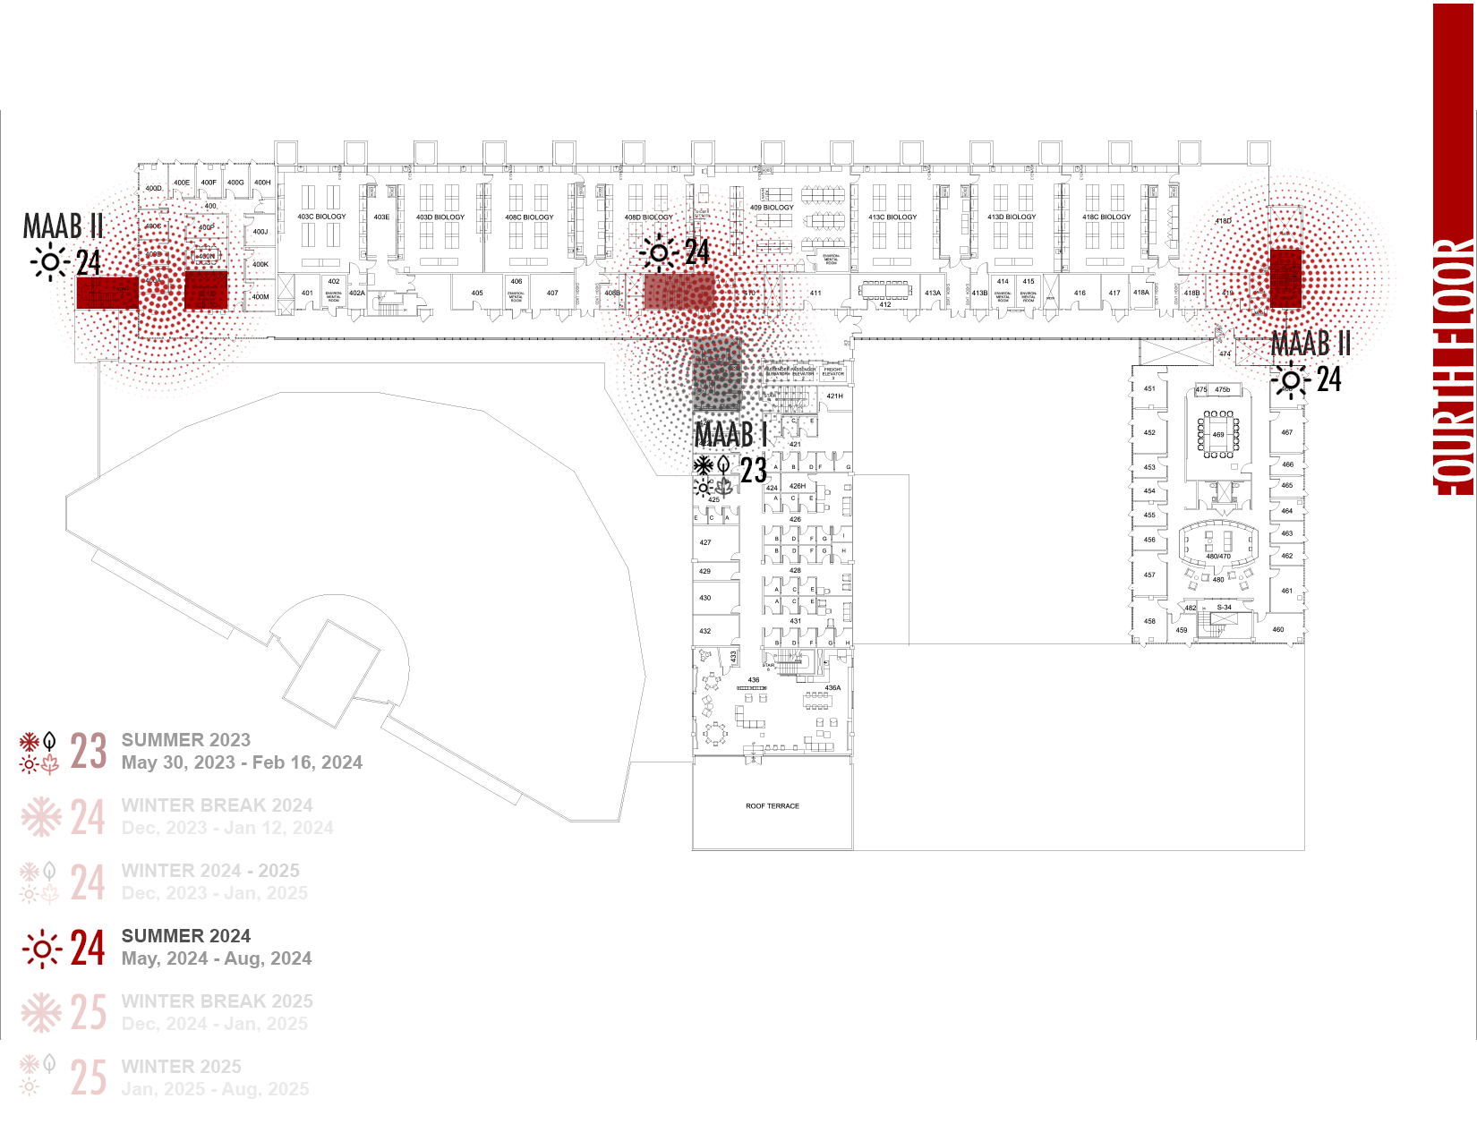
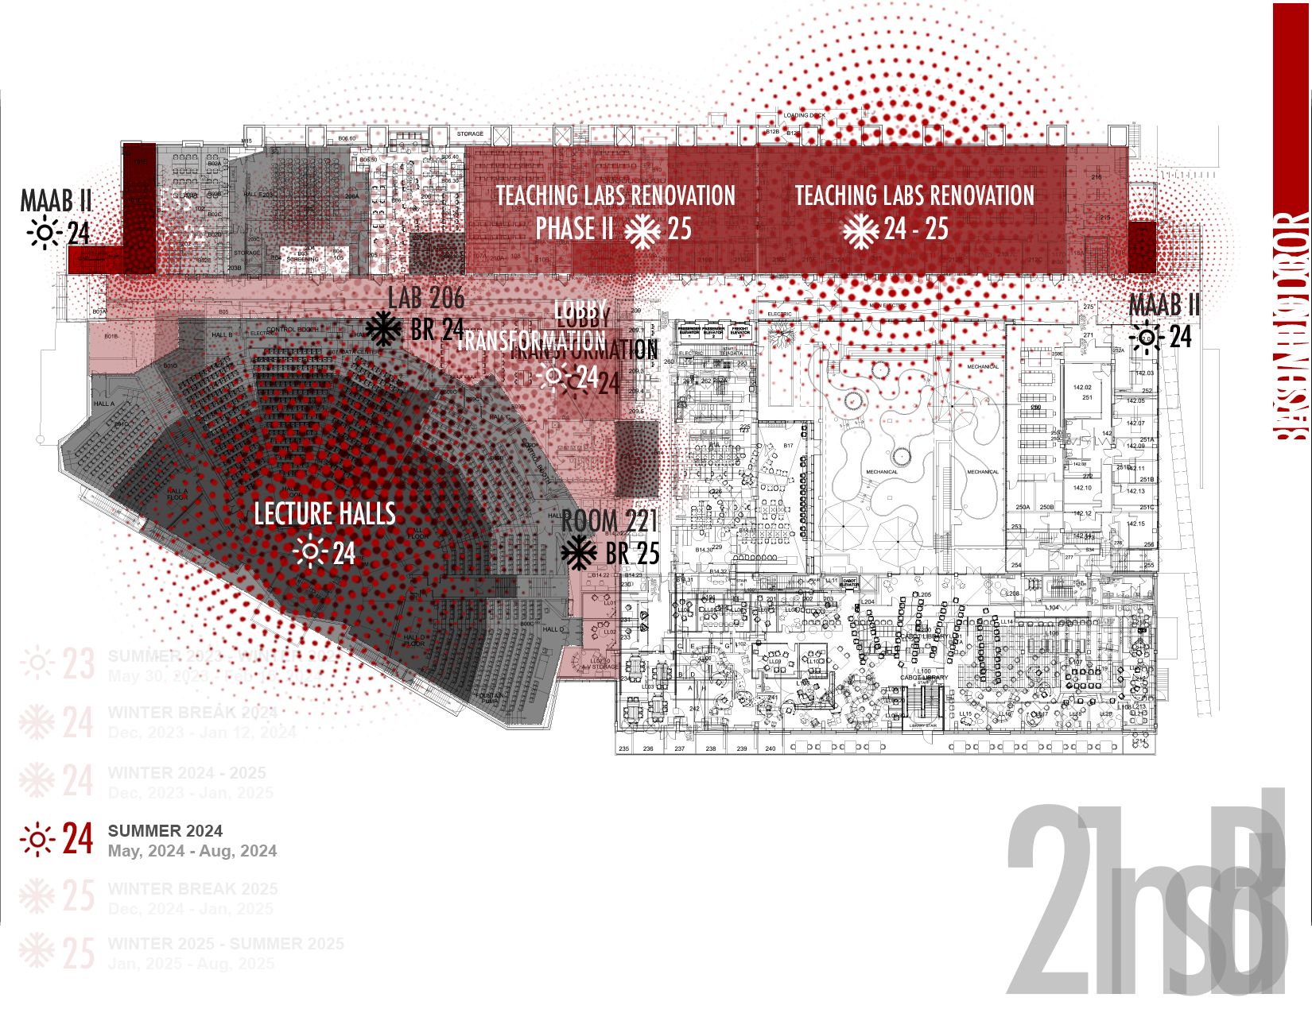
Basement, 1st Fl, 2nd Fl IMPACT SHOWN STARTING MAY 13TH

Slide 4
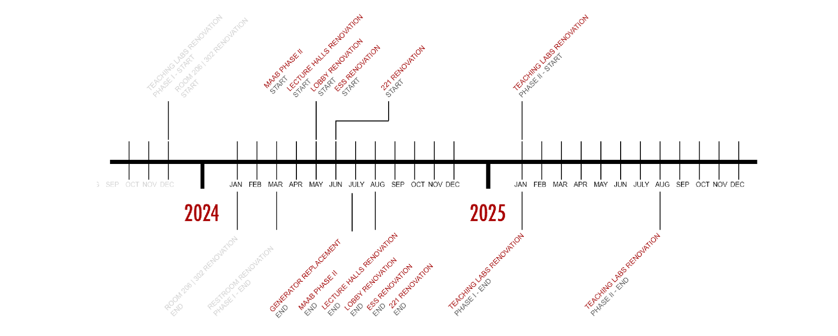

Slide 5
Science Center Project Update
Summer Projects
Ongoing/Continued Projects
MAAB Restroom Projects
Arcade/Lobby Renovation
Lecture Hall Renovations
ESS Space Upgrades
221 Space Upgrades
6. Electrical Infrastructure Project
7. Teaching Labs Projects

Slide 6
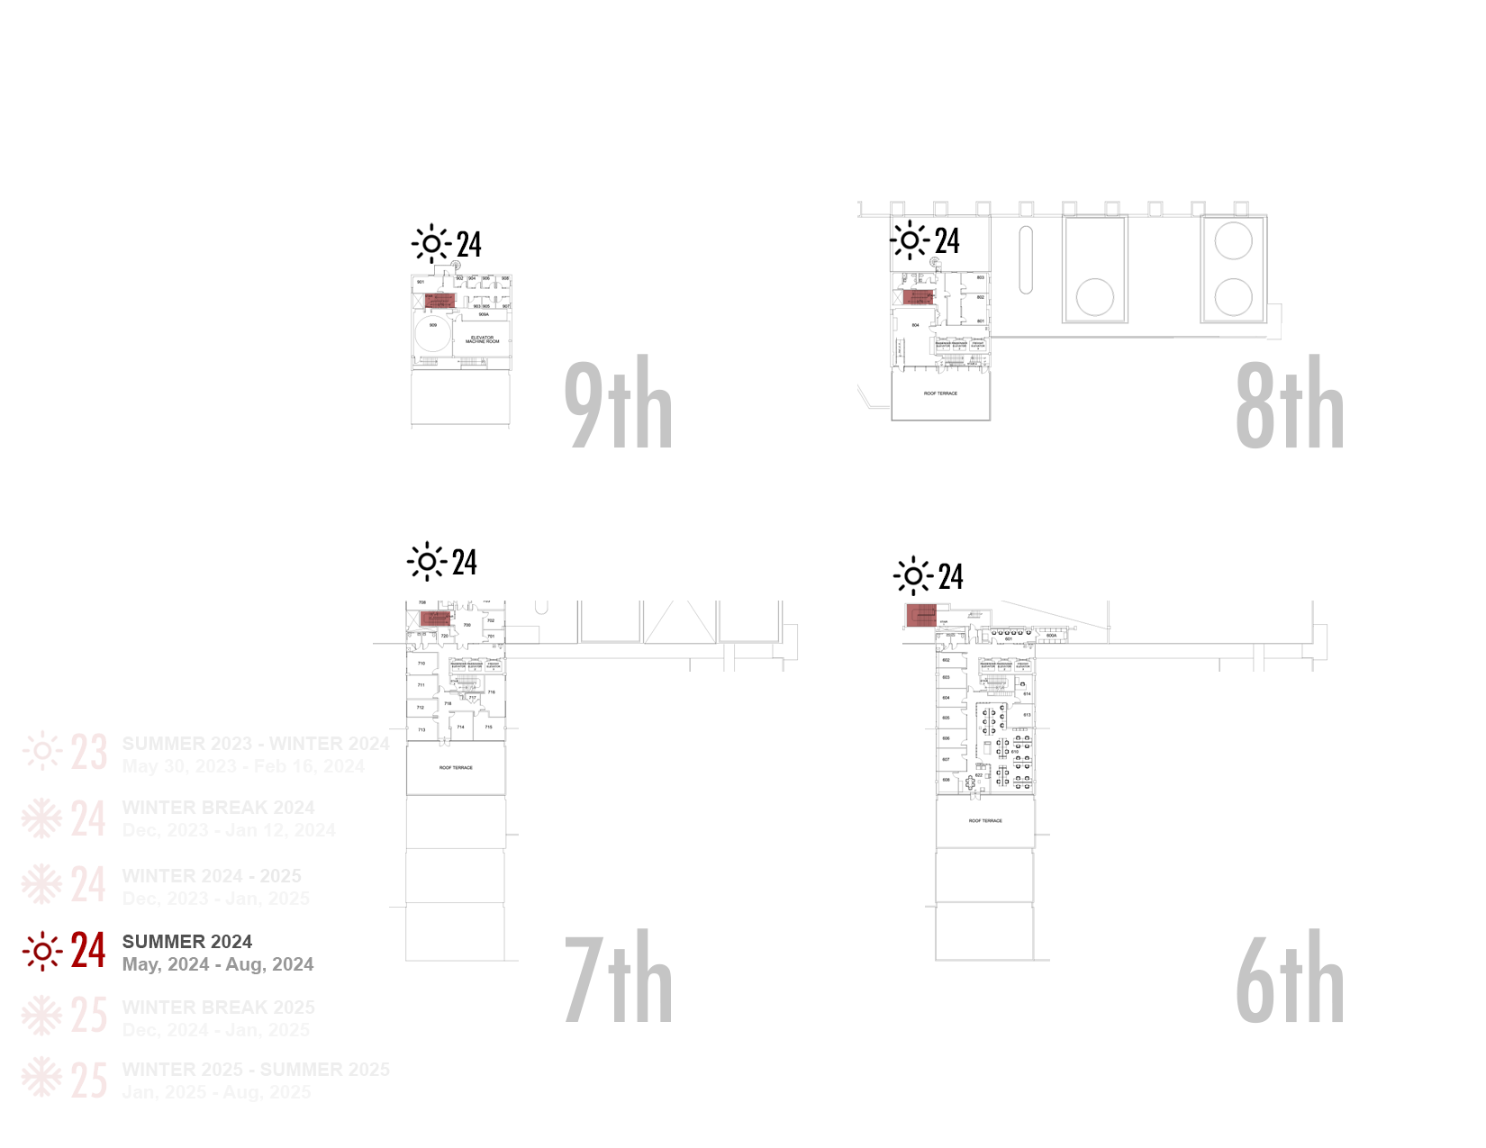
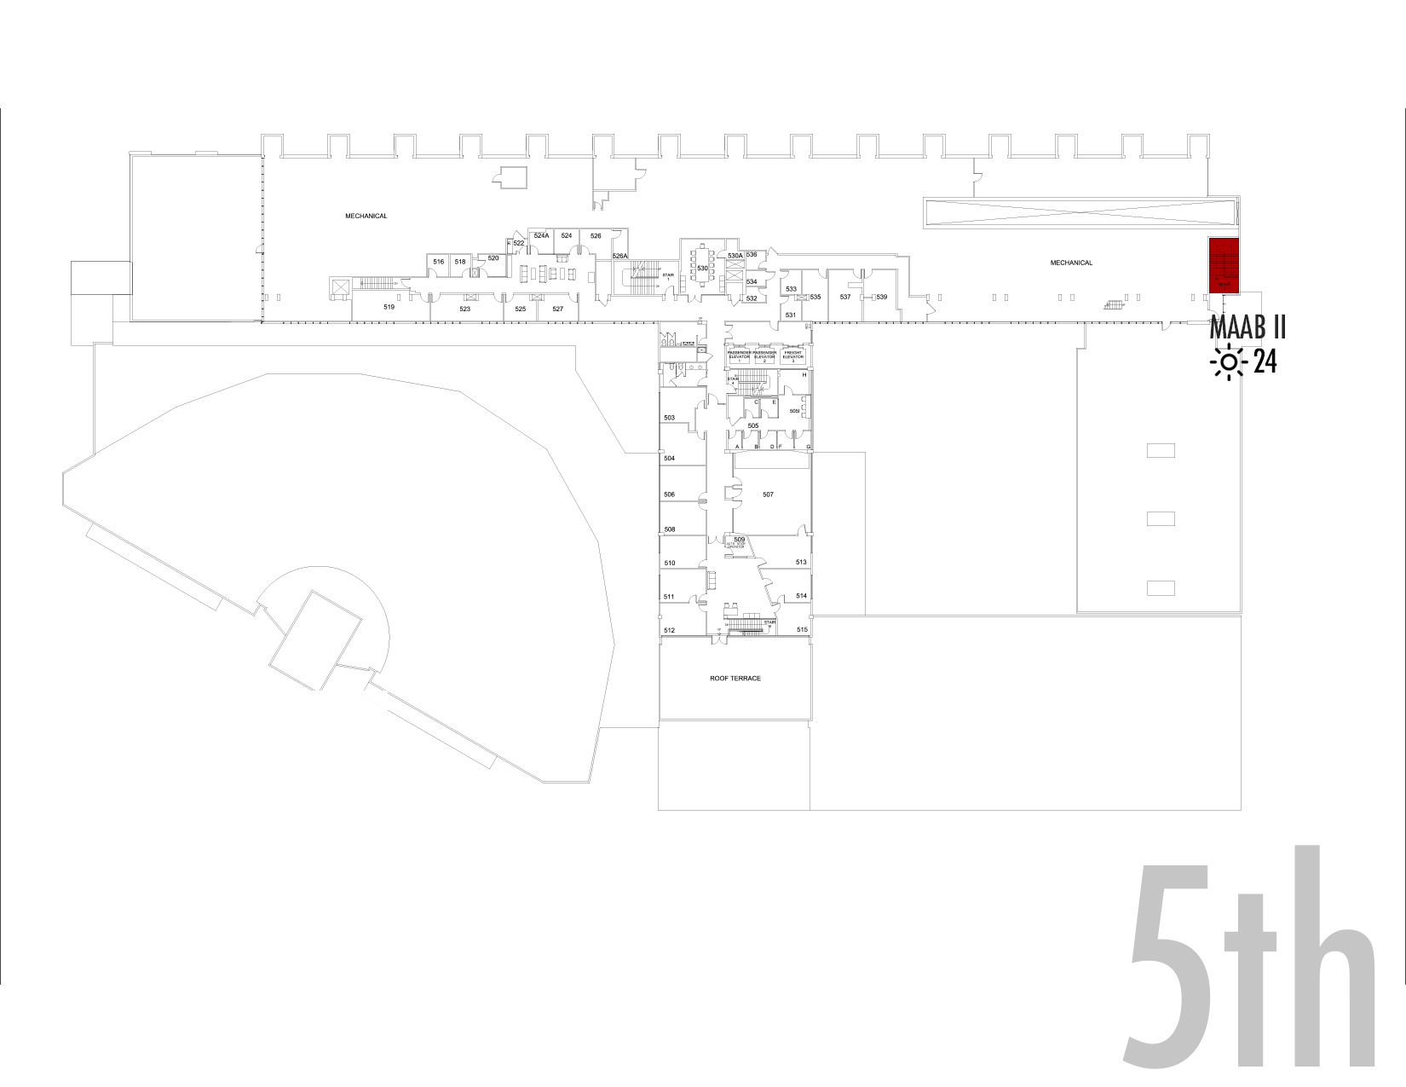
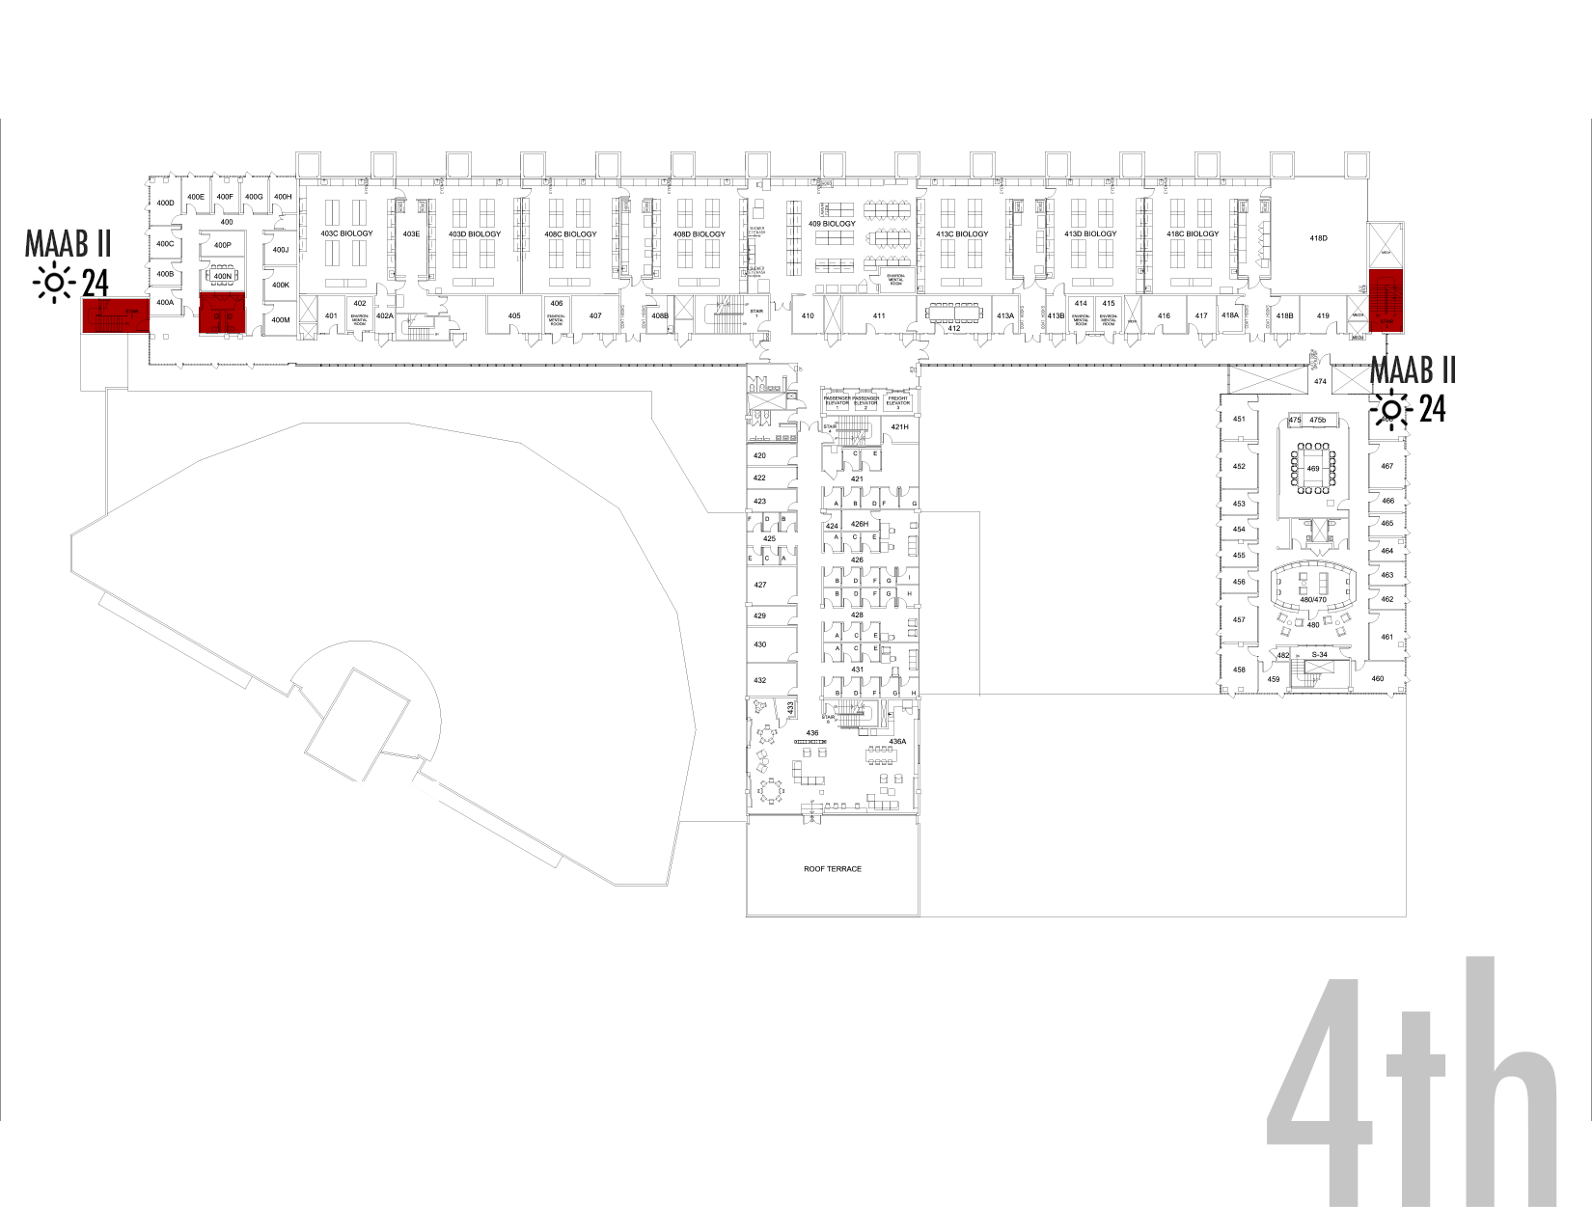
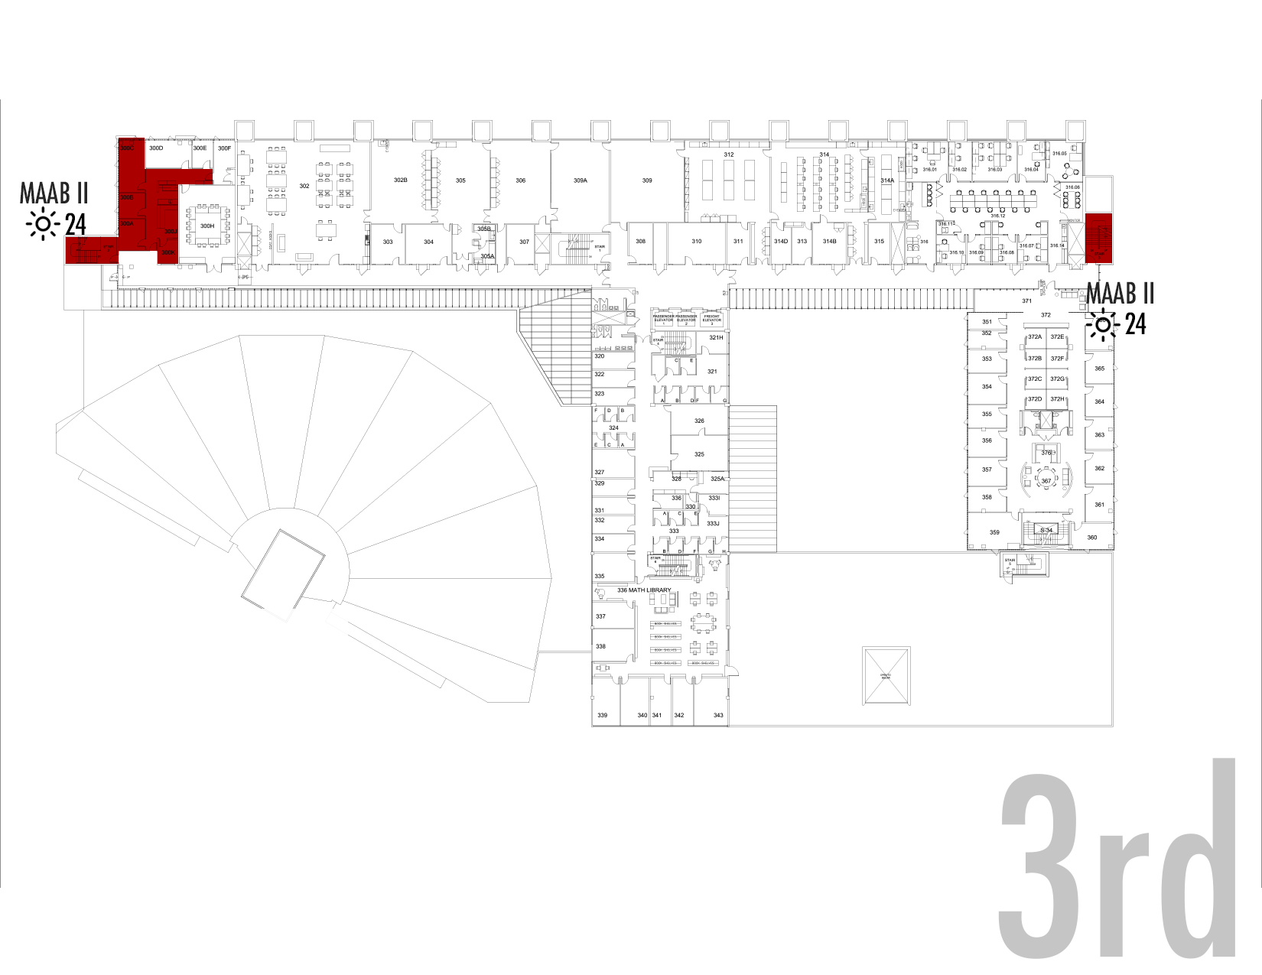
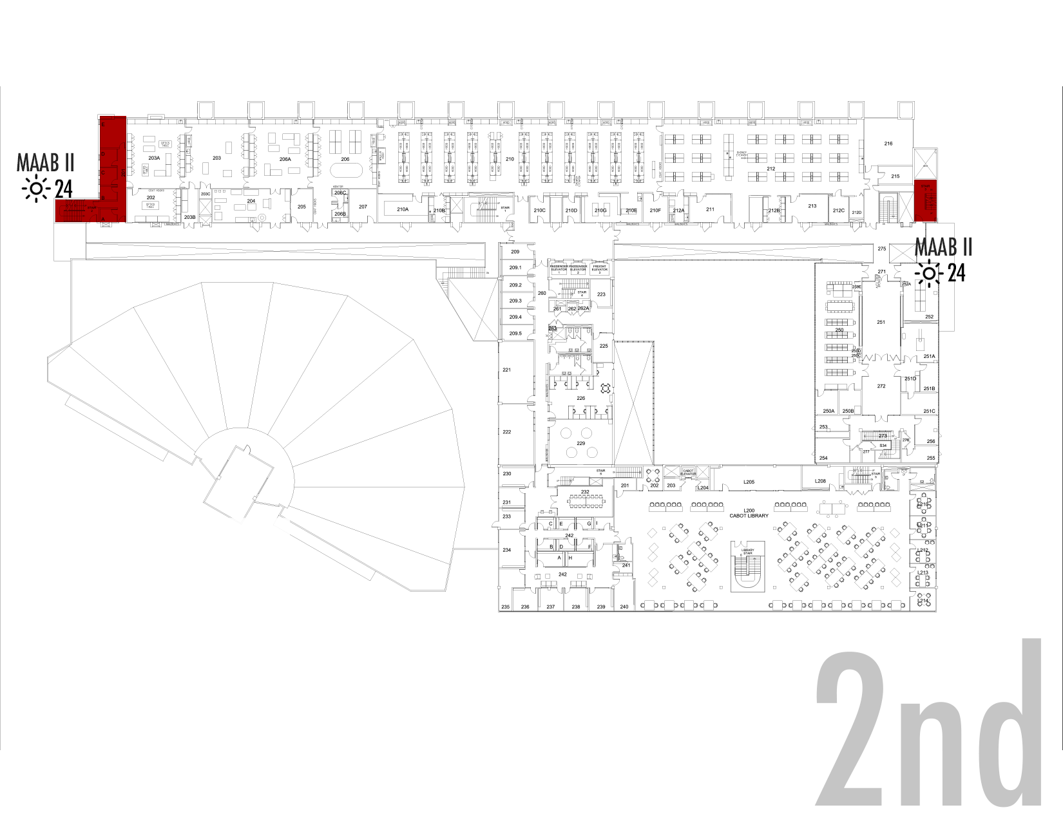
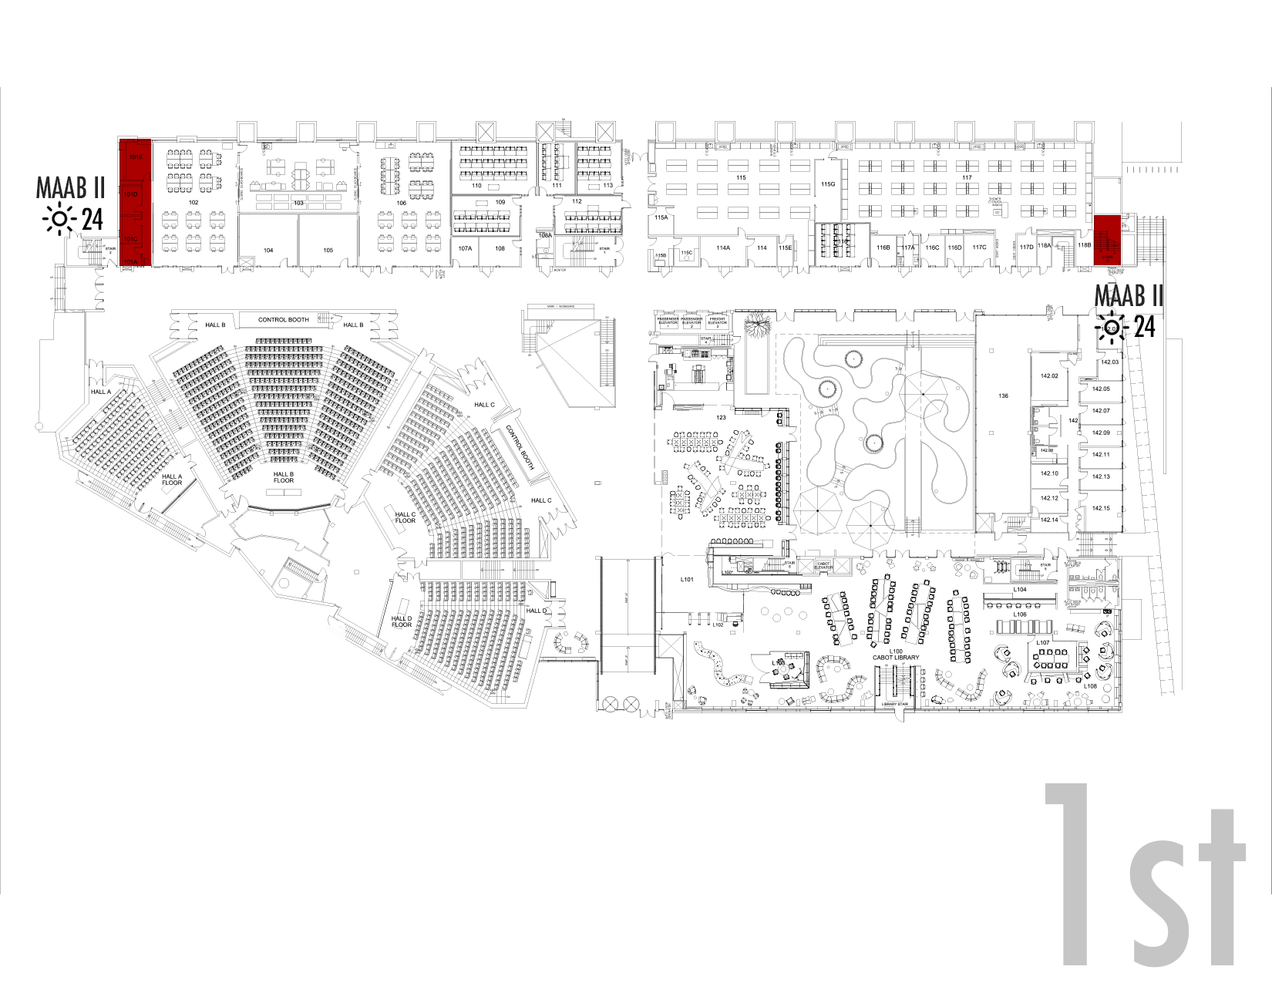
Science Center Project Update
Electrical Infrastructure Project
MAAB Restroom Projects
  Scope
  Current Status
  Project Schedule
  Potential Impacts
3. Teaching Labs Project
4. Arcade/Lobby Renovation
5. Lecture Hall Renovations
6. ESS Space Upgrades
7. 221 Space Upgrade

Slide 7
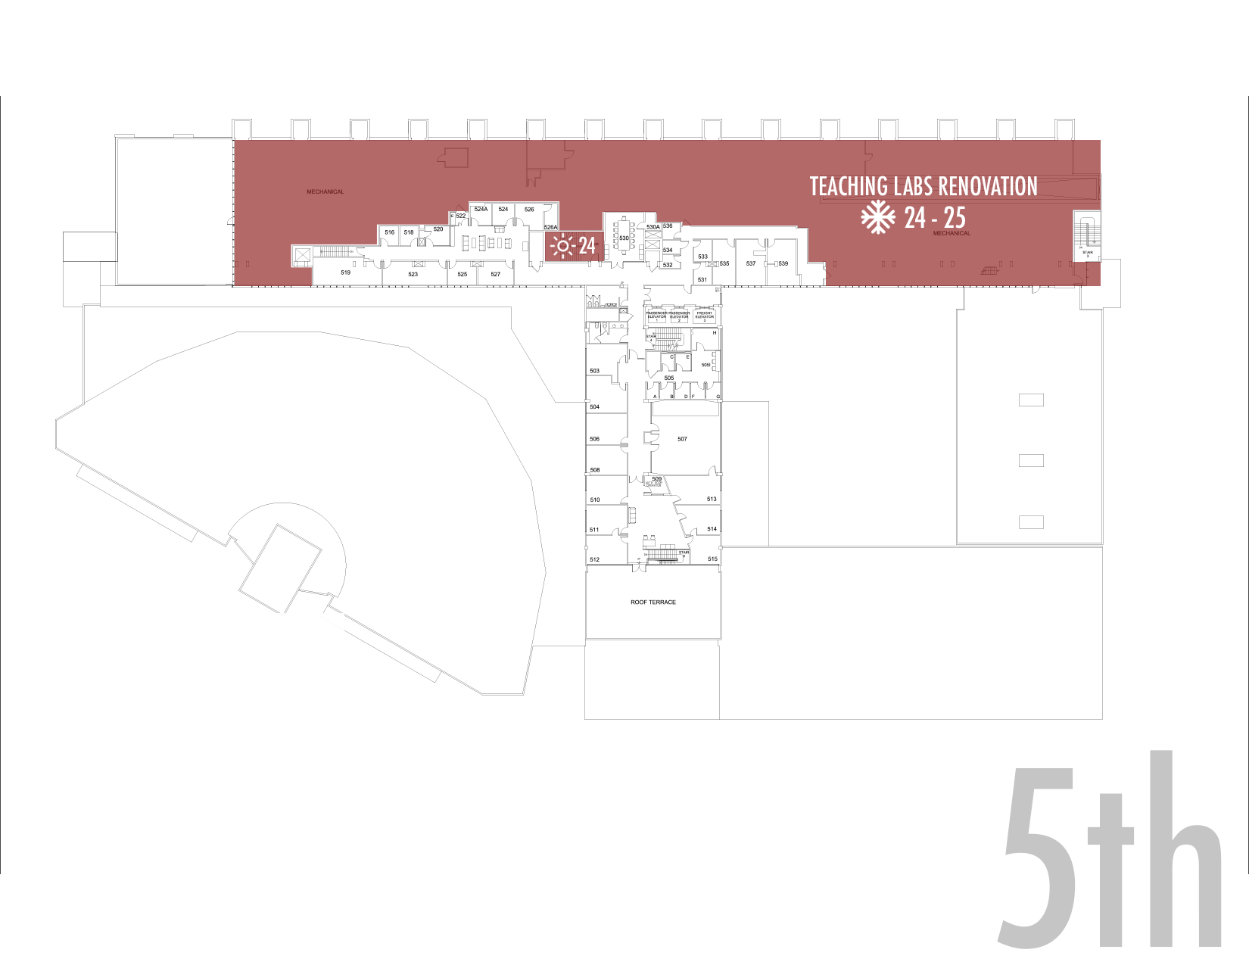
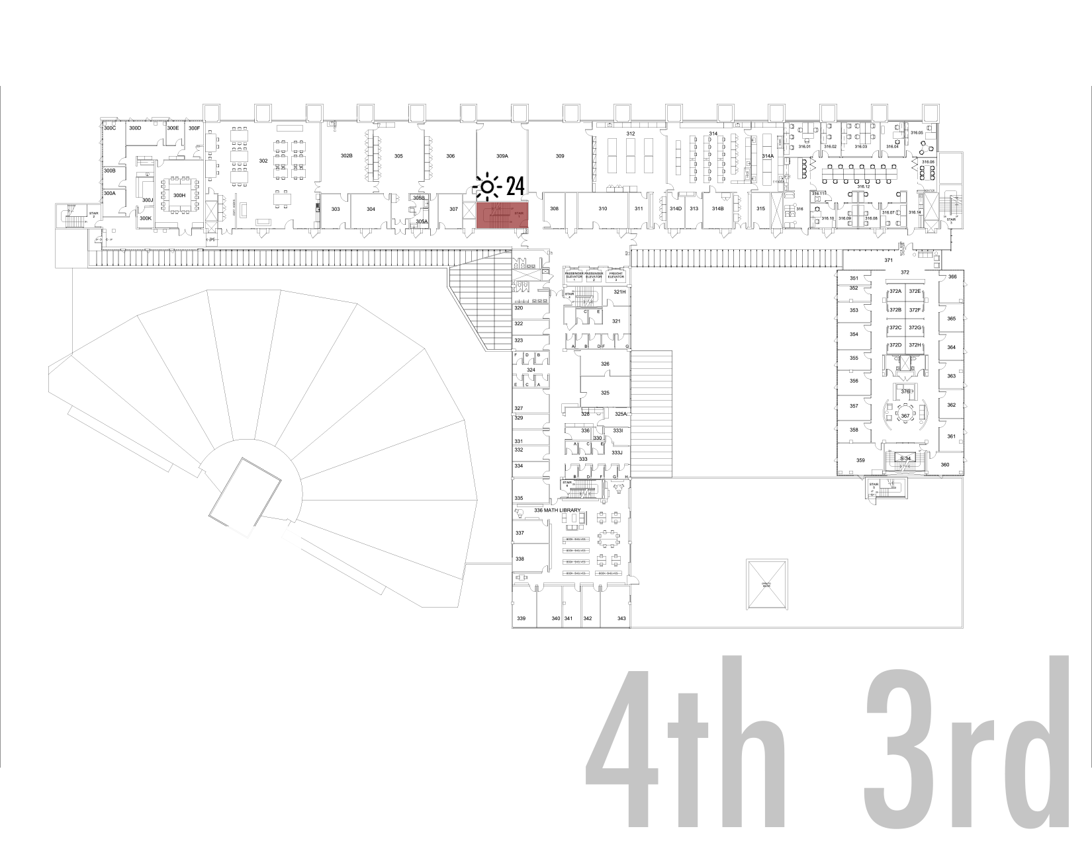
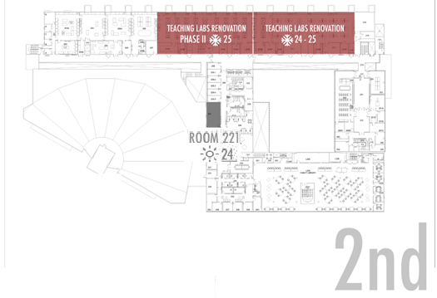
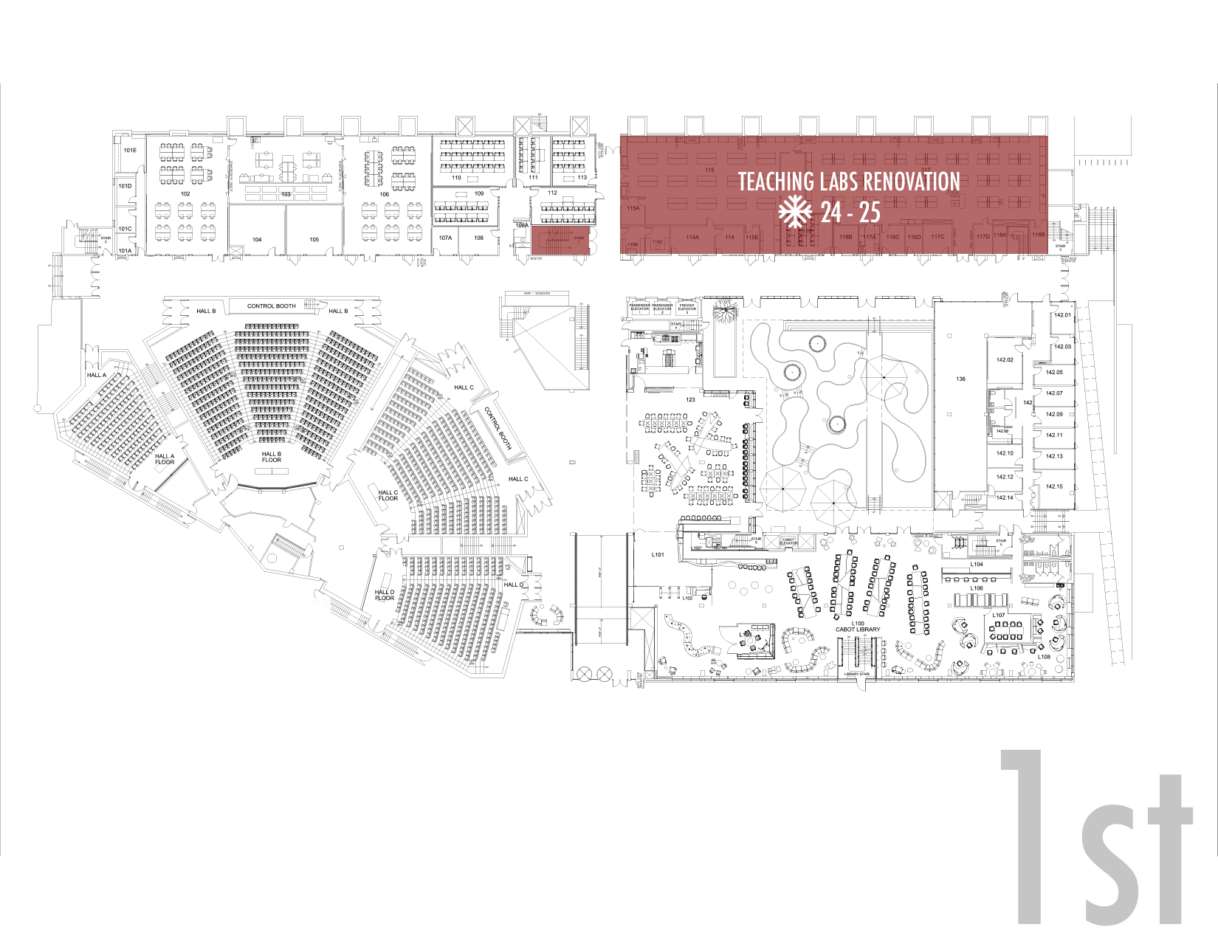
Science Center Project Update
Electrical Infrastructure Project
MAAB Restroom Projects
3. Teaching Labs Project
  Scope
  Current Status
  Project Schedule
  Potential Impacts
4. Arcade/Lobby Renovation
5. Lecture Hall Renovations
ESS Space Upgrades
221 Space Upgrade

Slide 8
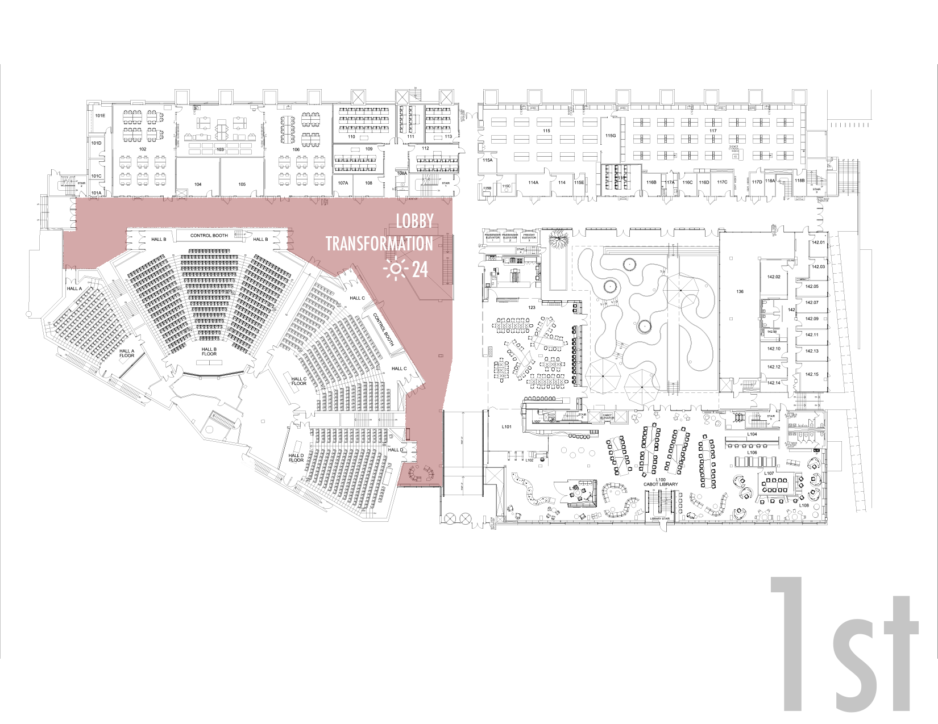
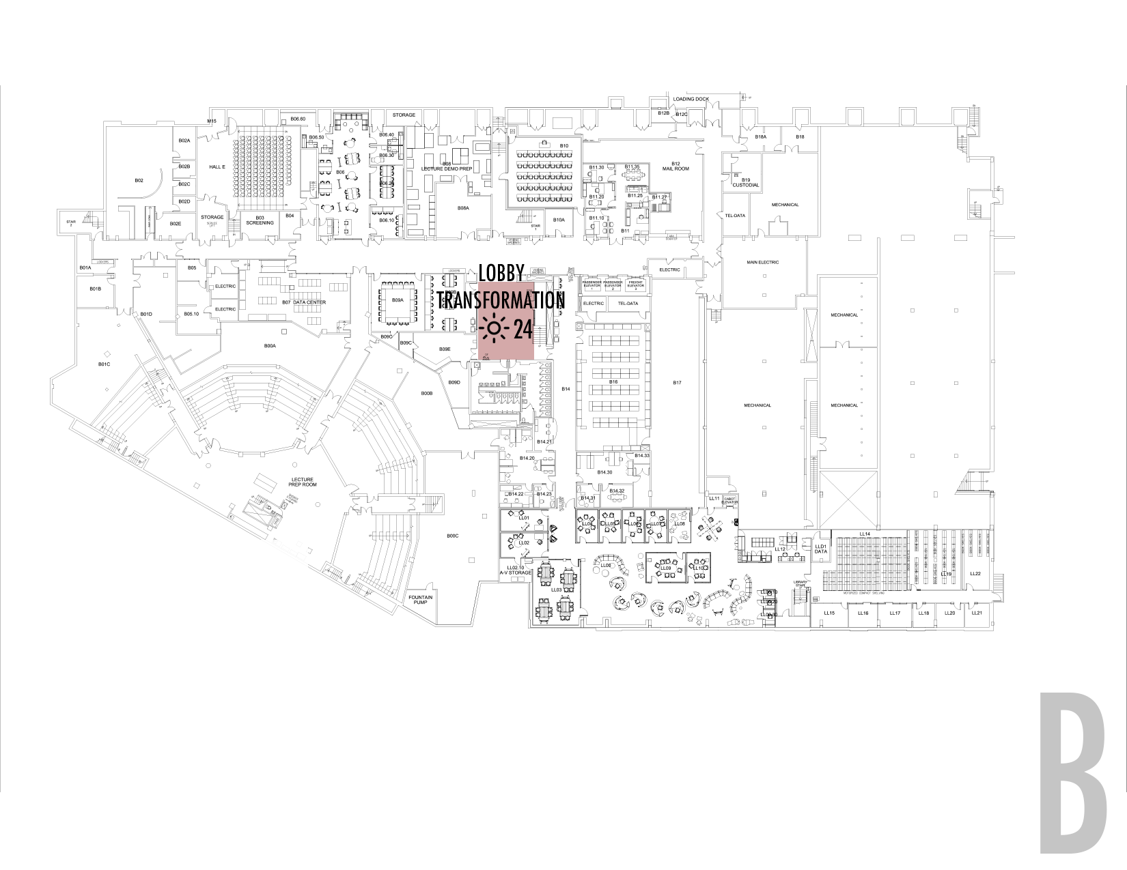
Science Center Project Update
Electrical Infrastructure Project
MAAB Restroom Projects
3. Teaching Labs Project
4. Arcade/Lobby Renovation
  Scope
  Current Status
  Project Schedule
  Potential Impacts
5. Lecture Hall Renovations
ESS Space Upgrades
221 Space Upgrade

Slide 9
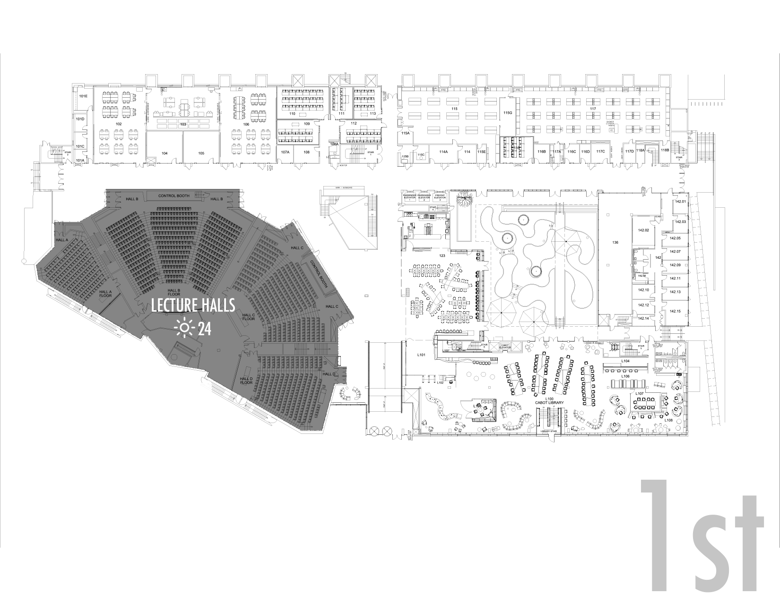
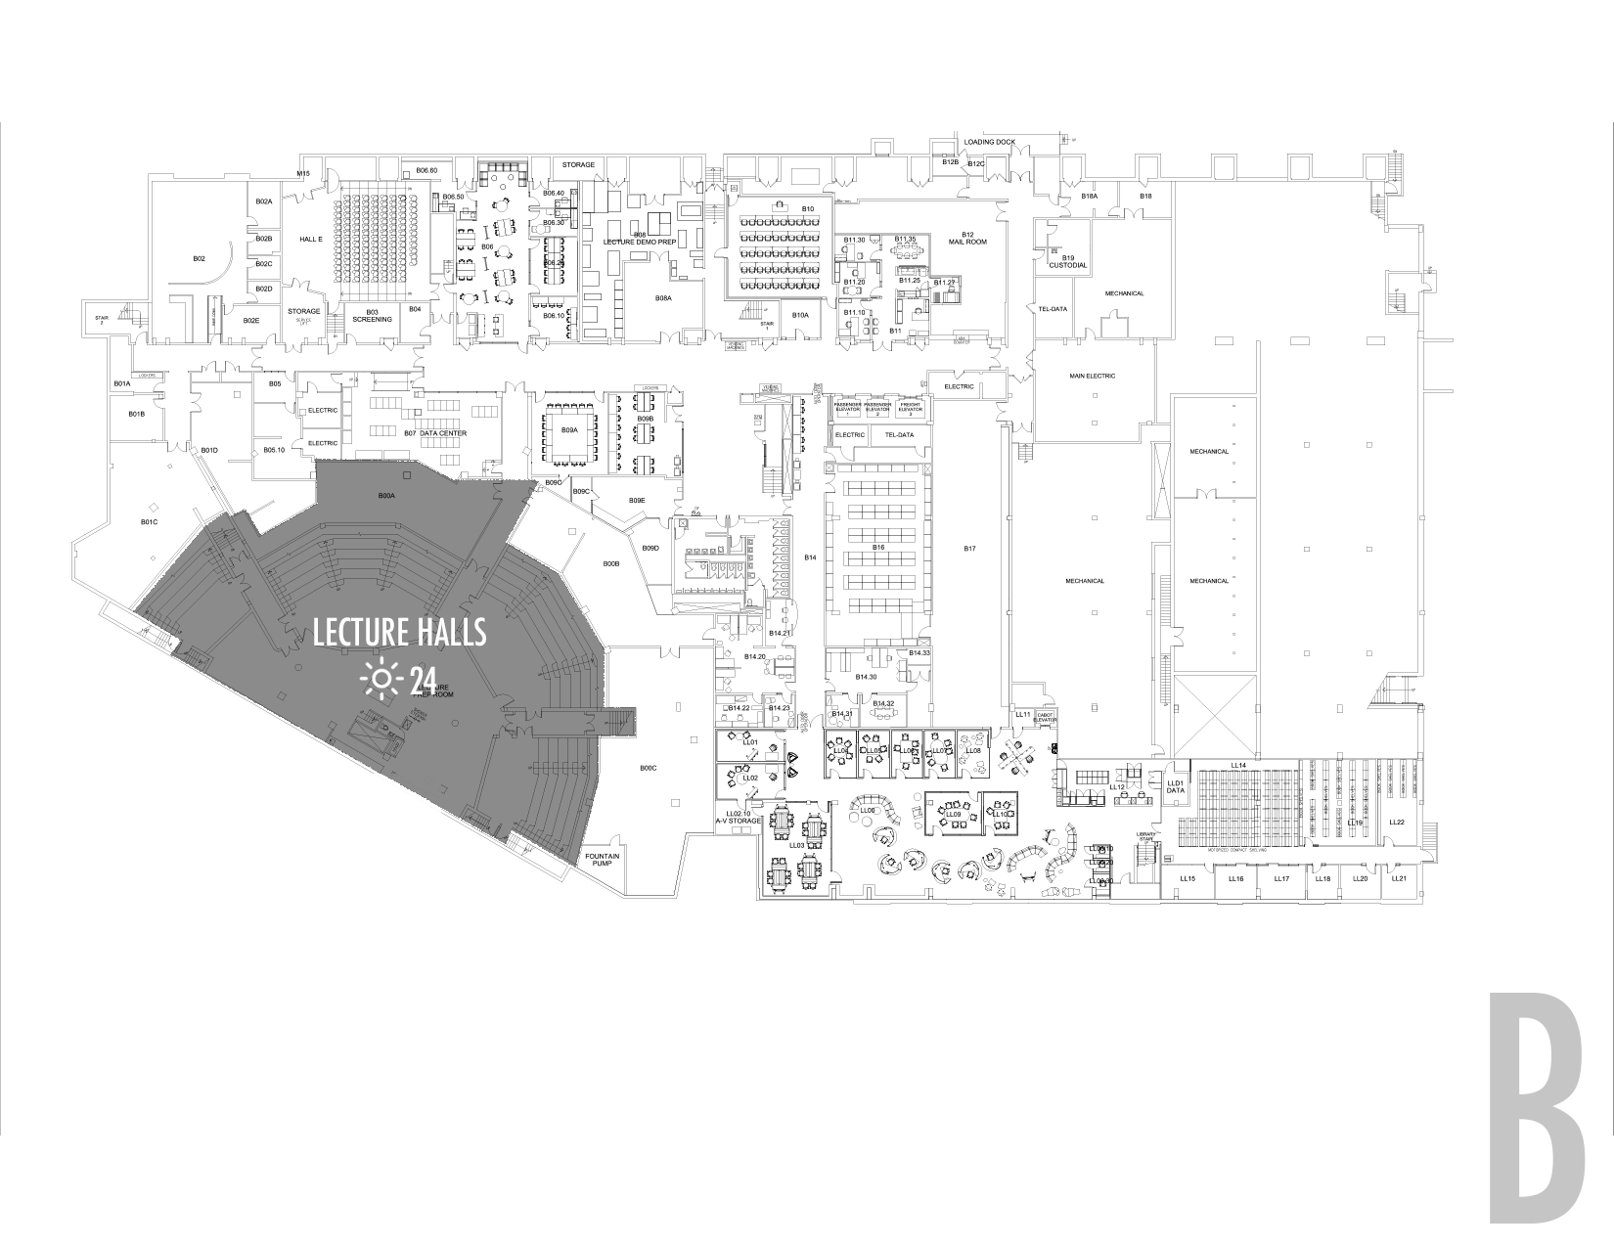
Science Center Project Update
Electrical Infrastructure Project
MAAB Restroom Projects
3. Teaching Labs Project
4. Arcade/Lobby Renovation
5. Lecture Hall Renovations
  Scope
  Current Status
  Project Schedule
  Potential Impacts
ESS Space Upgrades
221 Space Upgrade

Slide 10
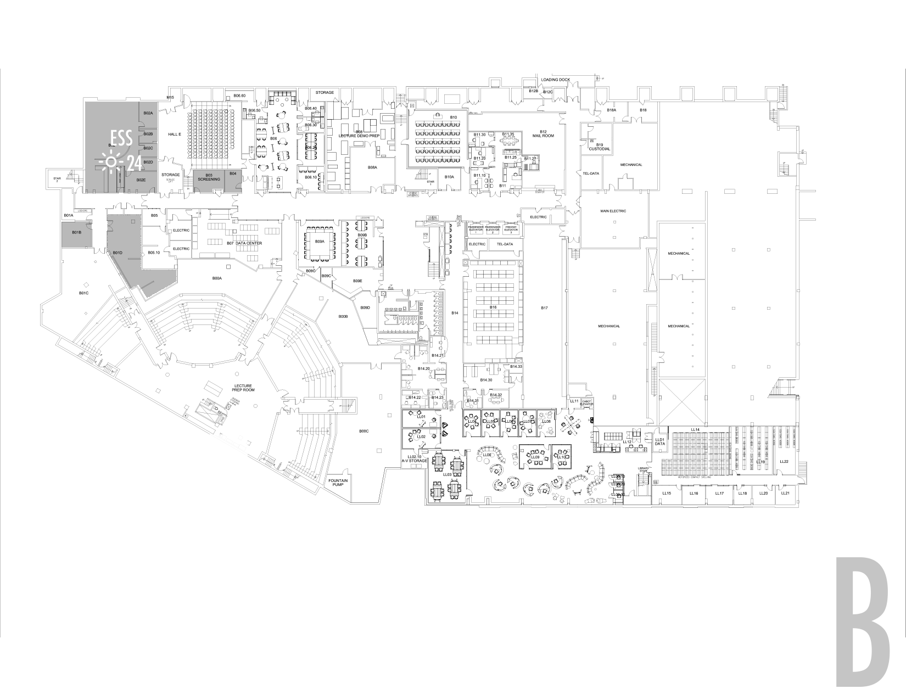
Science Center Project Update
Electrical Infrastructure Project
MAAB Restroom Projects
3. Teaching Labs Project
4. Arcade/Lobby Renovation
5. Lecture Hall Renovations
6. ESS Space Upgrades
  Scope
  Current Status
  Project Schedule
  Potential Impacts
7. 221 Space Upgrade

Slide 11
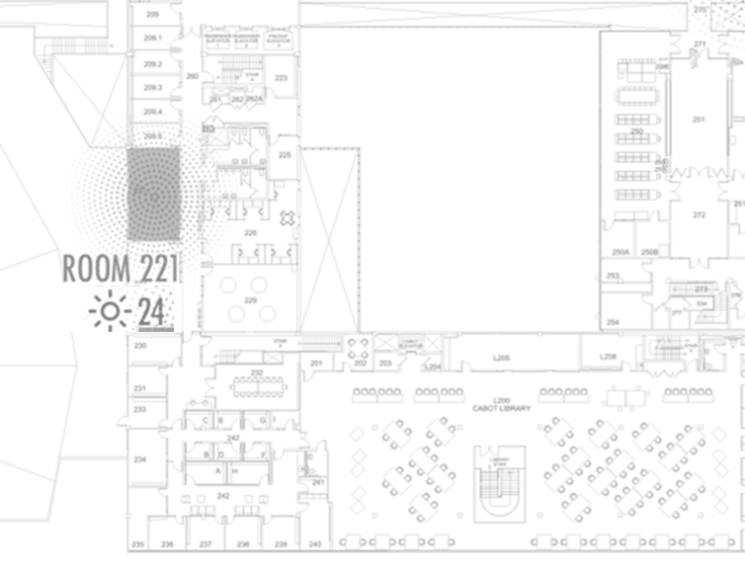
Science Center Project Update
Electrical Infrastructure Project
MAAB Restroom Projects
3. Teaching Labs Project
4. Arcade/Lobby Renovation
5. Lecture Hall Renovations
6. ESS Space Upgrades
221 Space Upgrade
  Scope
  Current Status
  Project Schedule
  Potential Impacts

Slide 12
EXPECTATIONS OVER THE NEXT MONTH

Slide 13
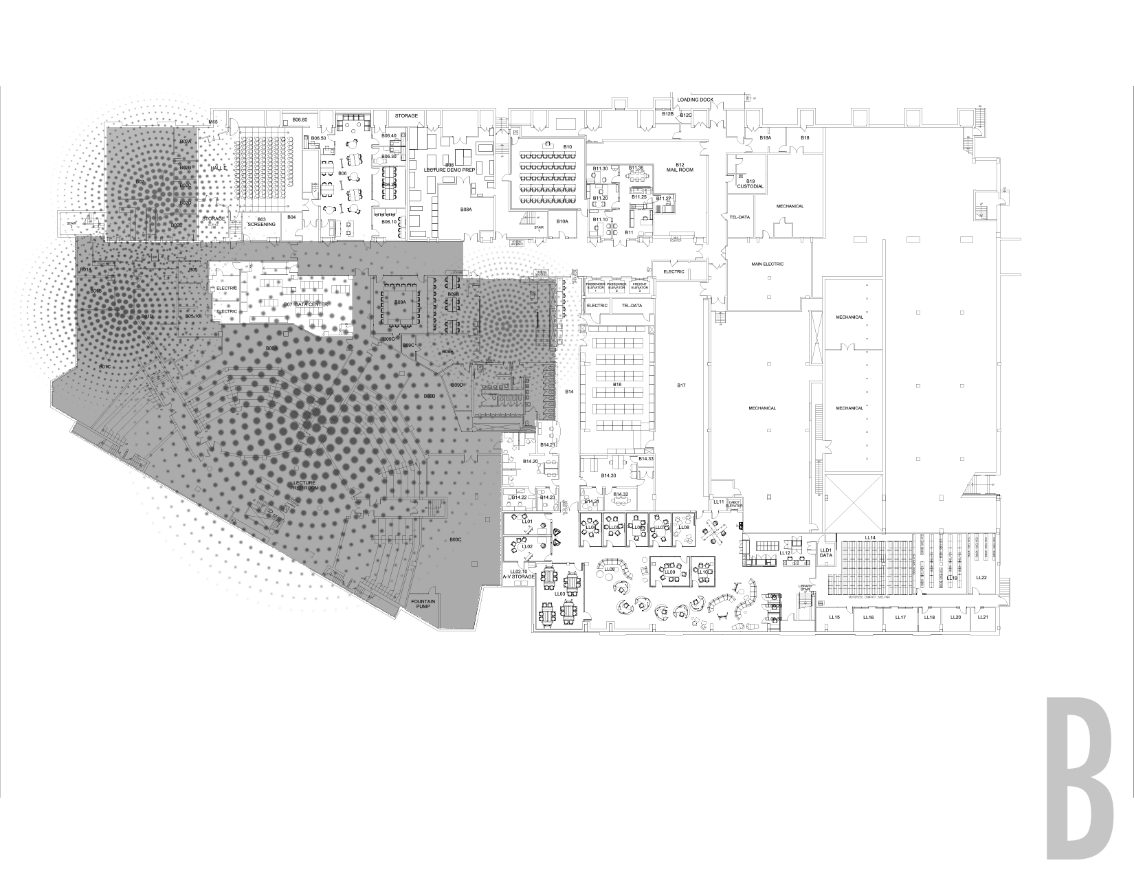


OCCUPANT
BASEMENT ACCESS
CONSTRUCTION PARTITION
BASEMENT ACCESS STARTING JUNE 11TH

Slide 14
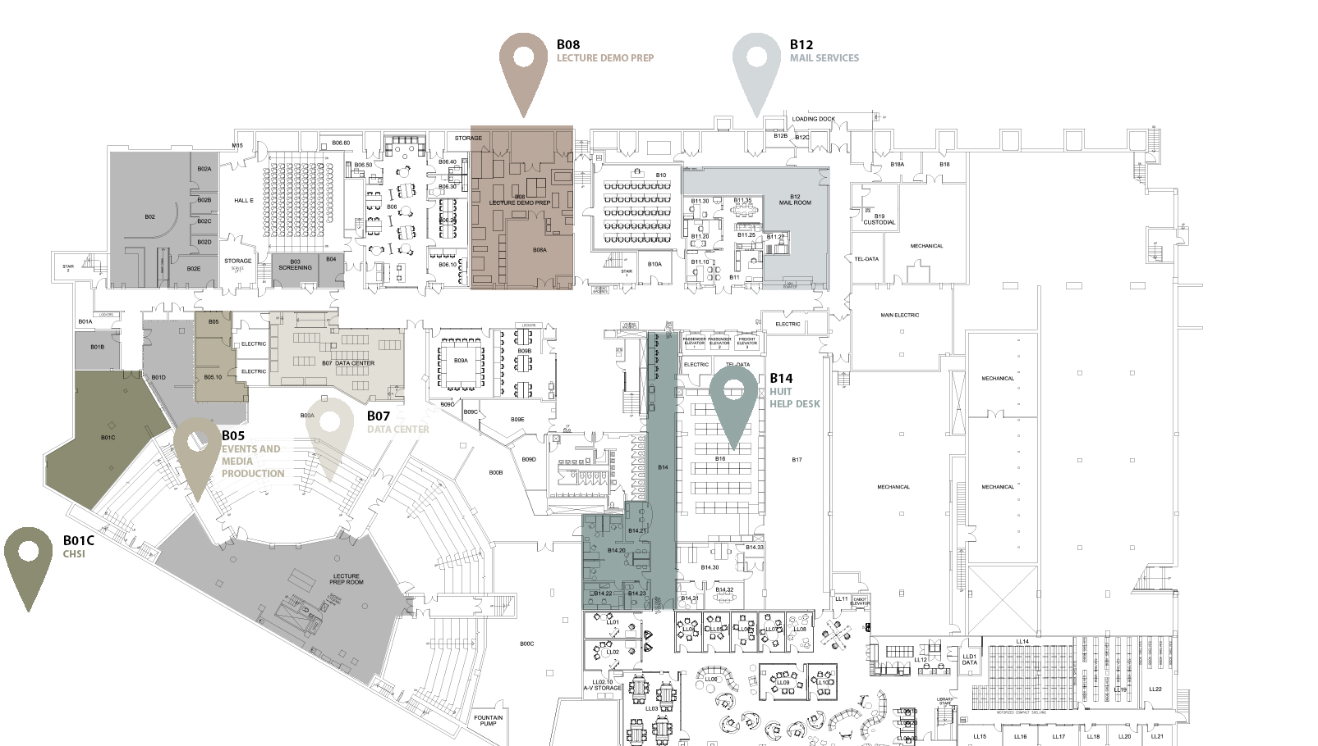
AUTHORIZED ACCESS ONLY
THROUGH CONSTRUCTION PARTITION DOOR
ORDINARY PUBLIC SUMMER ACCESS
SCIENCE CENTER SERVICES STARTING JUNE 11TH

Slide 15

OCCUPANT
EMERGENCY EGRESS
OCCUPANT
EMERGENCY EGRESS
CONTRACTOR
EMERGENCY EGRESS
CONSTRUCTION PARTITION
BASEMENT EMERGENCY EGRESS STARTING MAY 13TH

Slide 16
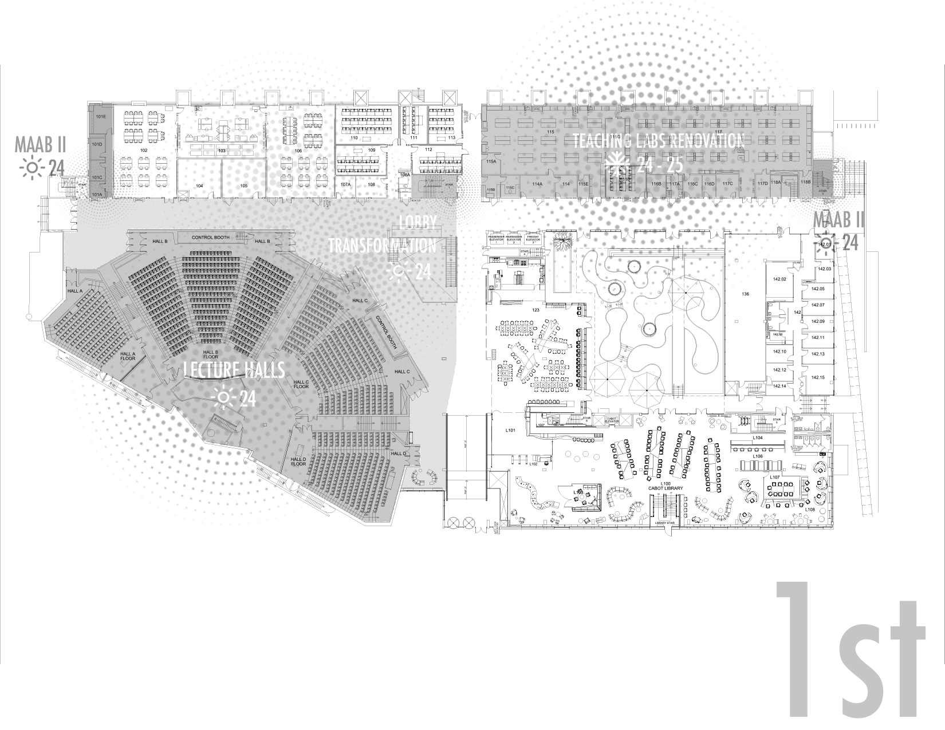
OCCUPANT
EMERGENCY EGRESS
FROM UPPER FLOORS
FROM UPPER FLOORS
FROM UPPER FLOORS
OCCUPANT
EMERGENCY EGRESS
OCCUPANT
EMERGENCY EGRESS
CONSTRUCTION PARTITION
CONSTRUCTION PARTITION
OCCUPANT
EMERGENCY EGRESS
BUILDING EMERGENCY EGRESS STARTING MAY 13TH

Slide 17
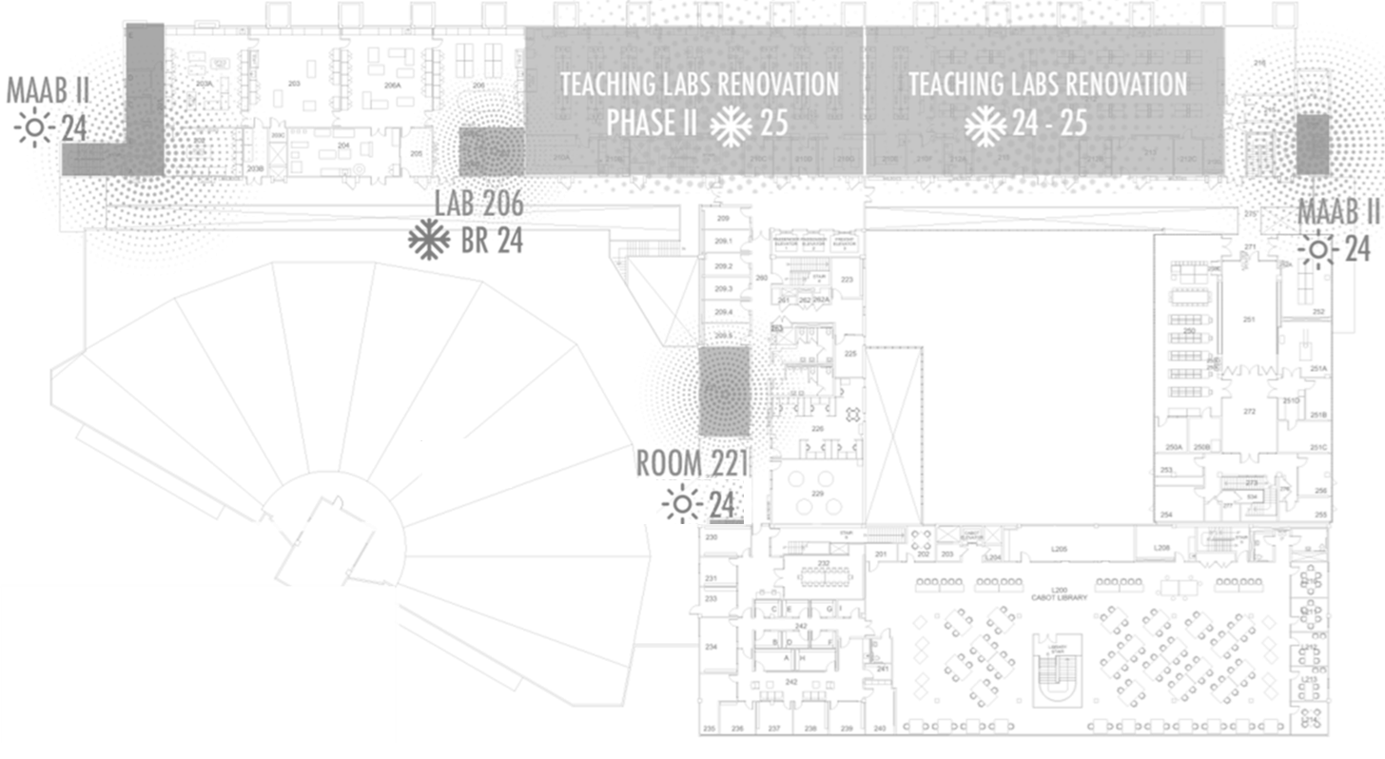

OCCUPANT
EMERGENCY EGRESS TO 1ST FLOOR EXIT
CONSTRUCTION AREA BEHIND DOORS
OCCUPANT
EMERGENCY EGRESS TO 1ST FLOOR EXIT
OCCUPANT
EMERGENCY EGRESS TO 1ST FLOOR EXIT
BUILDING EMERGENCY EGRESS STARTING MAY 13TH

Slide 18
PROGRESS PHOTOS

Slide 19
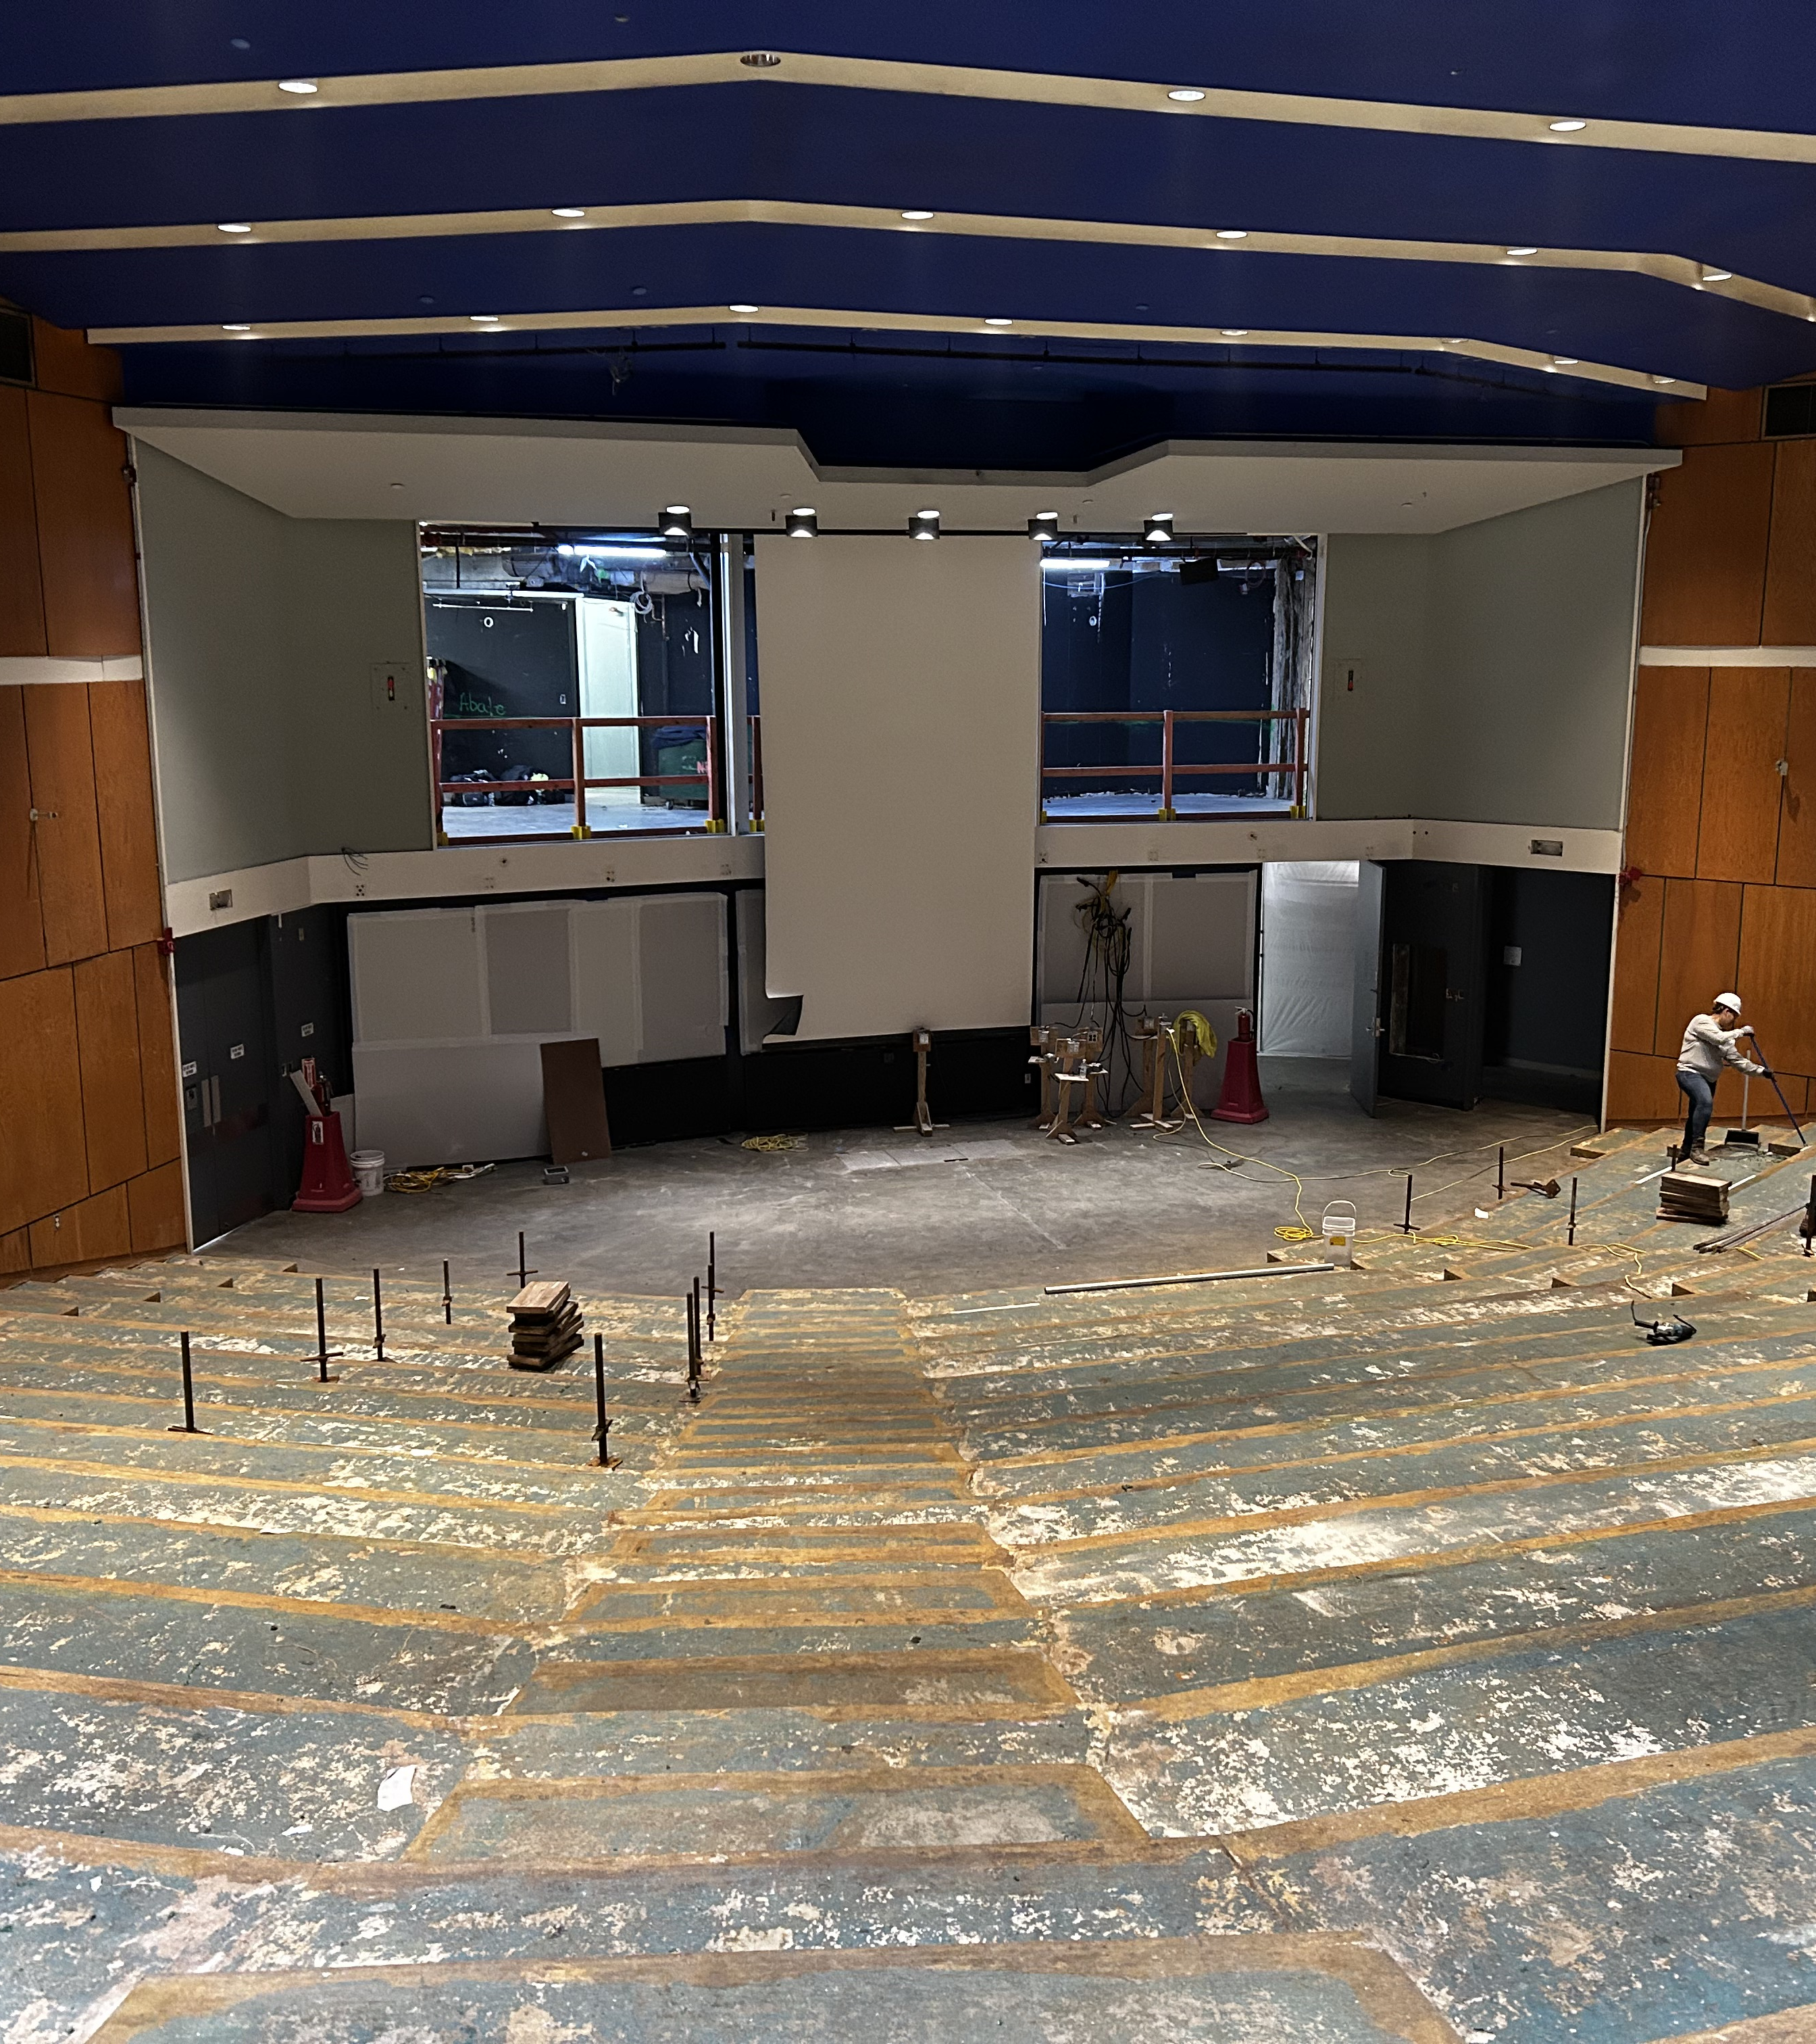
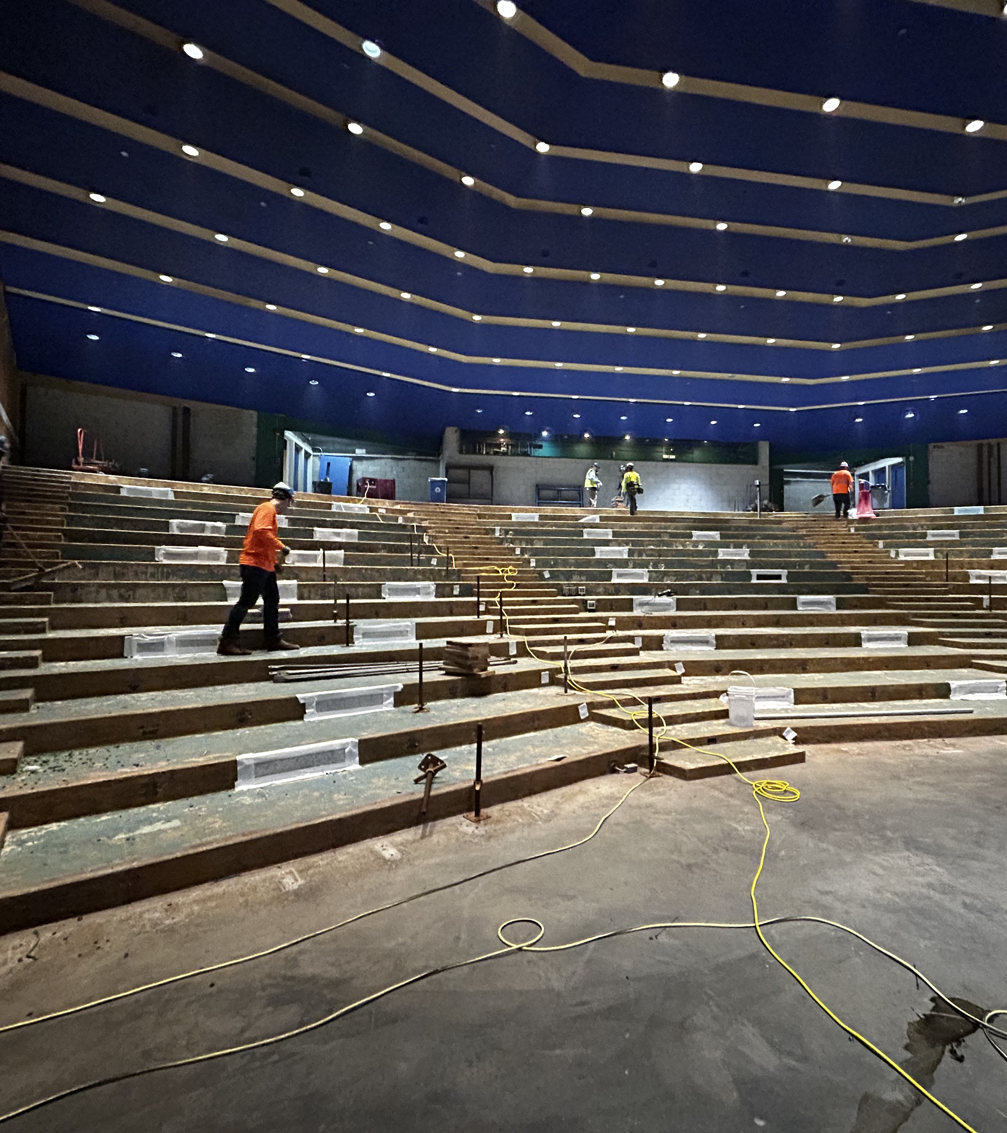

Slide 20
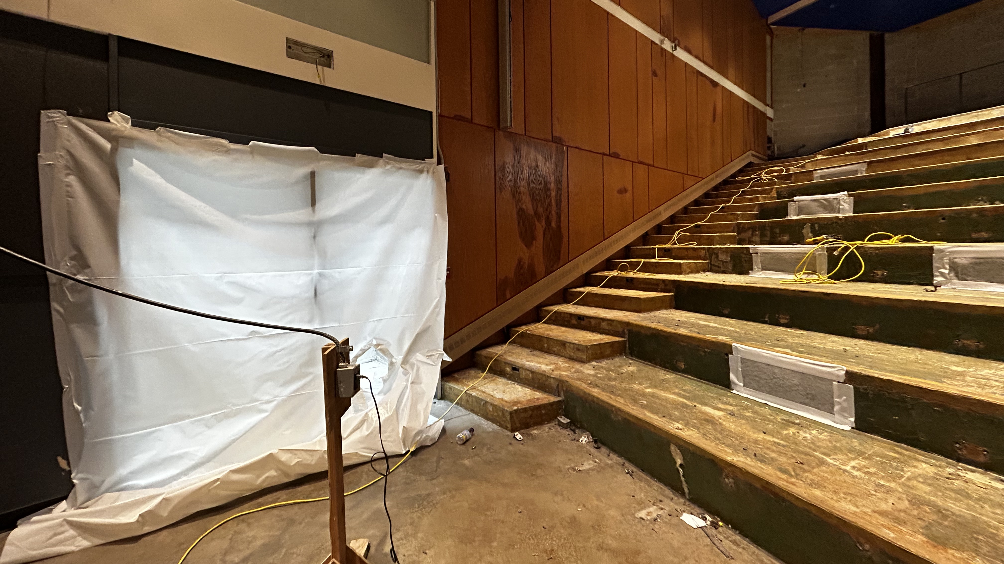

Slide 21
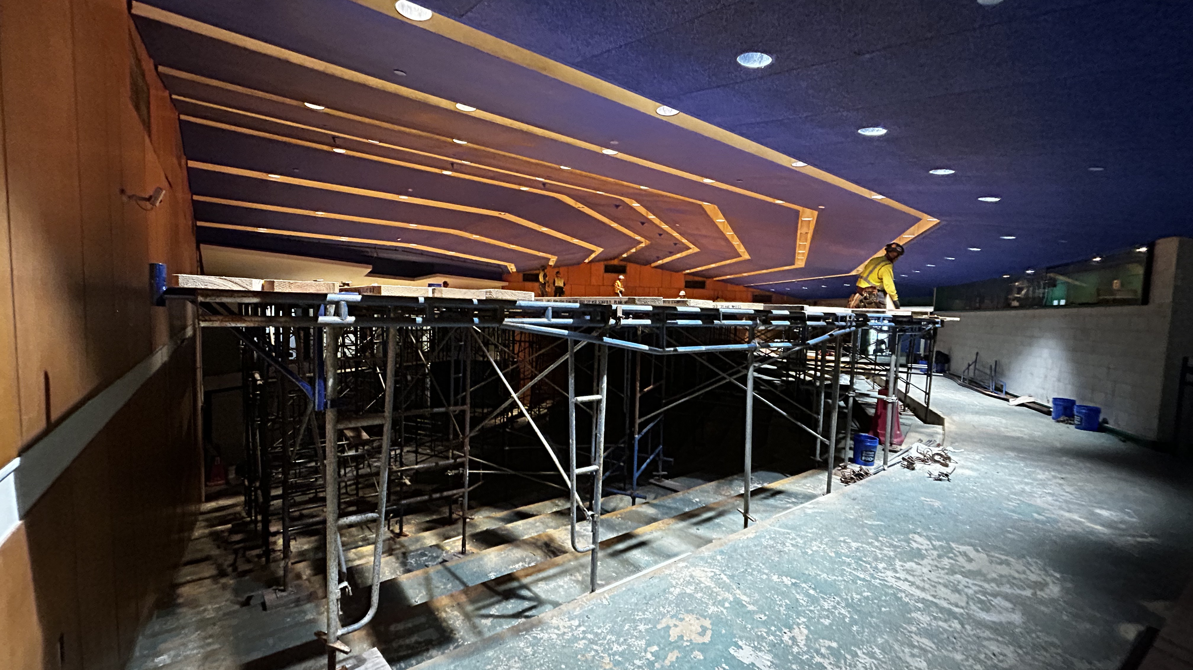

Slide 22
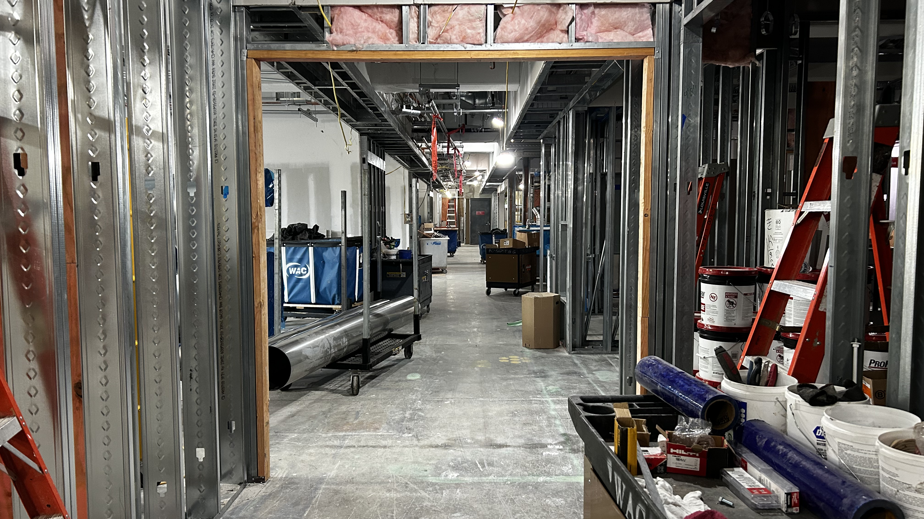

Slide 23
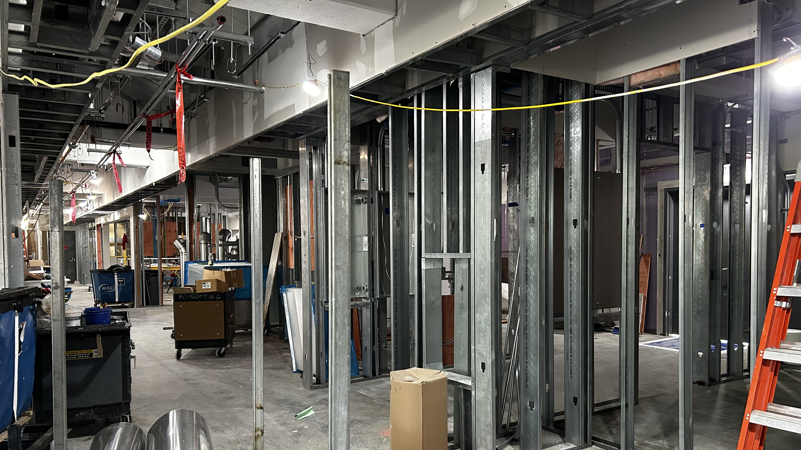

Slide 24
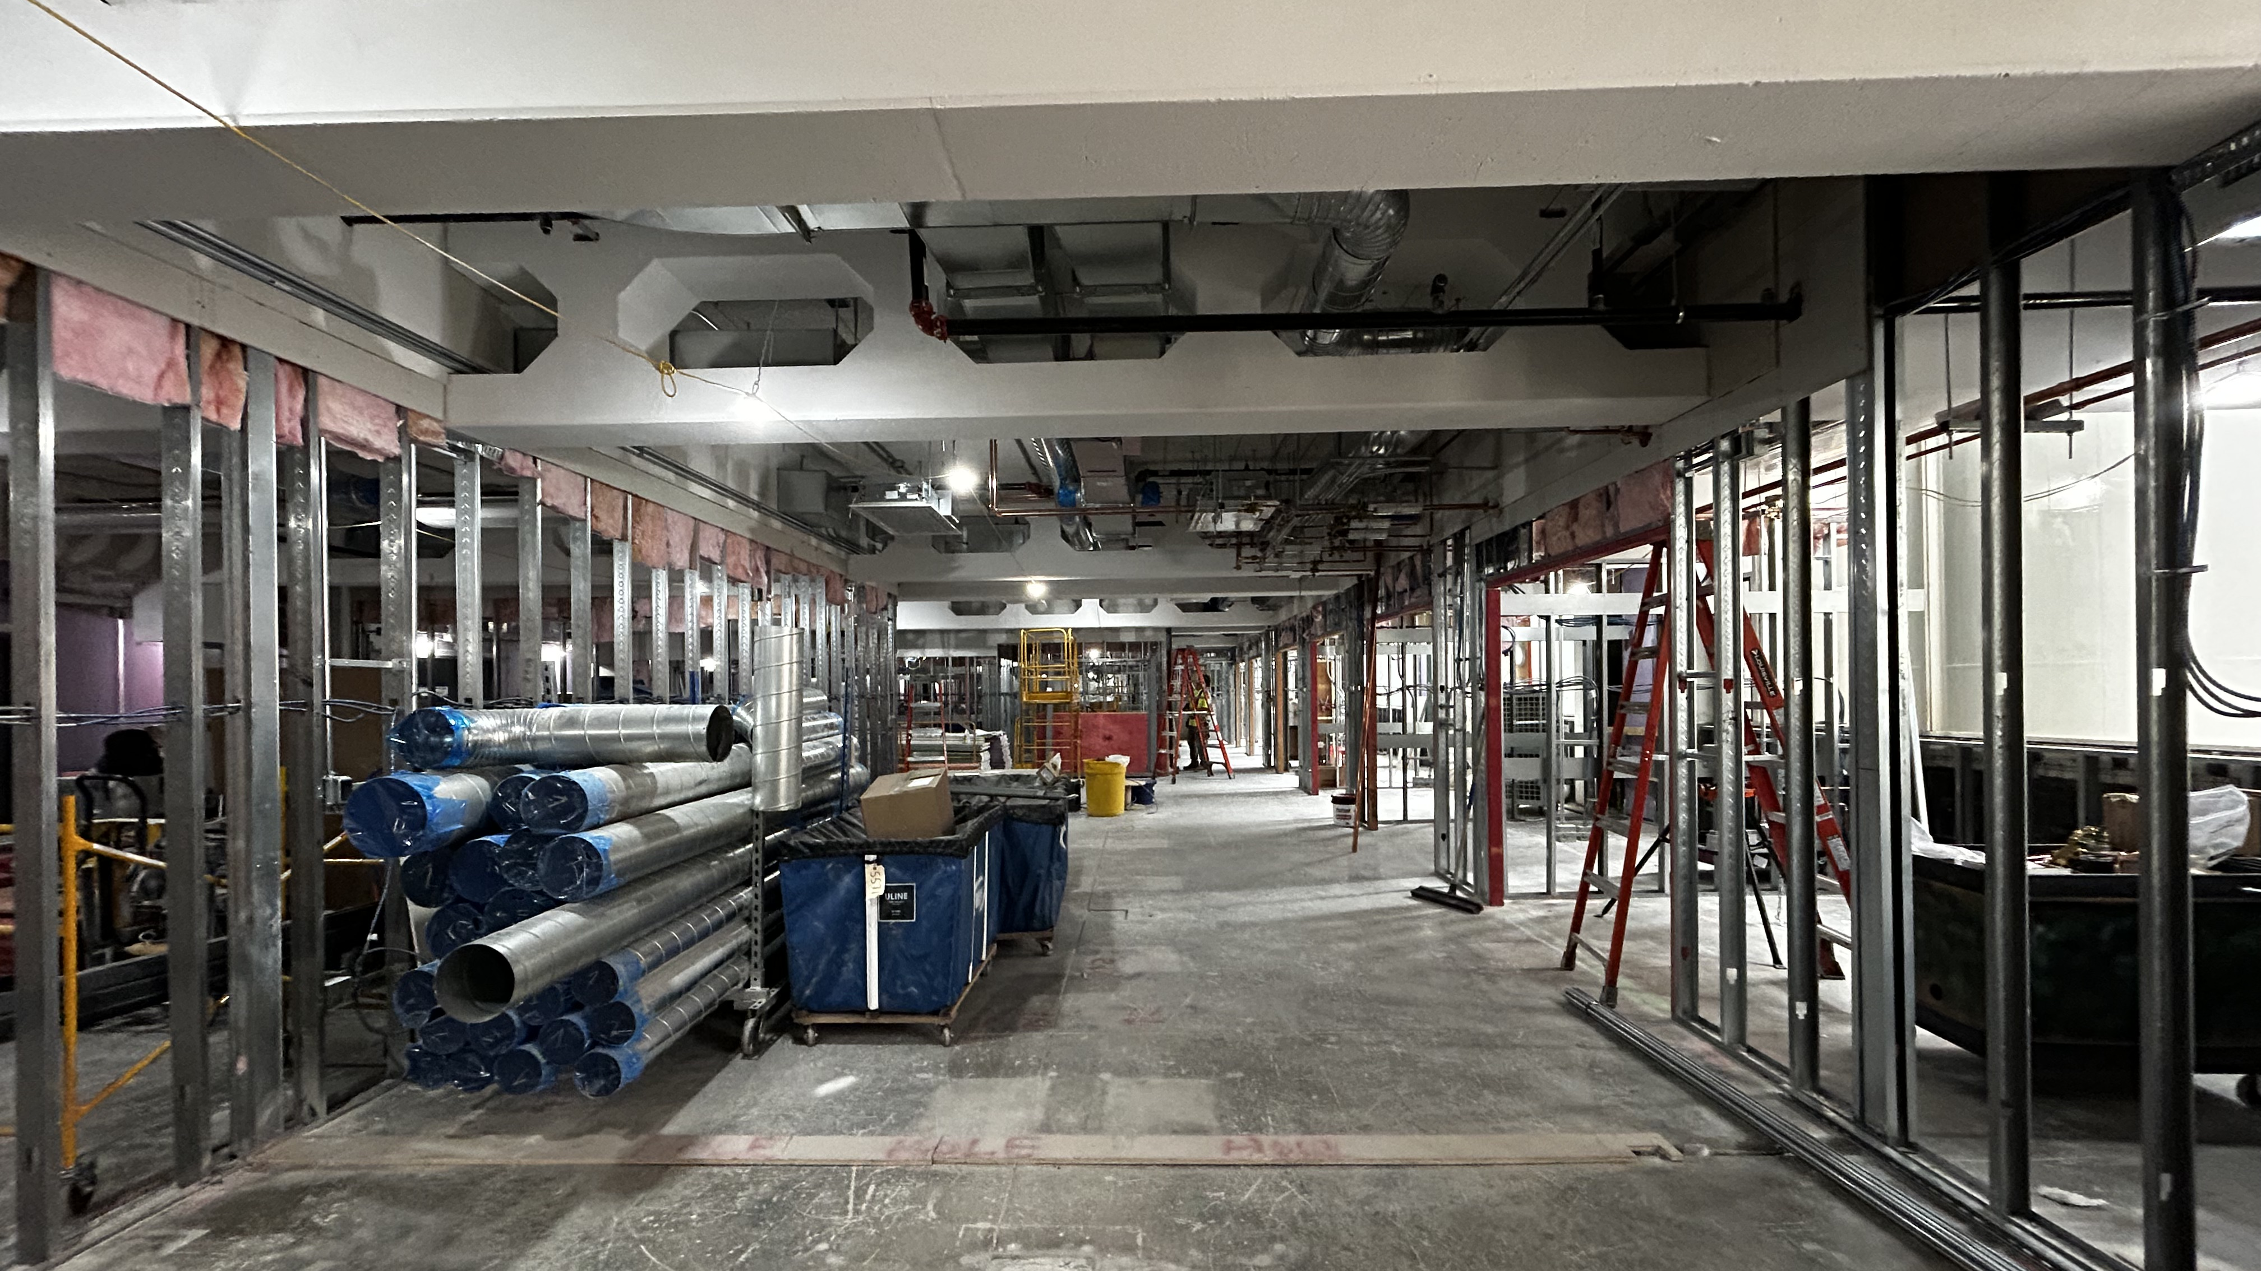

Slide 25
WEBSITE & NOTIFICATIONS REMINDER!

Slide 26
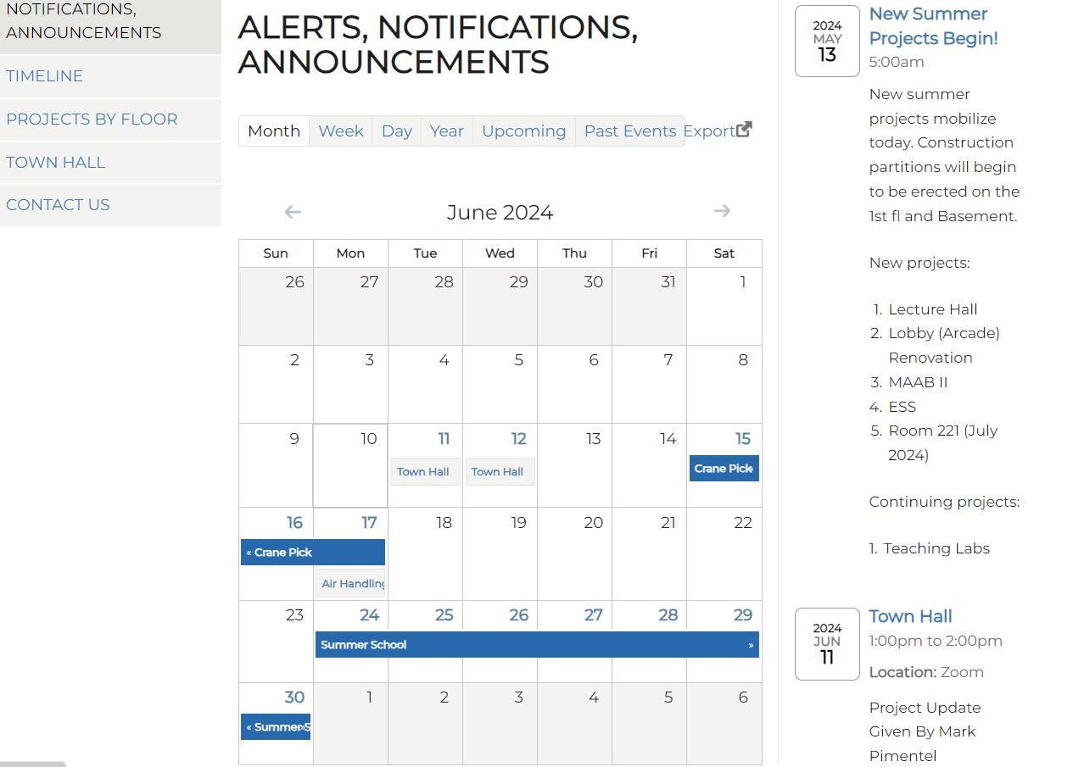


DON’T FORGET TO CHECK THE WEBSITE FREQUENTLY FOR NOTIFICATIONS!
https://projects.iq.harvard.edu/scictr-renovations

Slide 27
QUESTIONS?
https://projects.iq.harvard.edu/scictr-renovations

Slide 28
THANK YOU!
https://projects.iq.harvard.edu/scictr-renovations

