Slide 1
HARVARD SCIENCE CENTER TOWNHALL
July 16th and 17th, 2024

Slide 2
Project Updates
Expectations over the next month
Progress Photos
Crane Pick Schedule
Website & Notifications Reminder!
Q&A
AGENDA

Slide 3
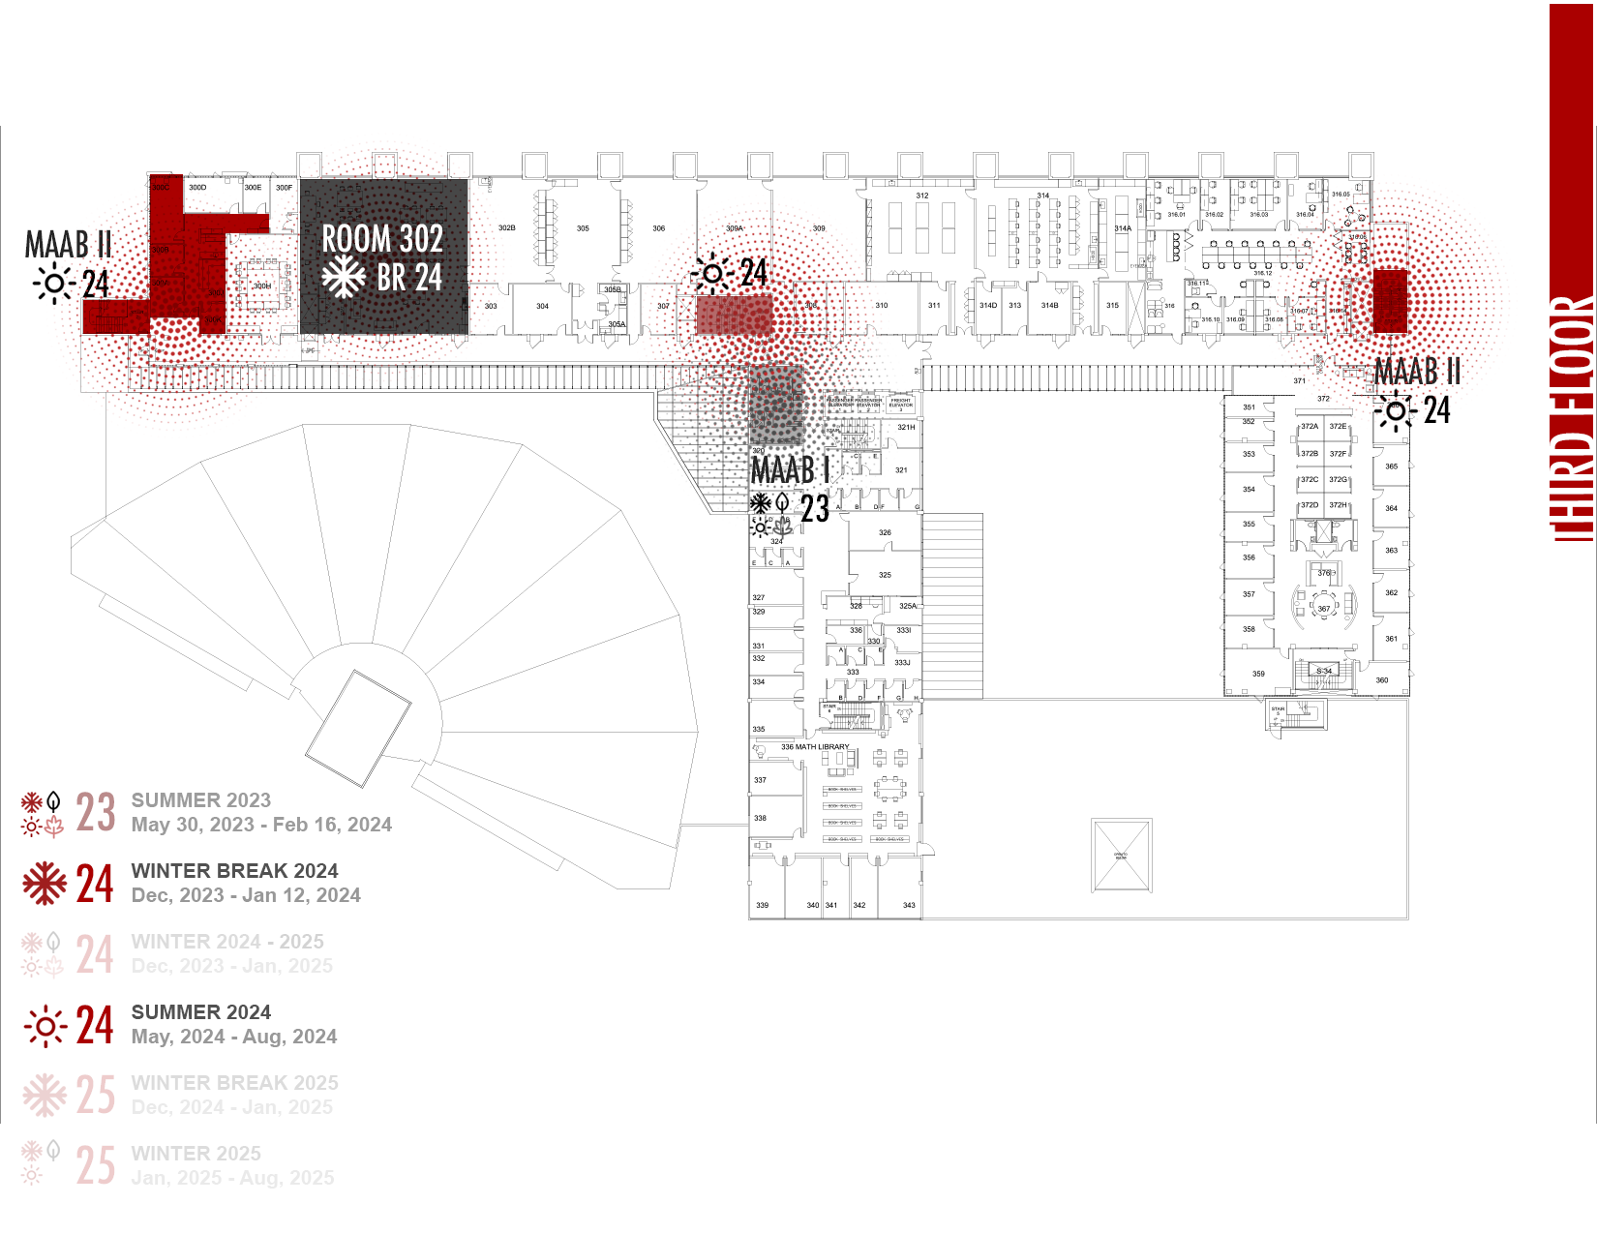
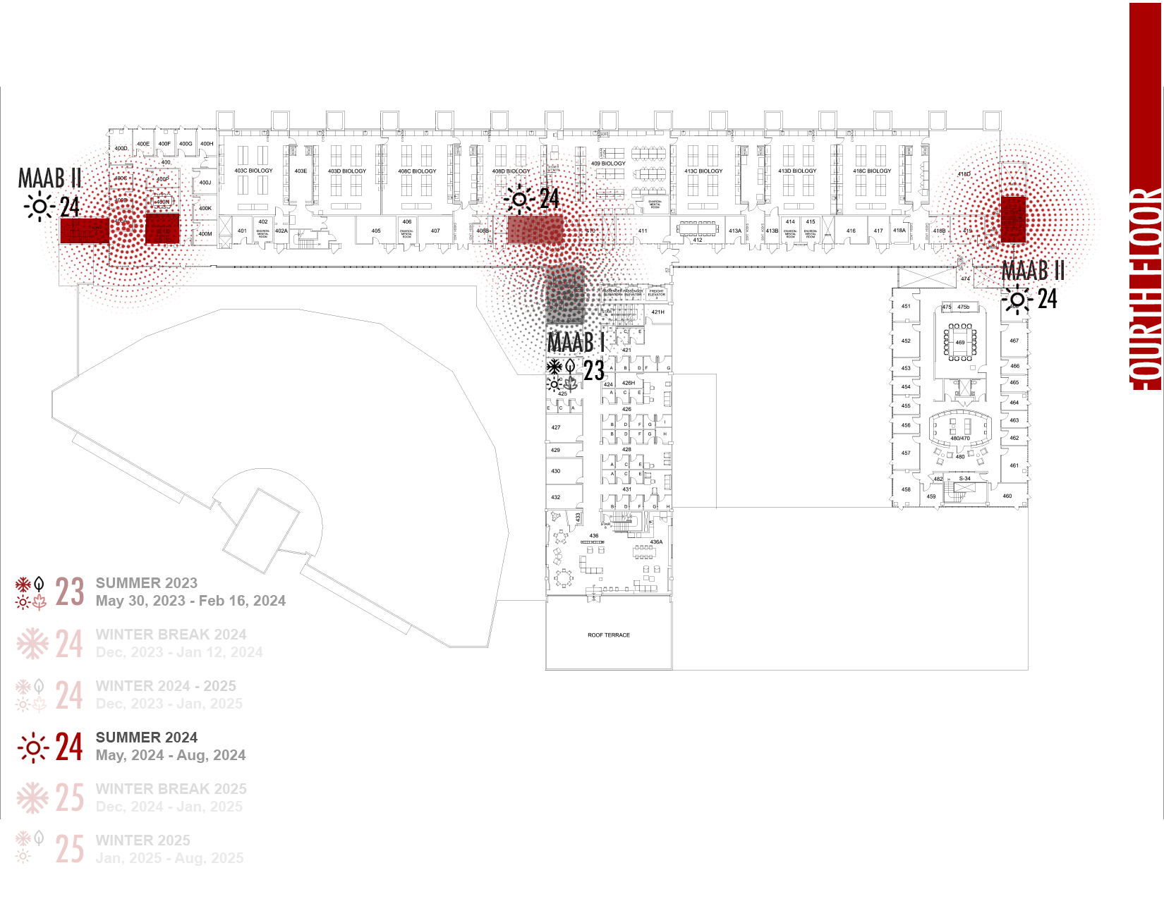
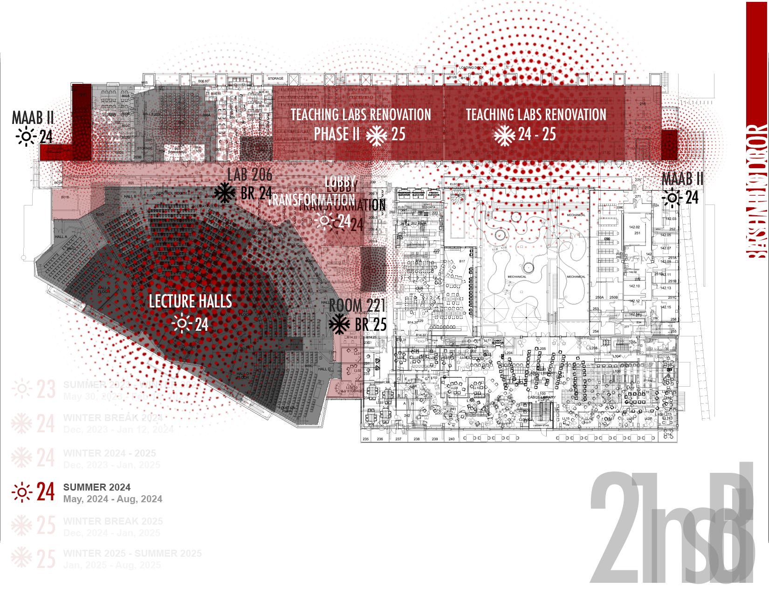
Basement, 1st Fl, 2nd Fl IMPACT SHOWN STARTING MAY 13TH

Slide 4
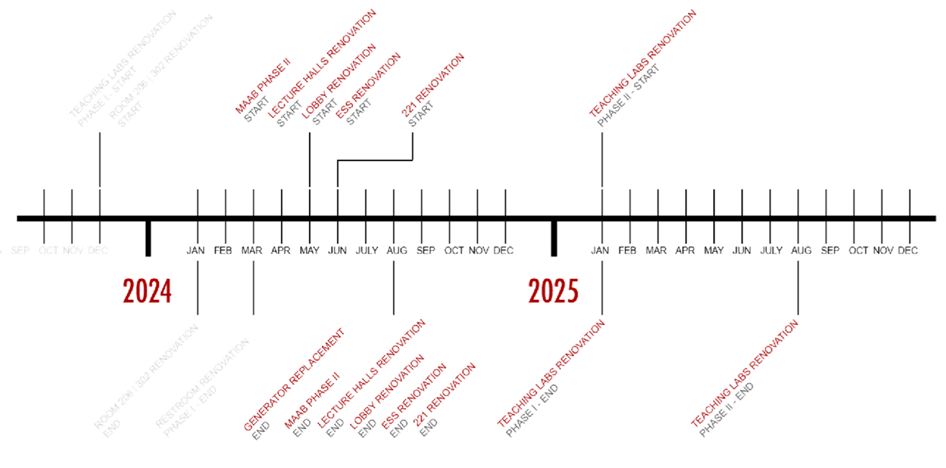

Slide 5
Science Center Project Update
Summer Projects
Ongoing/Continued Projects
MAAB Restroom Projects
Arcade/Lobby Renovation
Lecture Hall Renovations
ESS Space Upgrades
221 Math Offices
Biology Space Renovation
7. Electrical Infrastructure Project
8. Teaching Labs Projects

Slide 6
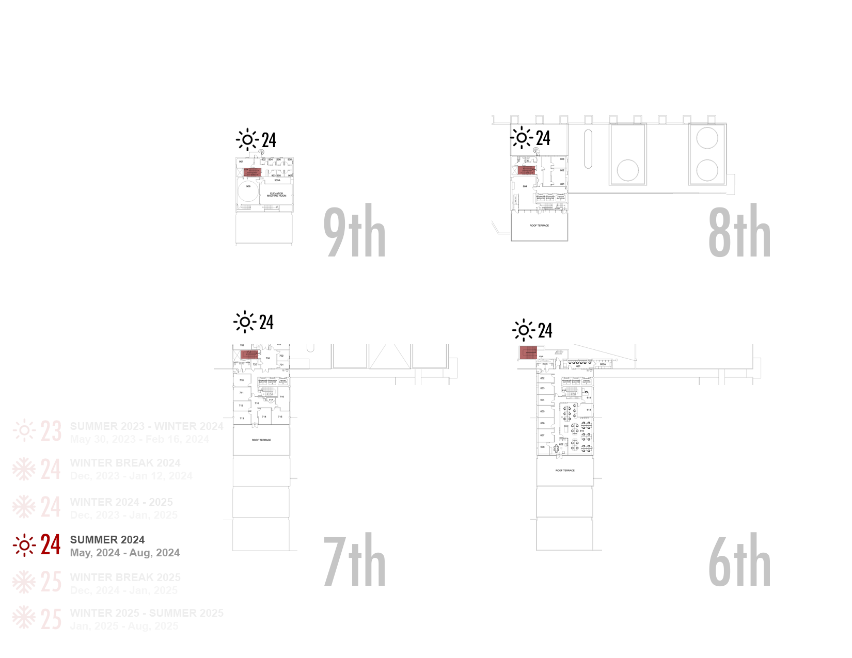
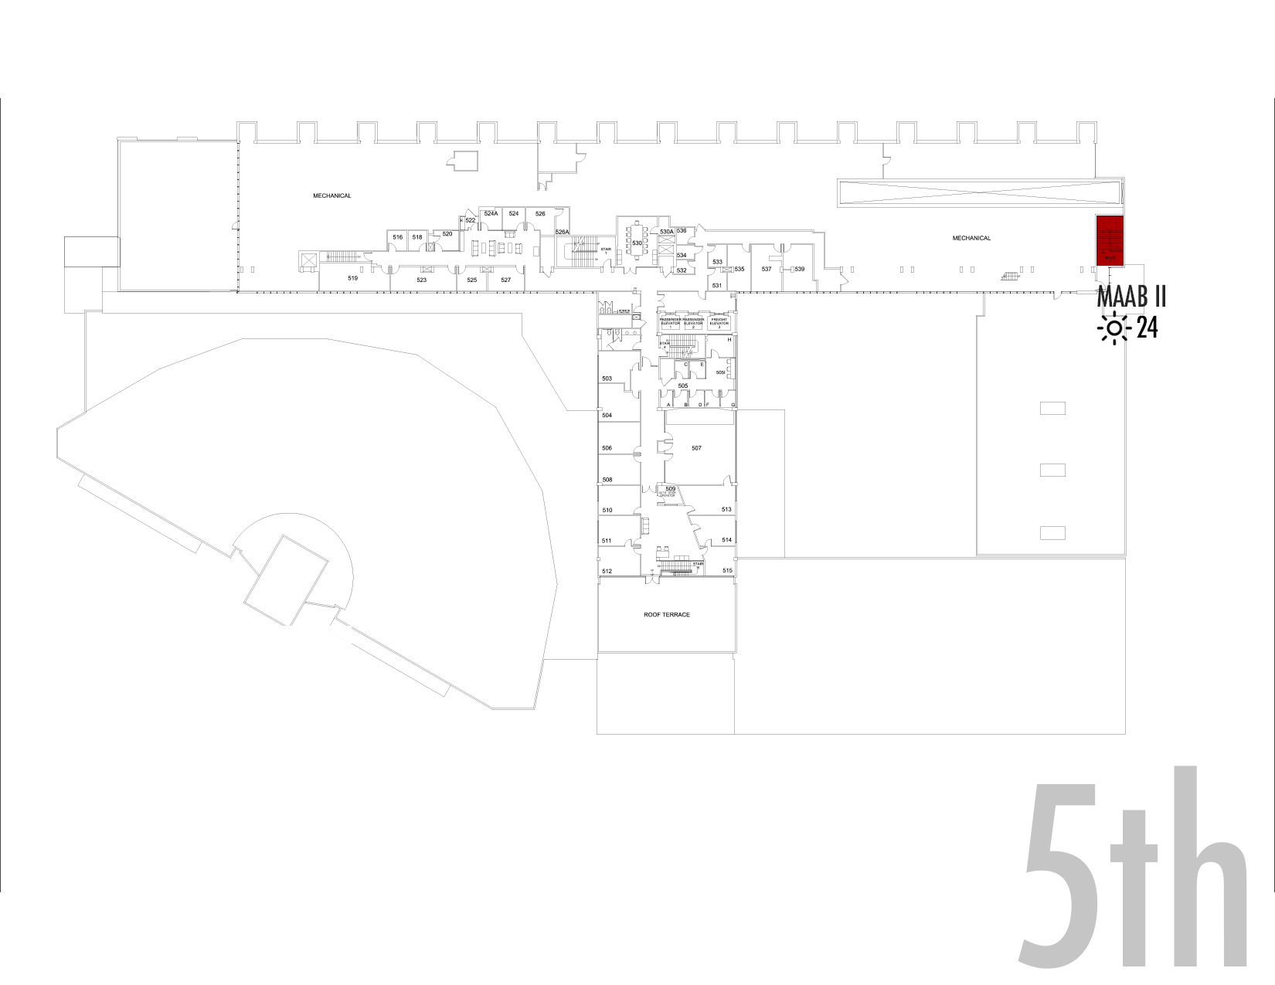
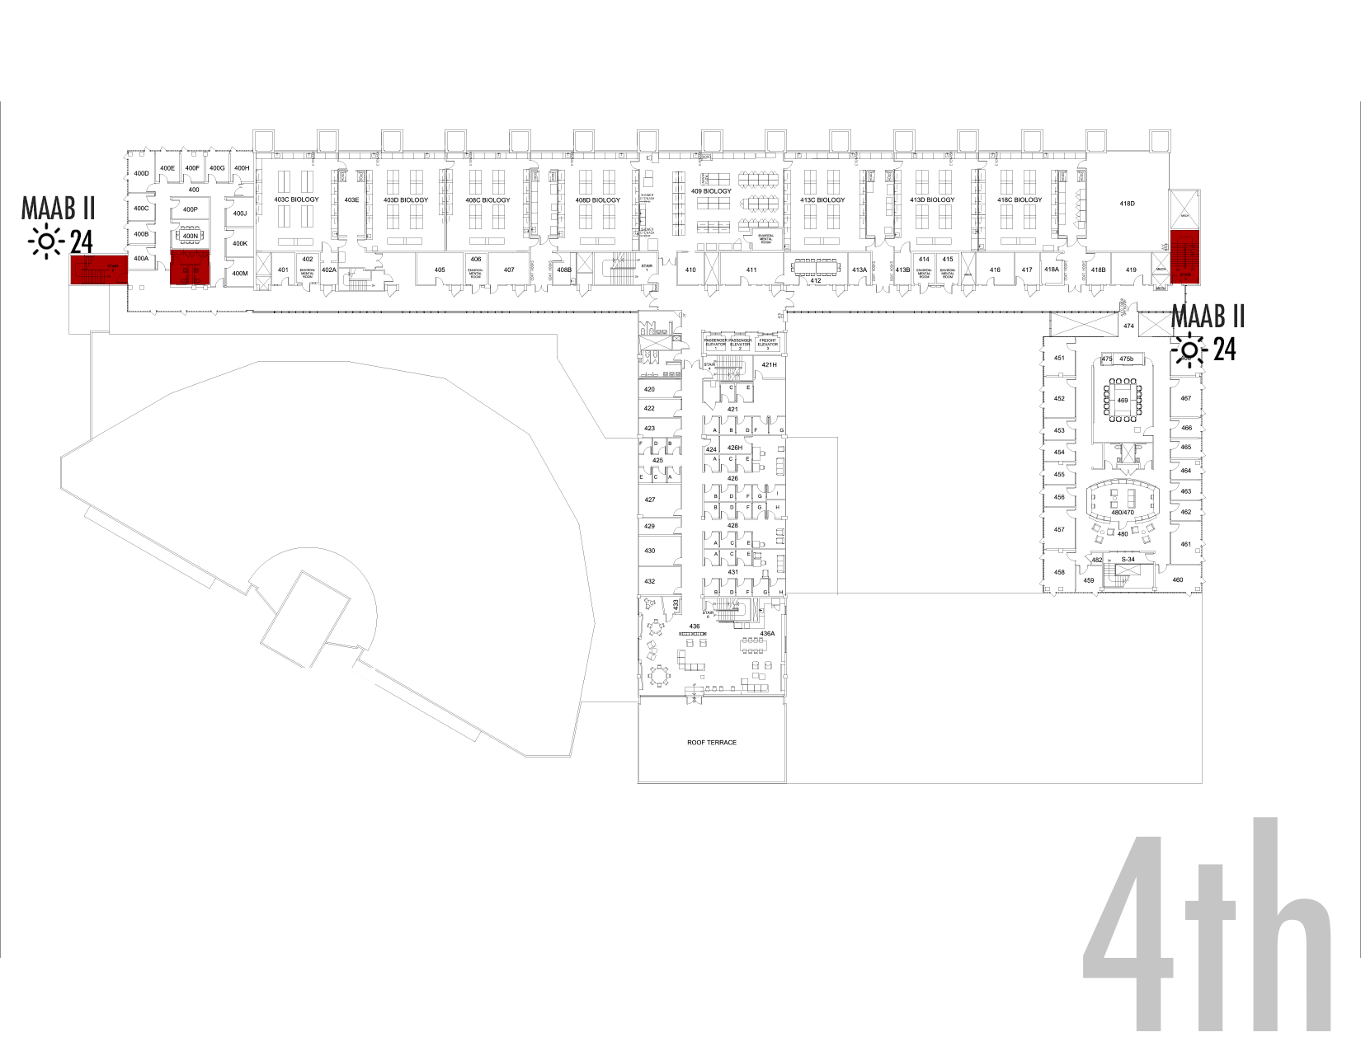
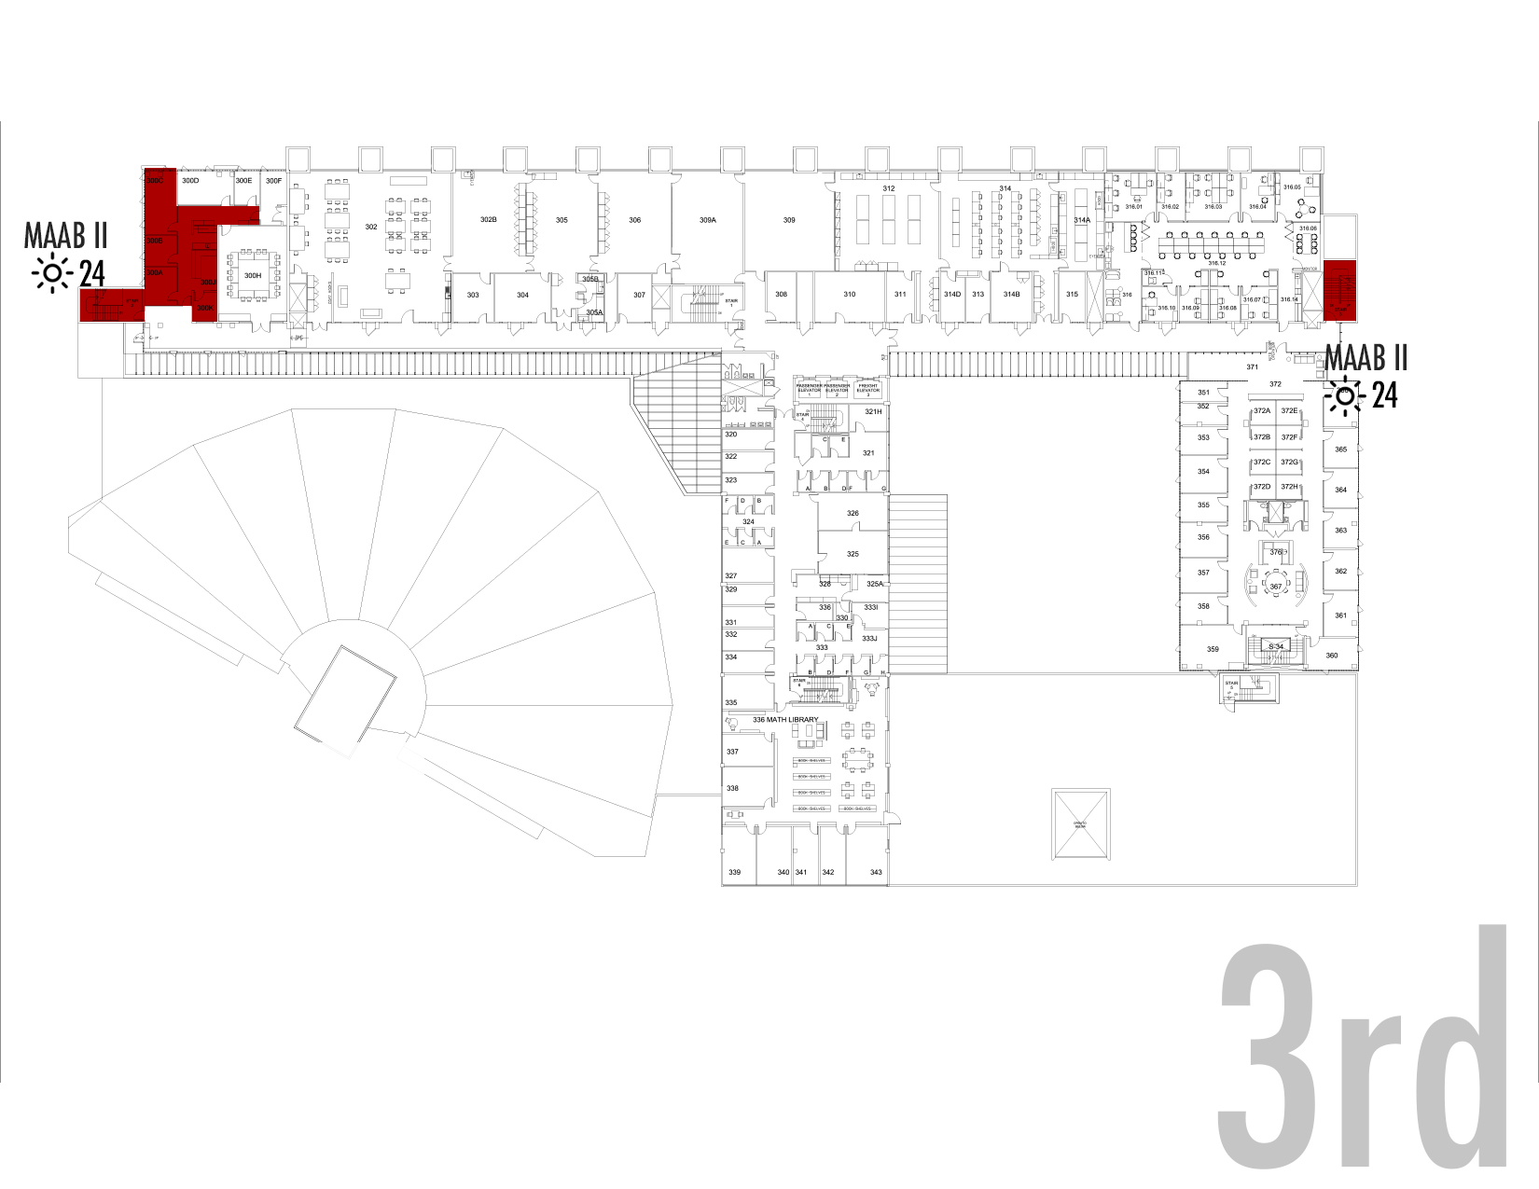
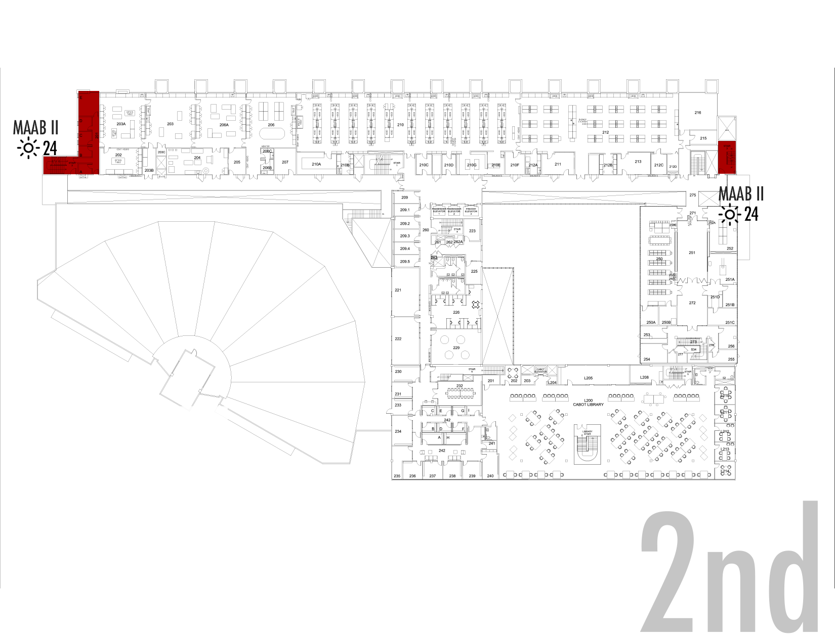
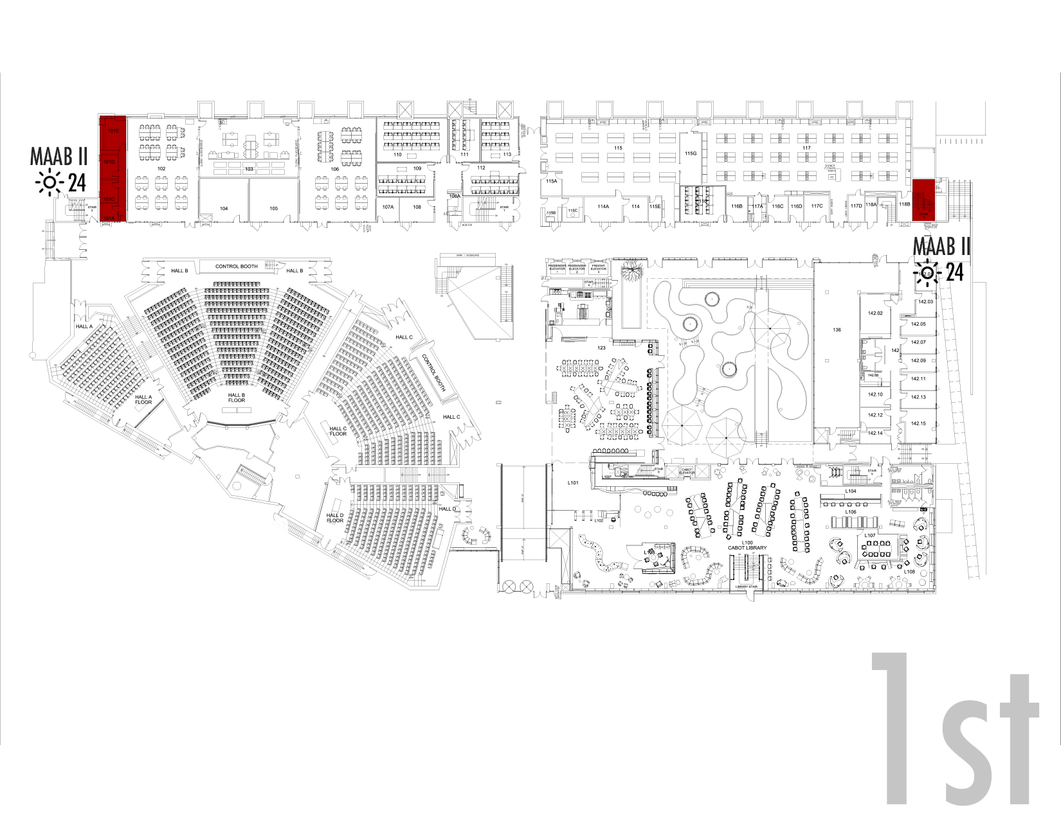
Science Center Project Update
Electrical Infrastructure Project
MAAB Restroom Projects
  Scope
  Current Status
  Project Schedule
  Potential Impacts
3. Teaching Labs Project
4. Arcade/Lobby Renovation
5. Lecture Hall Renovations
6. ESS Space Upgrades
7. 221 Math Offices

Slide 7
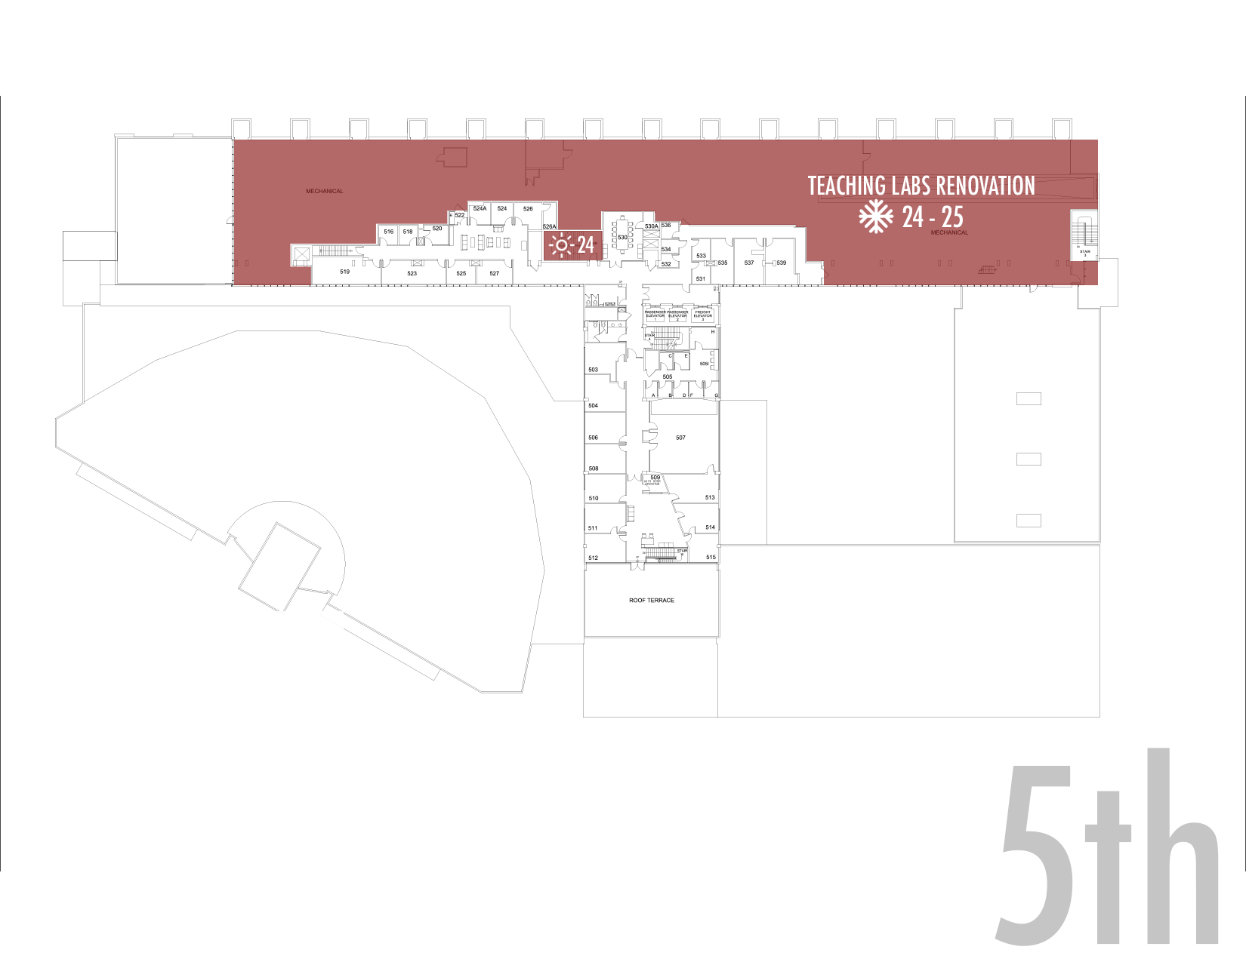
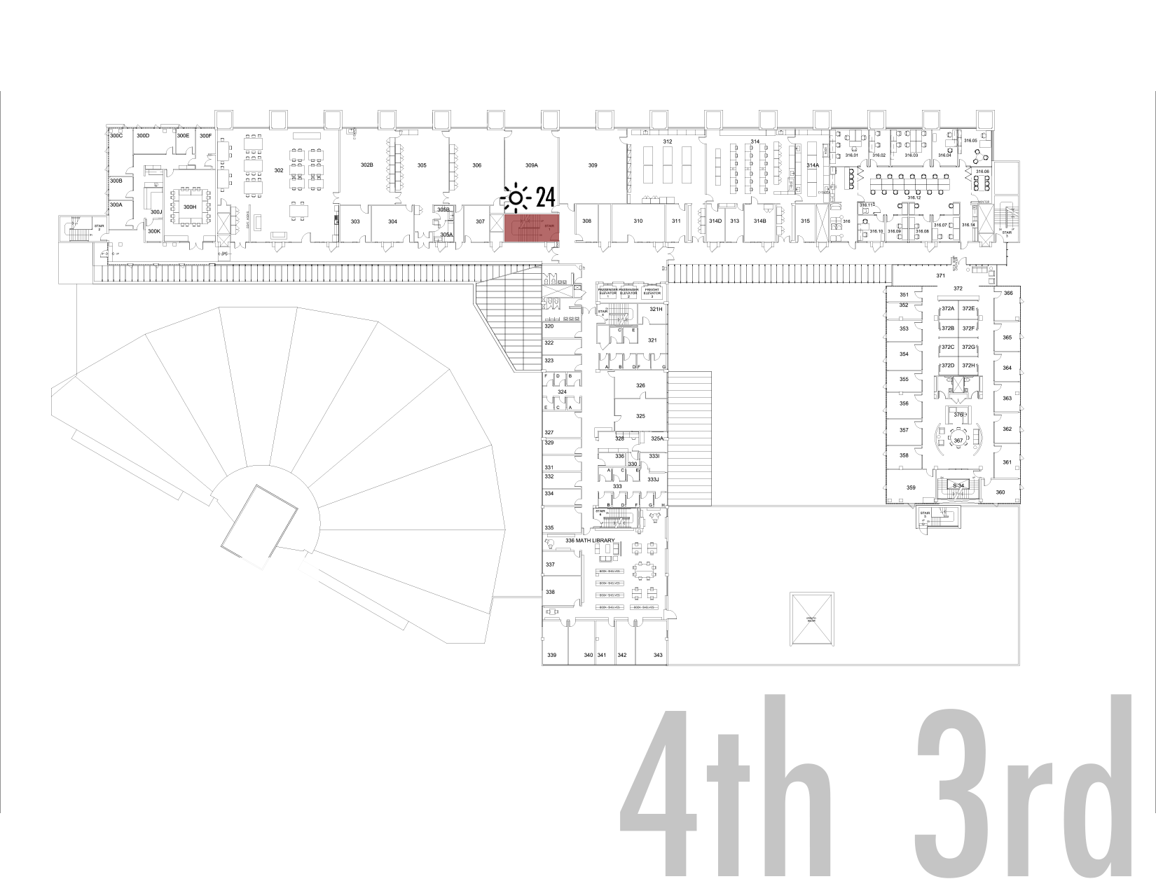
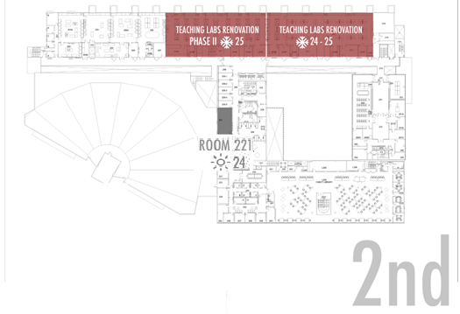
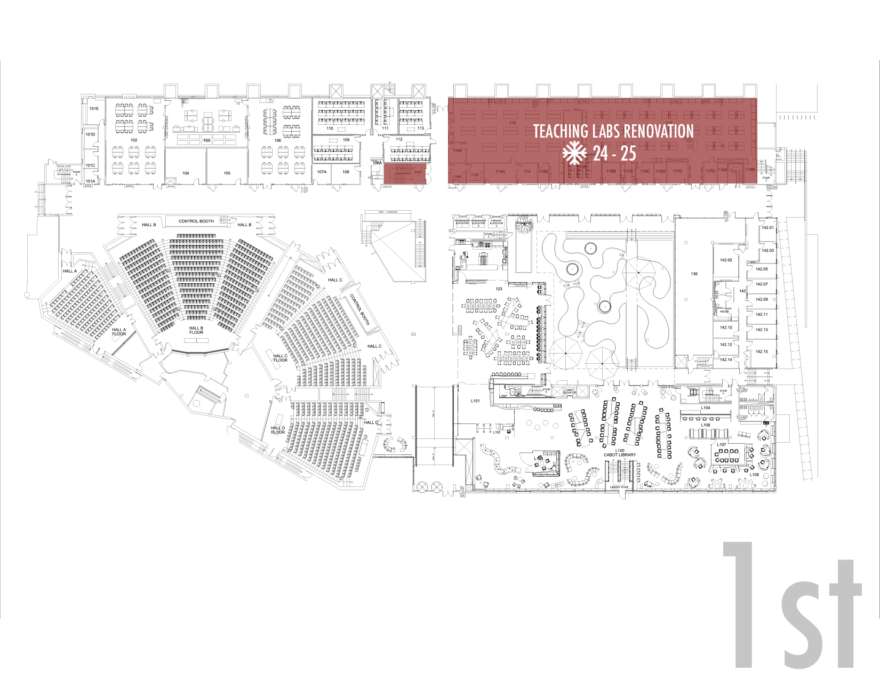
Science Center Project Update
Electrical Infrastructure Project
MAAB Restroom Projects
3. Teaching Labs Project
  Scope
  Current Status
  Project Schedule
  Potential Impacts
4. Arcade/Lobby Renovation
5. Lecture Hall Renovations
ESS Space Upgrades
221 Math Offices

Slide 8
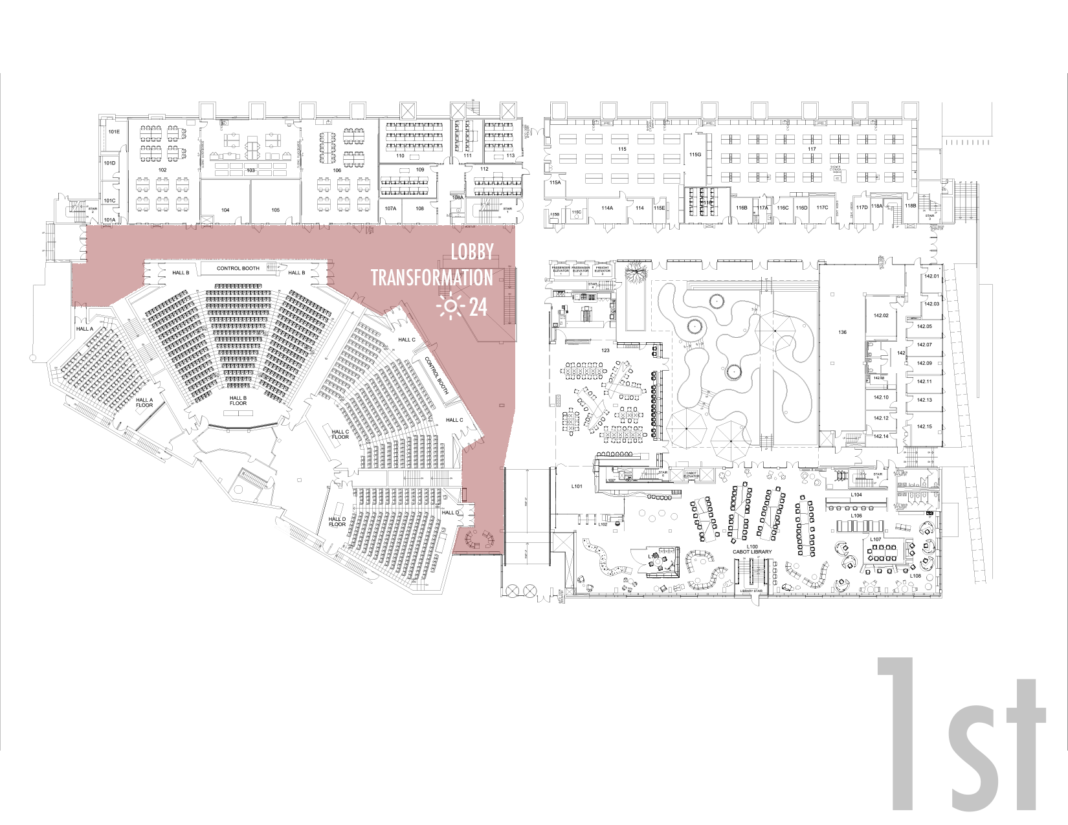
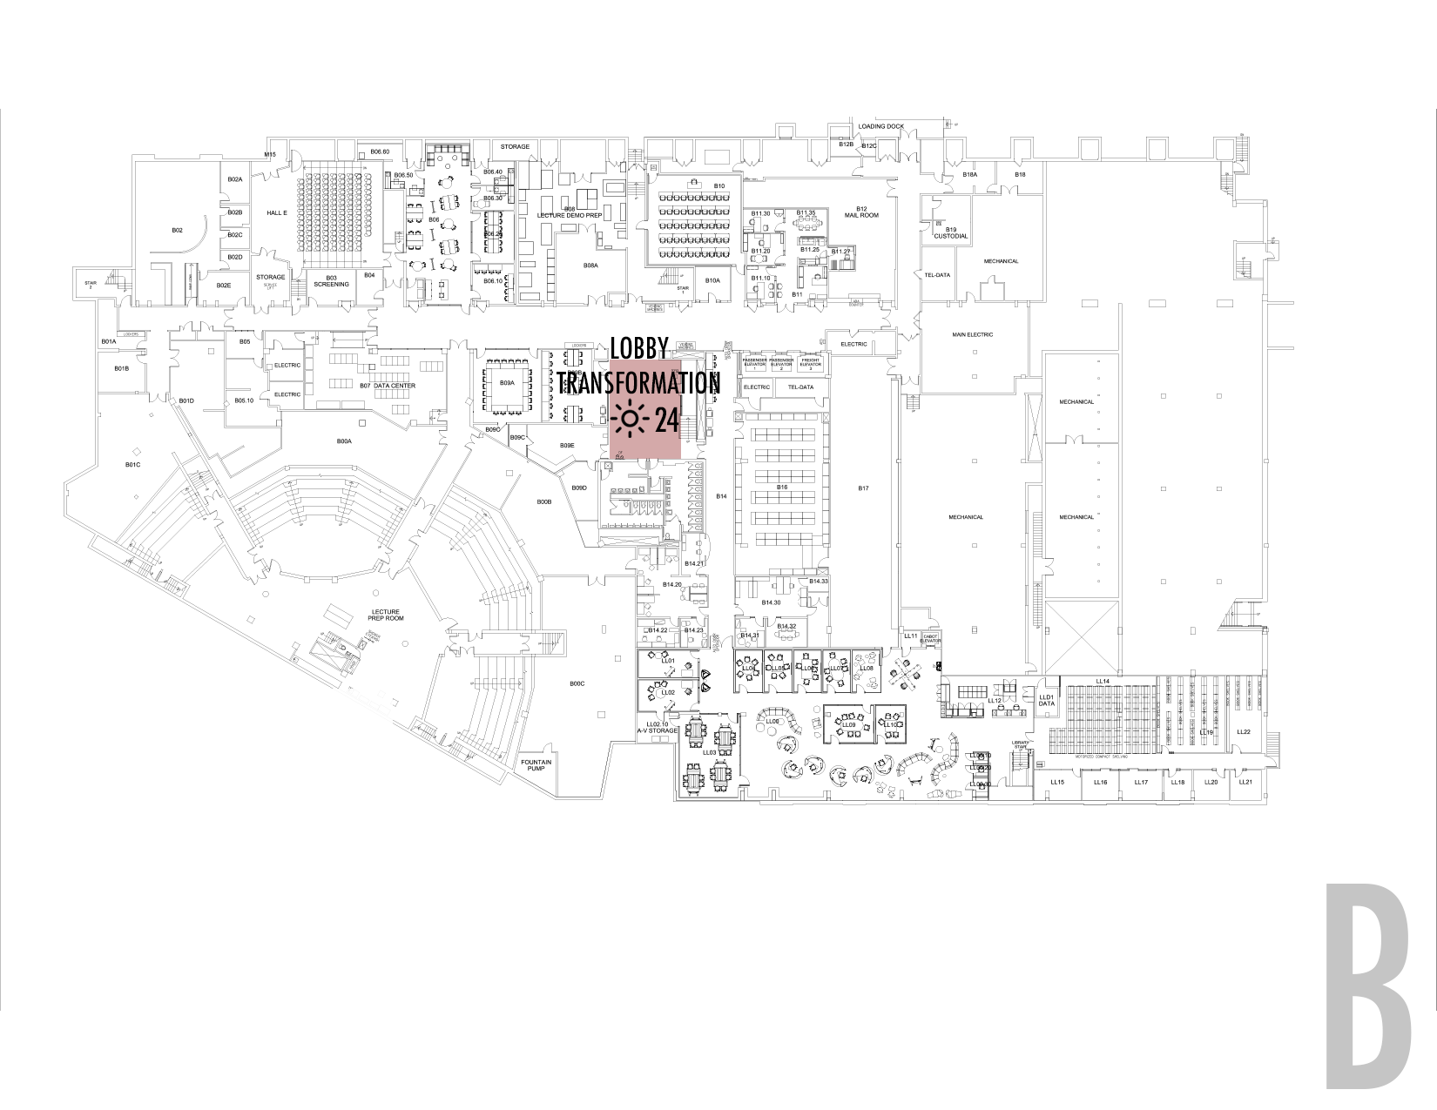
Science Center Project Update
Electrical Infrastructure Project
MAAB Restroom Projects
3. Teaching Labs Project
4. Lobby Renovation
  Scope
  Current Status
  Project Schedule
  Potential Impacts
5. Lecture Hall Renovations
ESS Space Upgrades
221 Math Offices

Slide 9
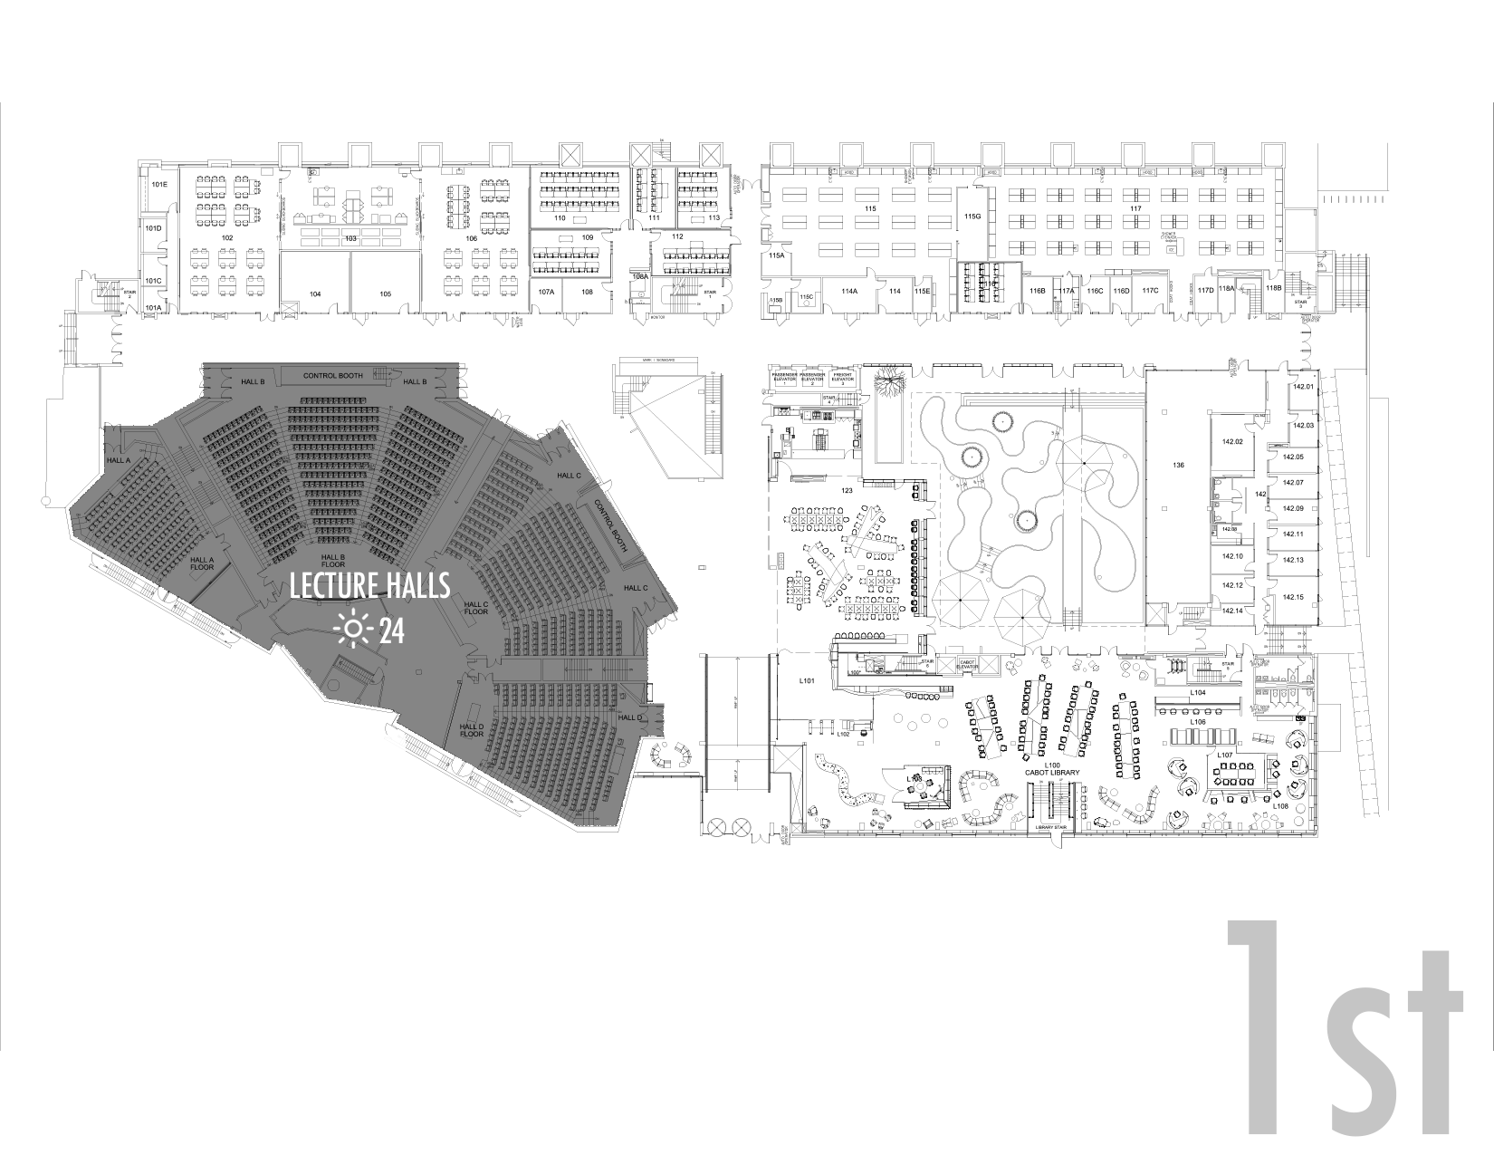
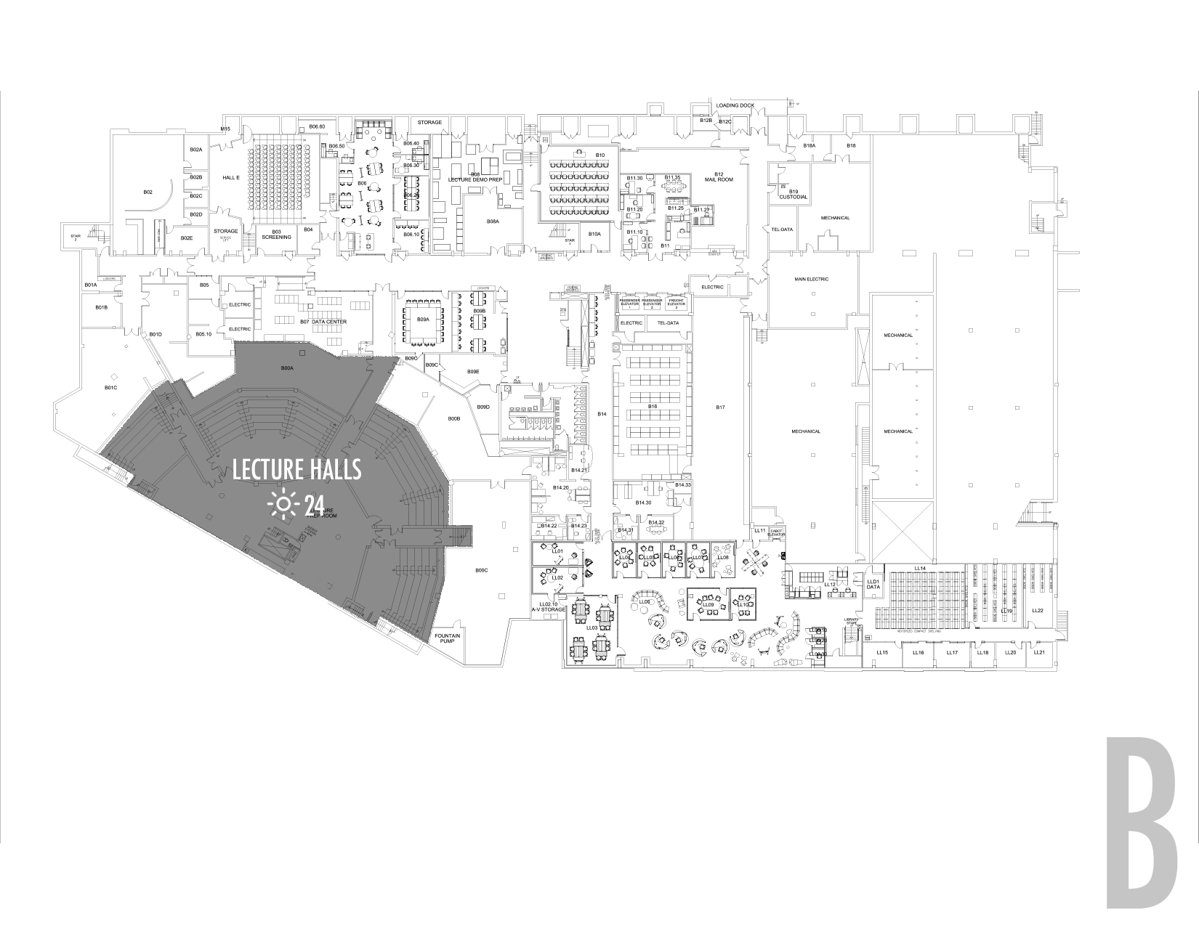
Science Center Project Update
Electrical Infrastructure Project
MAAB Restroom Projects
3. Teaching Labs Project
4. Arcade/Lobby Renovation
5. Lecture Hall Renovations
  Scope
  Current Status
  Project Schedule
  Potential Impacts
ESS Space Upgrades
221 Math Offices

Slide 10
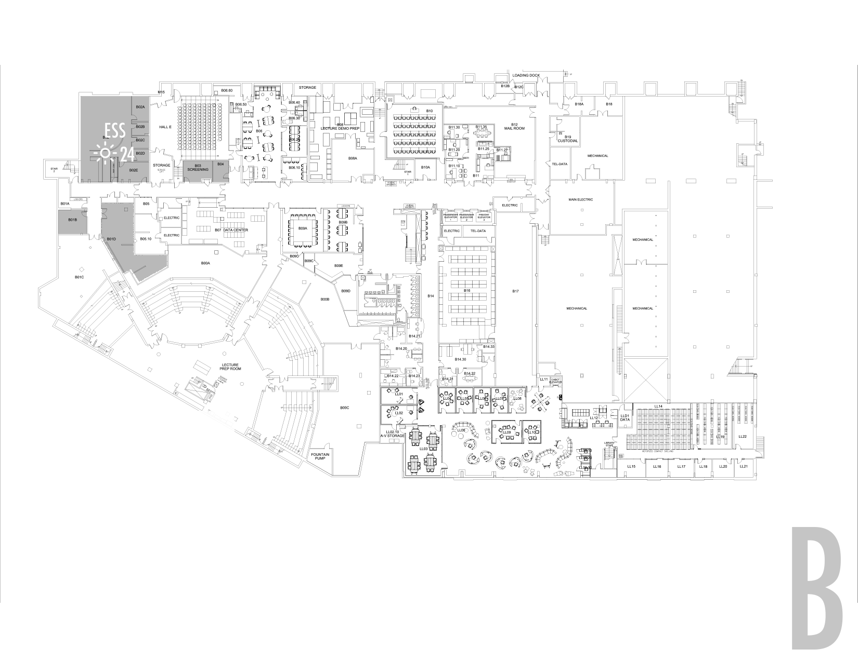
Science Center Project Update
Electrical Infrastructure Project
MAAB Restroom Projects
3. Teaching Labs Project
4. Arcade/Lobby Renovation
5. Lecture Hall Renovations
6. ESS Space Upgrades
  Scope
  Current Status
  Project Schedule
  Potential Impacts
7. 221 Math Offices

Slide 11
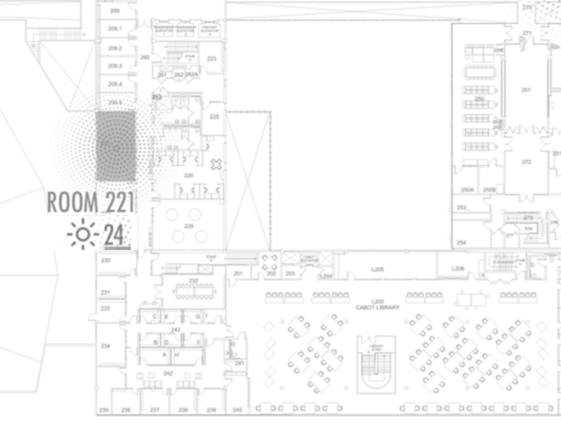
Science Center Project Update
Electrical Infrastructure Project
MAAB Restroom Projects
3. Teaching Labs Project
4. Arcade/Lobby Renovation
5. Lecture Hall Renovations
6. ESS Space Upgrades
221 Math Offices
  Scope
  Current Status
  Project Schedule
  Potential Impacts

Slide 12
EXPECTATIONS OVER THE NEXT MONTH

Slide 13
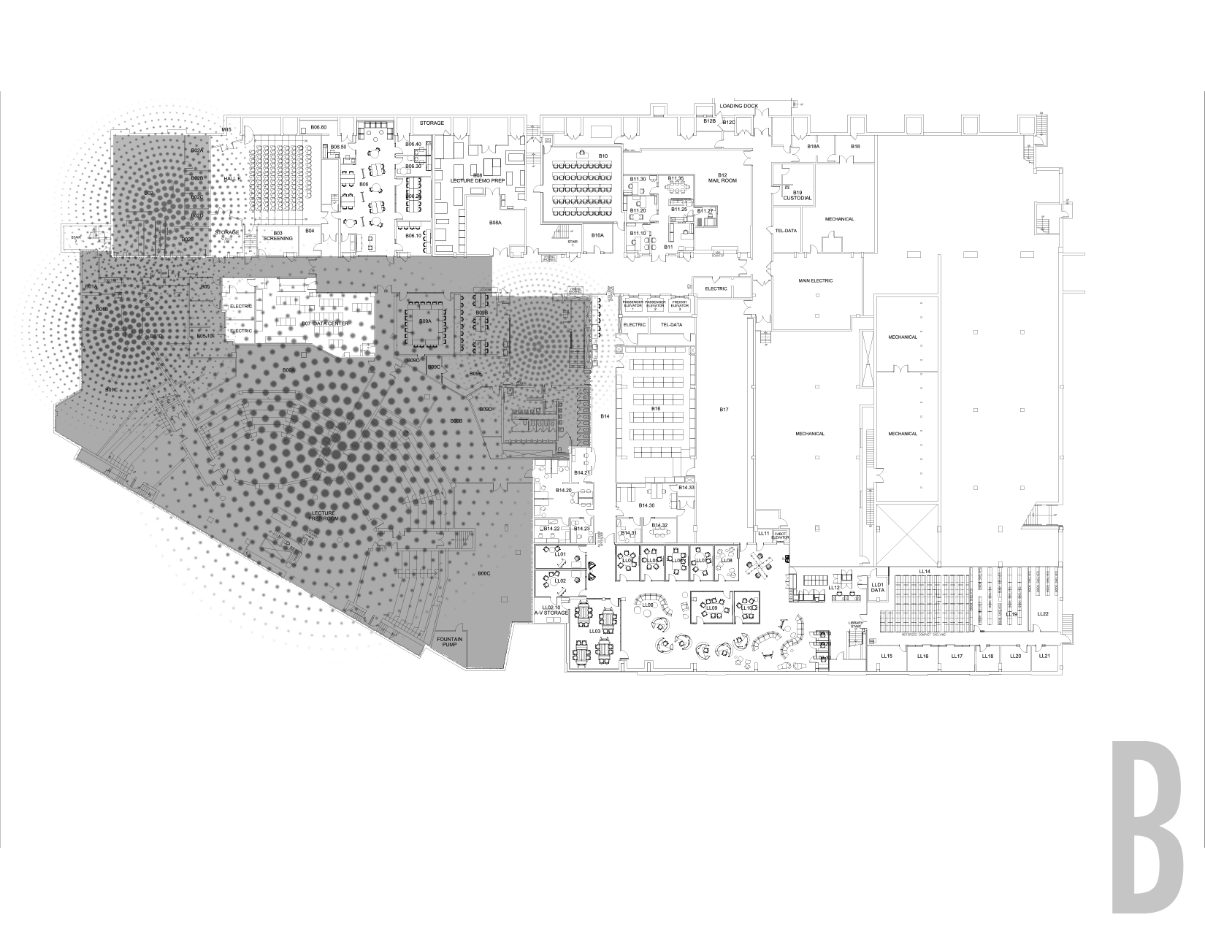

OCCUPANT
EMERGENCY EGRESS
OCCUPANT
EMERGENCY EGRESS
CONTRACTOR
EMERGENCY EGRESS
CONSTRUCTION PARTITION
BUILDING EMERGENCY EGRESS & STAIRWELL CLOSURE

Slide 14
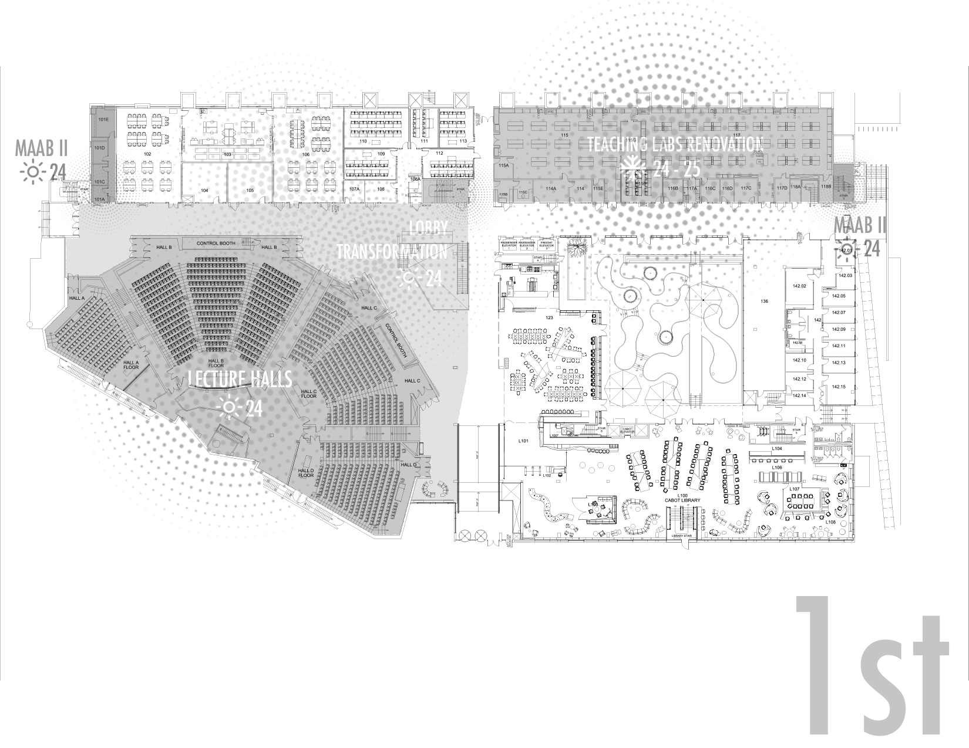
OCCUPANT
EMERGENCY EGRESS
FROM UPPER FLOORS
FROM UPPER FLOORS
FROM UPPER FLOORS
CONSTRUCTION PARTITION
OCCUPANT
EMERGENCY EGRESS
OCCUPANT
EMERGENCY EGRESS
CONSTRUCTION PARTITION
CONSTRUCTION PARTITION
OCCUPANT
EMERGENCY EGRESS
BUILDING EMERGENCY EGRESS & STAIRWELL CLOSURE

Slide 15
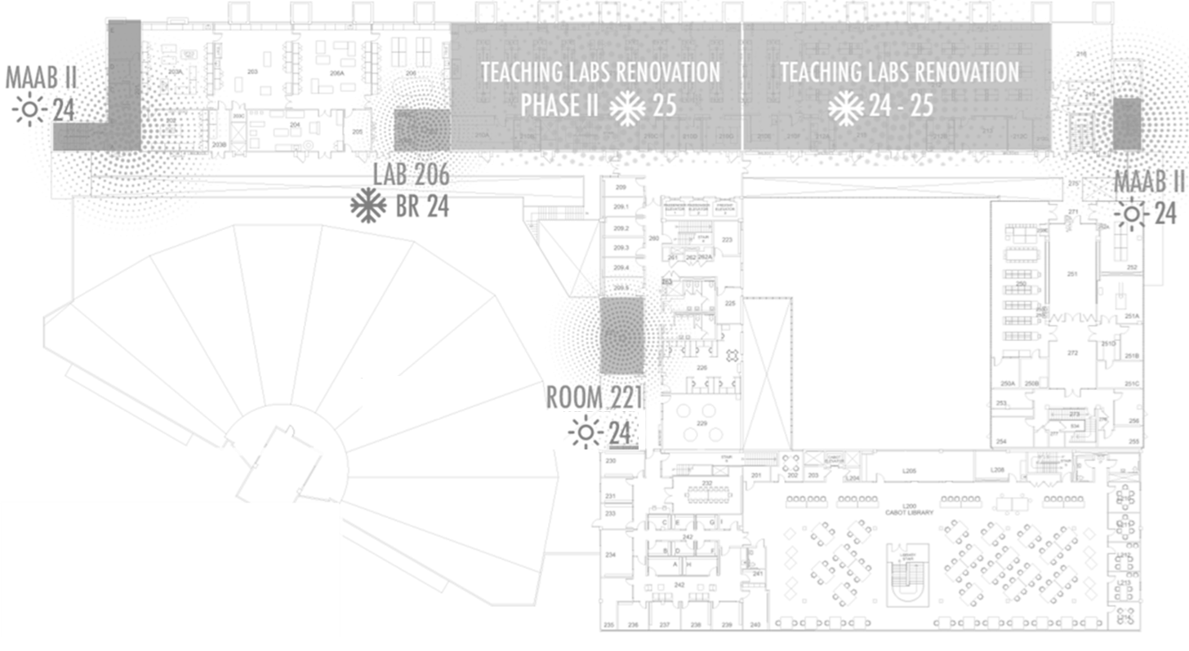

OCCUPANT
EMERGENCY EGRESS TO 1ST FLOOR EXIT
CONSTRUCTION PARTITION
CONSTRUCTION AREA BEHIND DOORS
OCCUPANT
EMERGENCY EGRESS TO 1ST FLOOR EXIT
OCCUPANT
EMERGENCY EGRESS TO 1ST FLOOR EXIT
BUILDING EMERGENCY EGRESS & STAIRWELL CLOSURE

Slide 16
PROGRESS PHOTOS

Slide 17
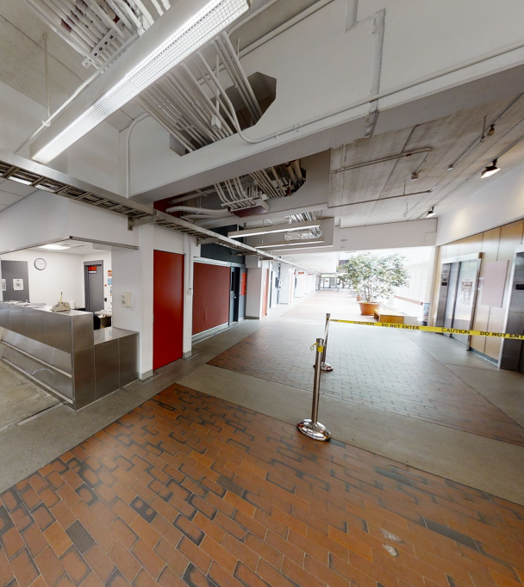
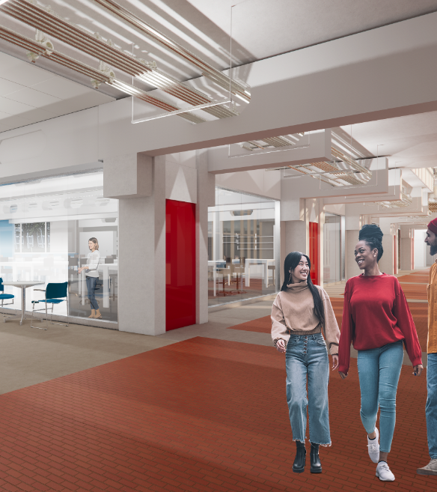
Lobby – 1ST FL
BEFORE
AFTER

Slide 18
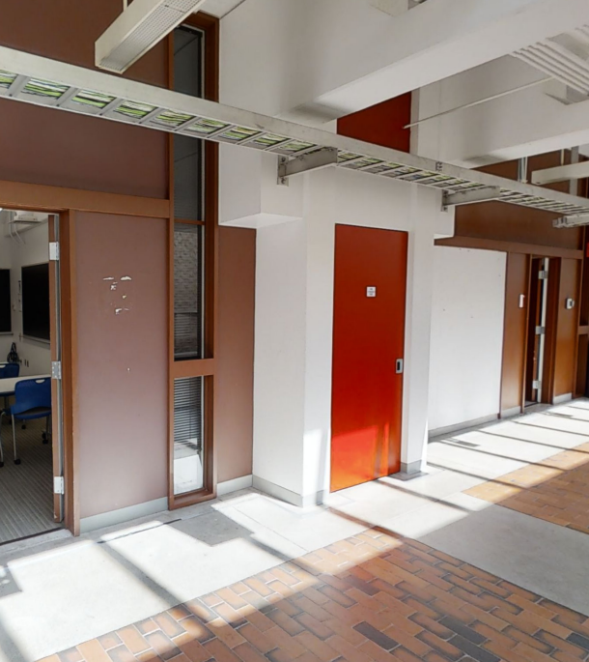
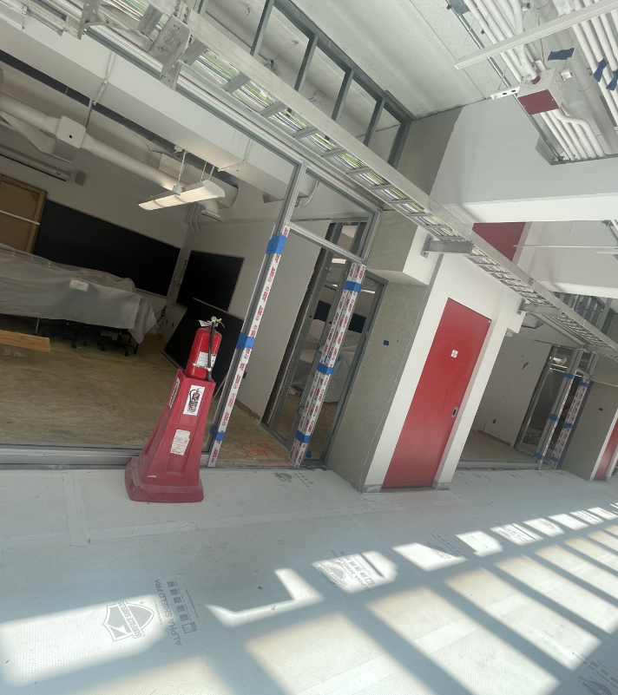
Lobby/Classrooms
BEFORE

Slide 19
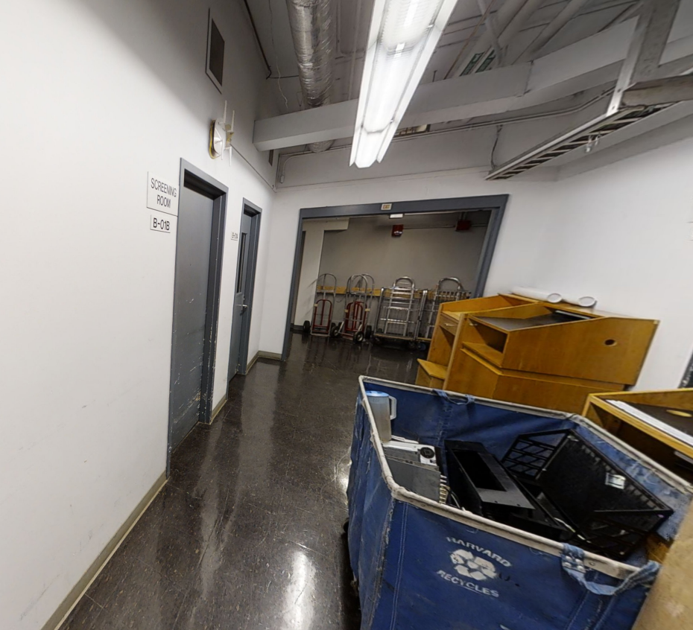
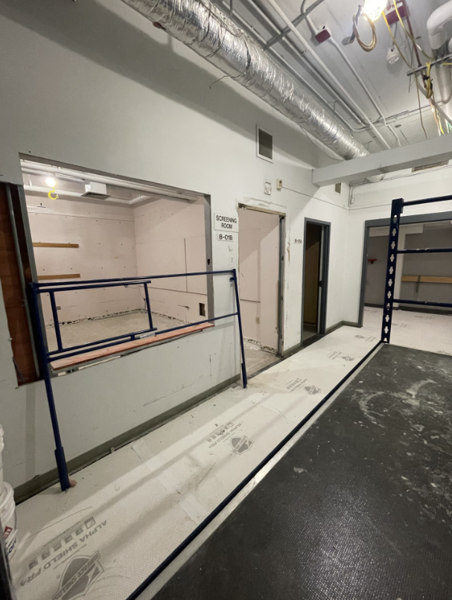
ESS Renovations
BEFORE

Slide 20
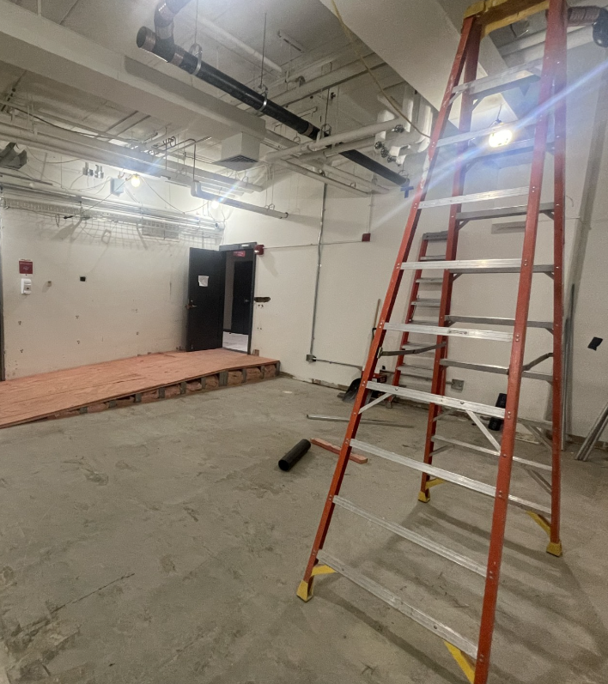
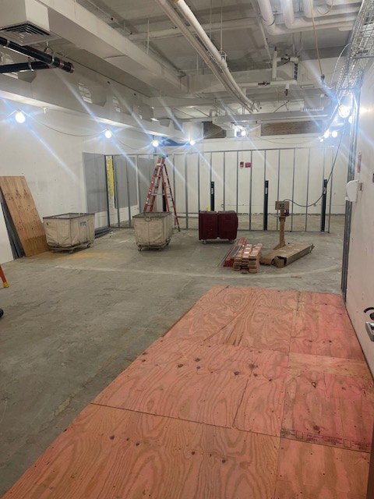
ESS Renovations

Slide 21
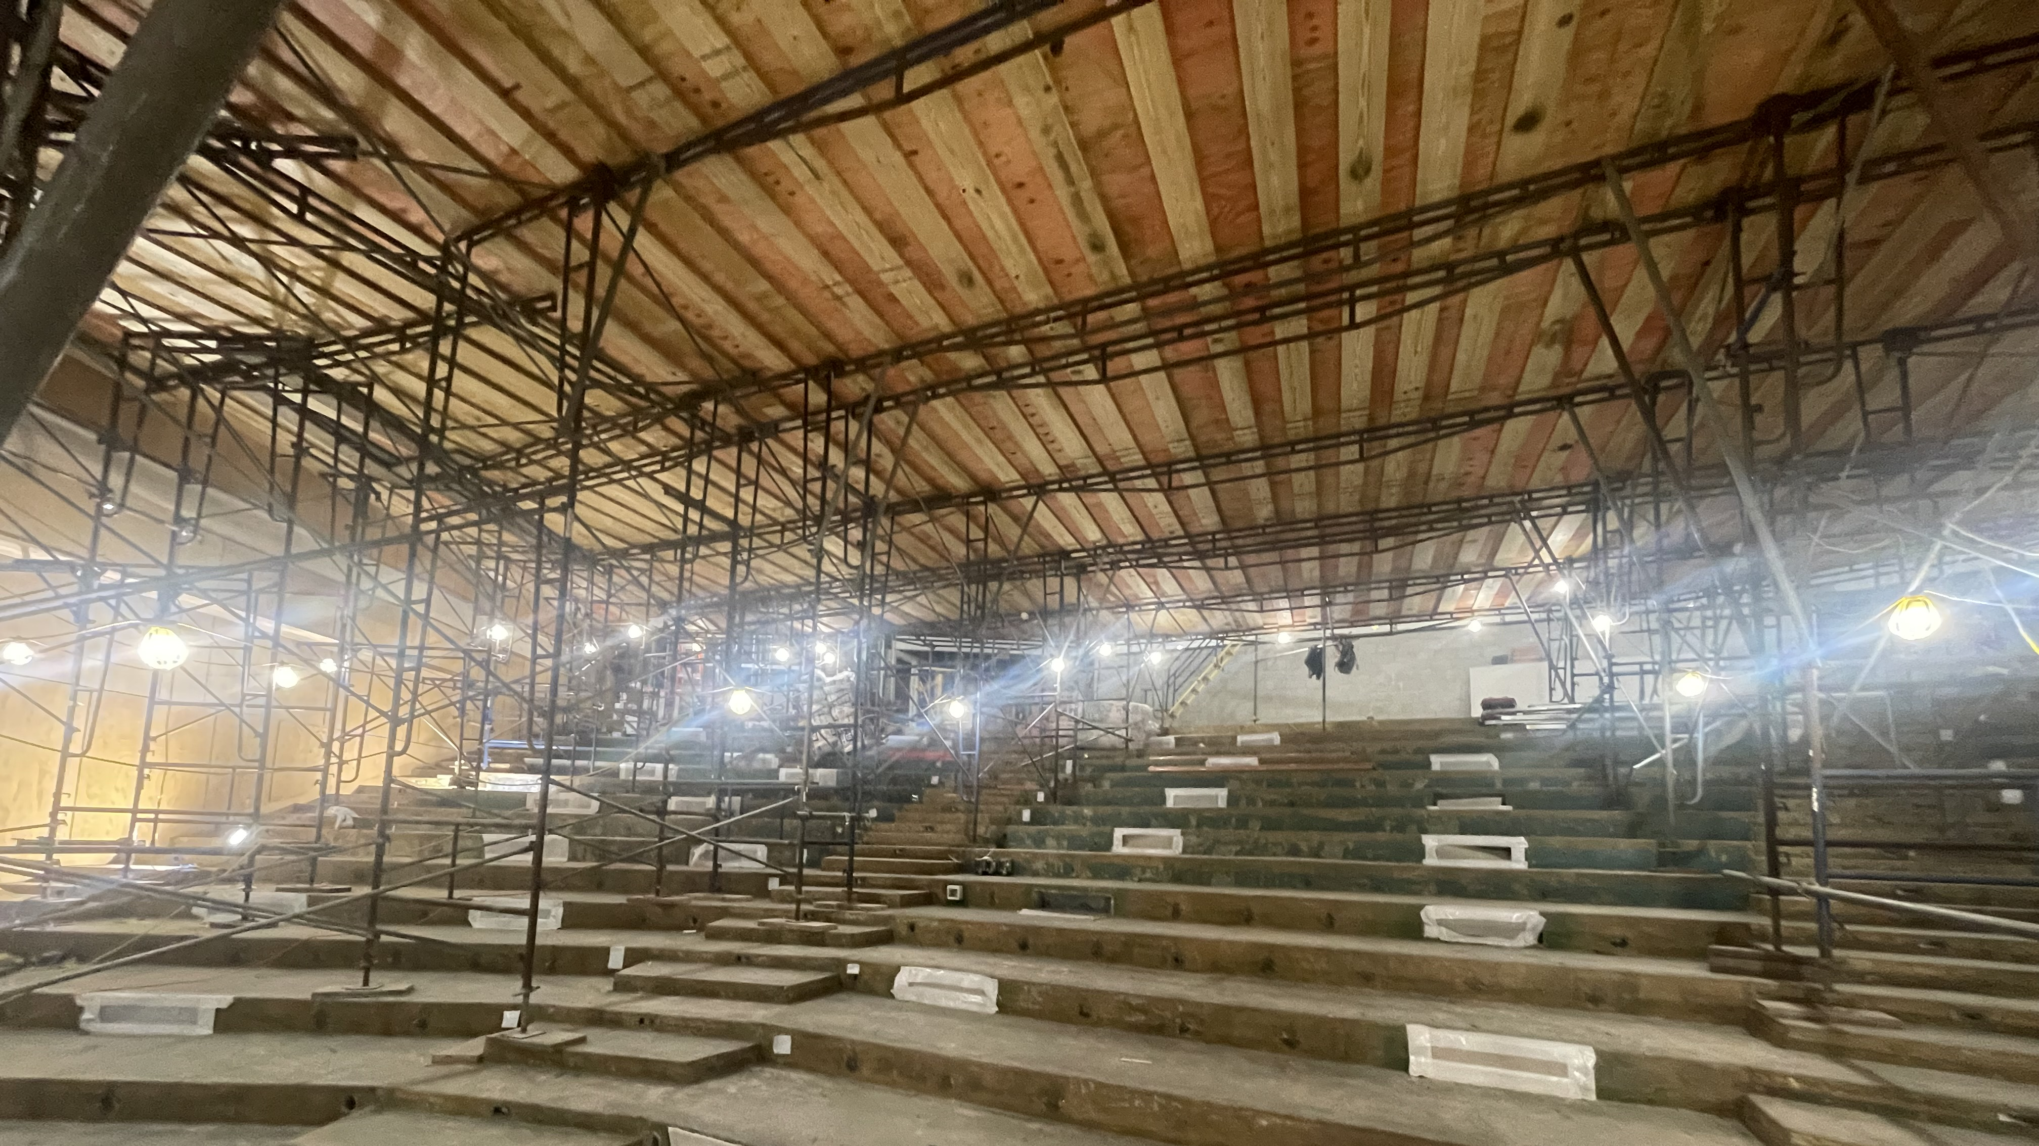
Lecture Hall

Slide 22
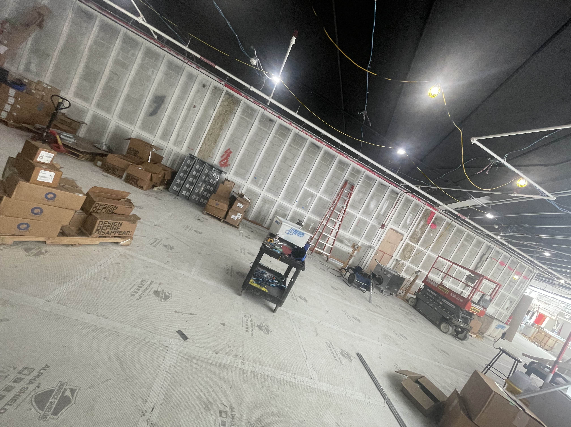
Lobby Renovation
Art Wall

Slide 23
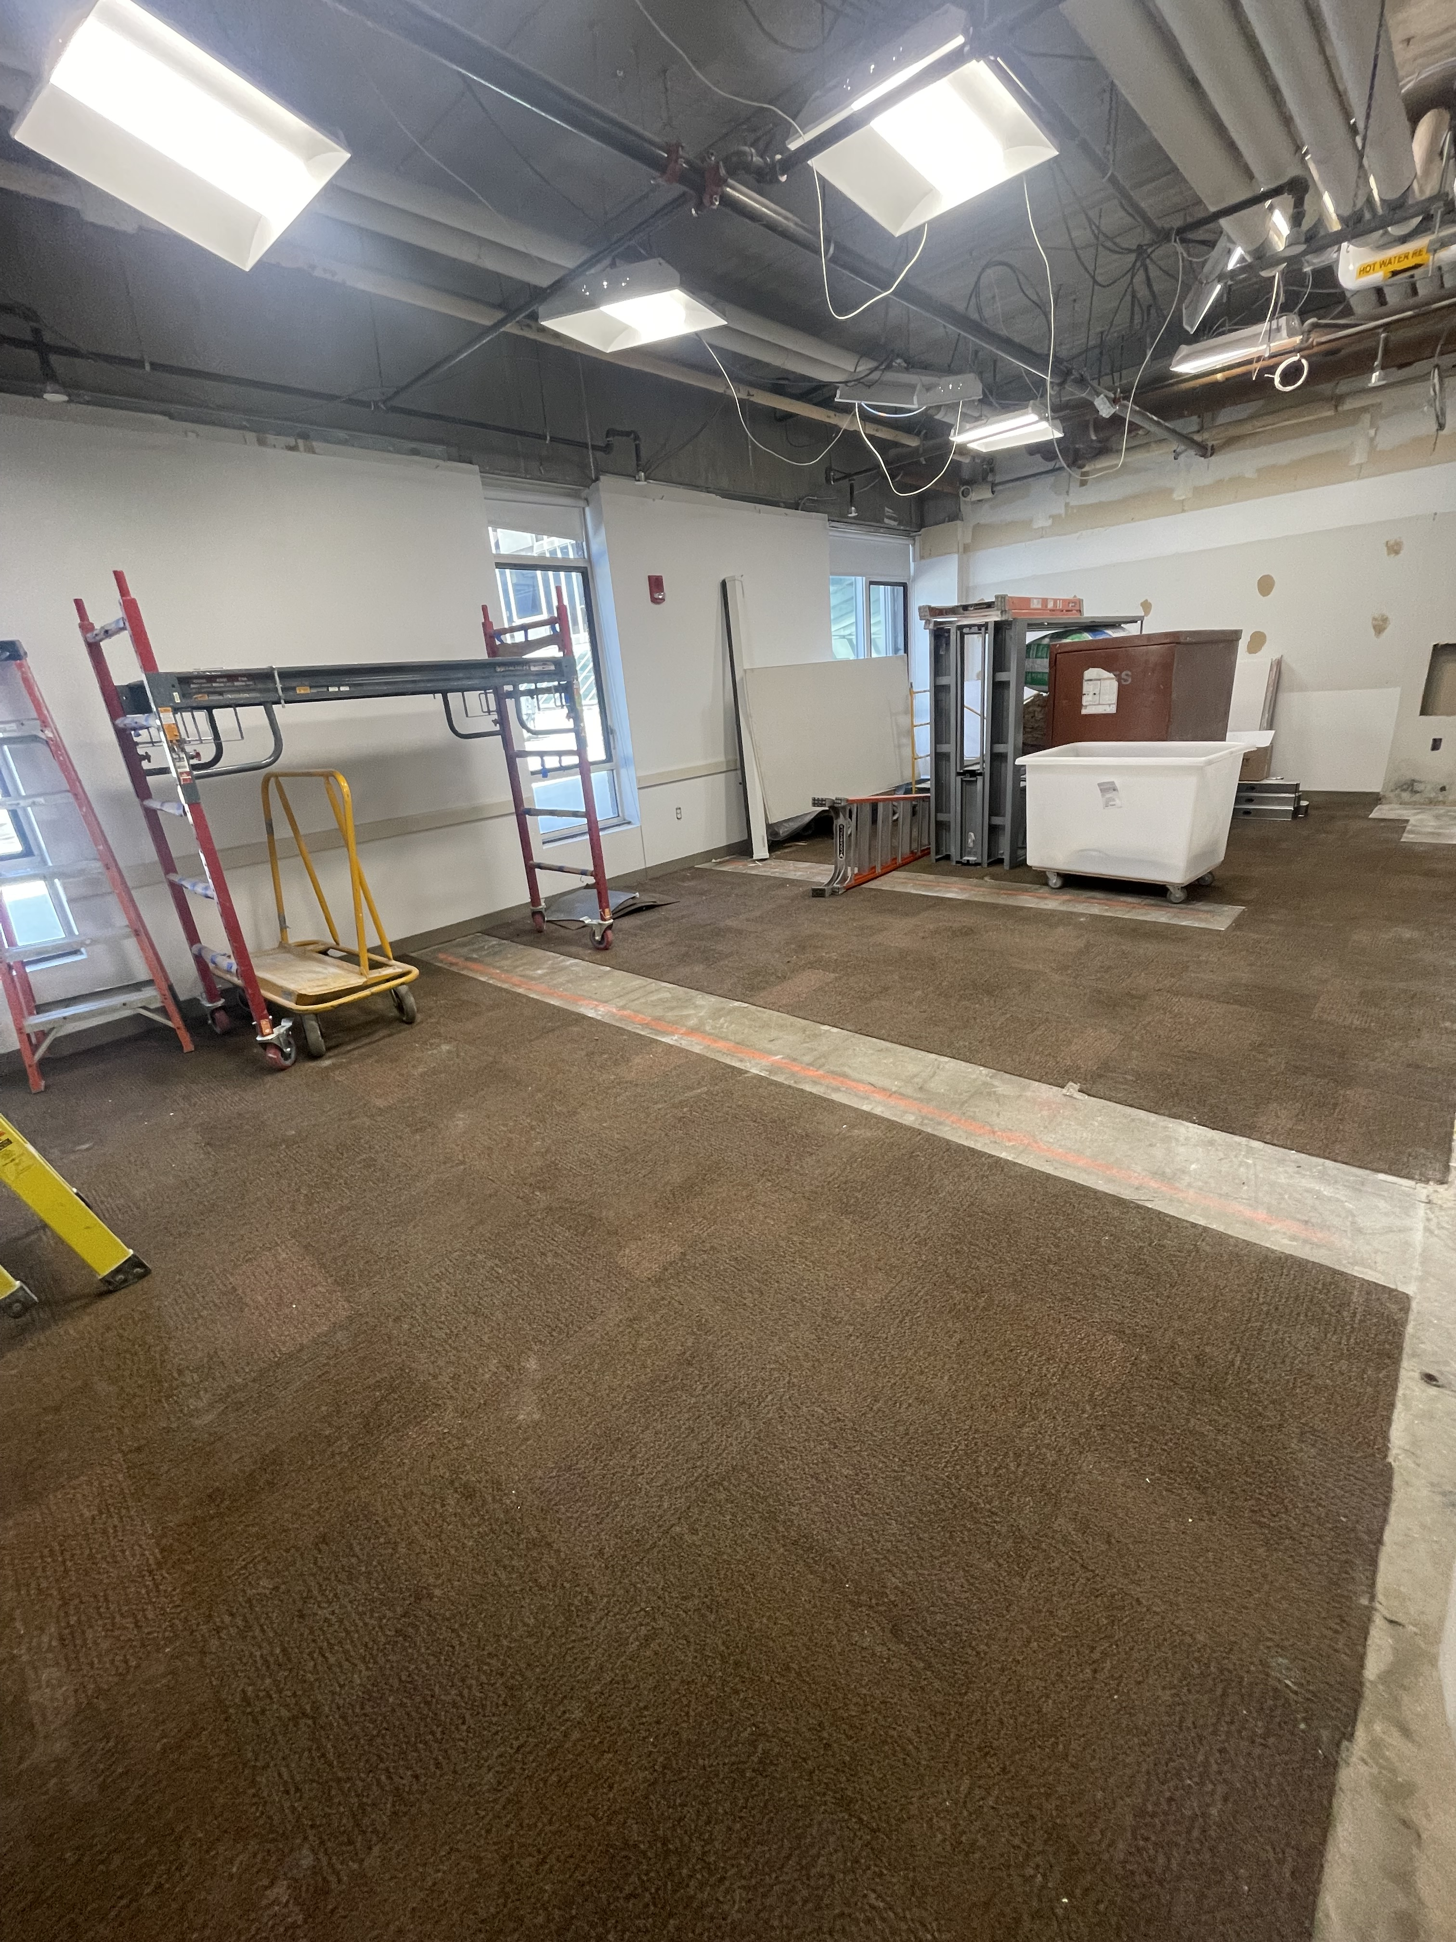
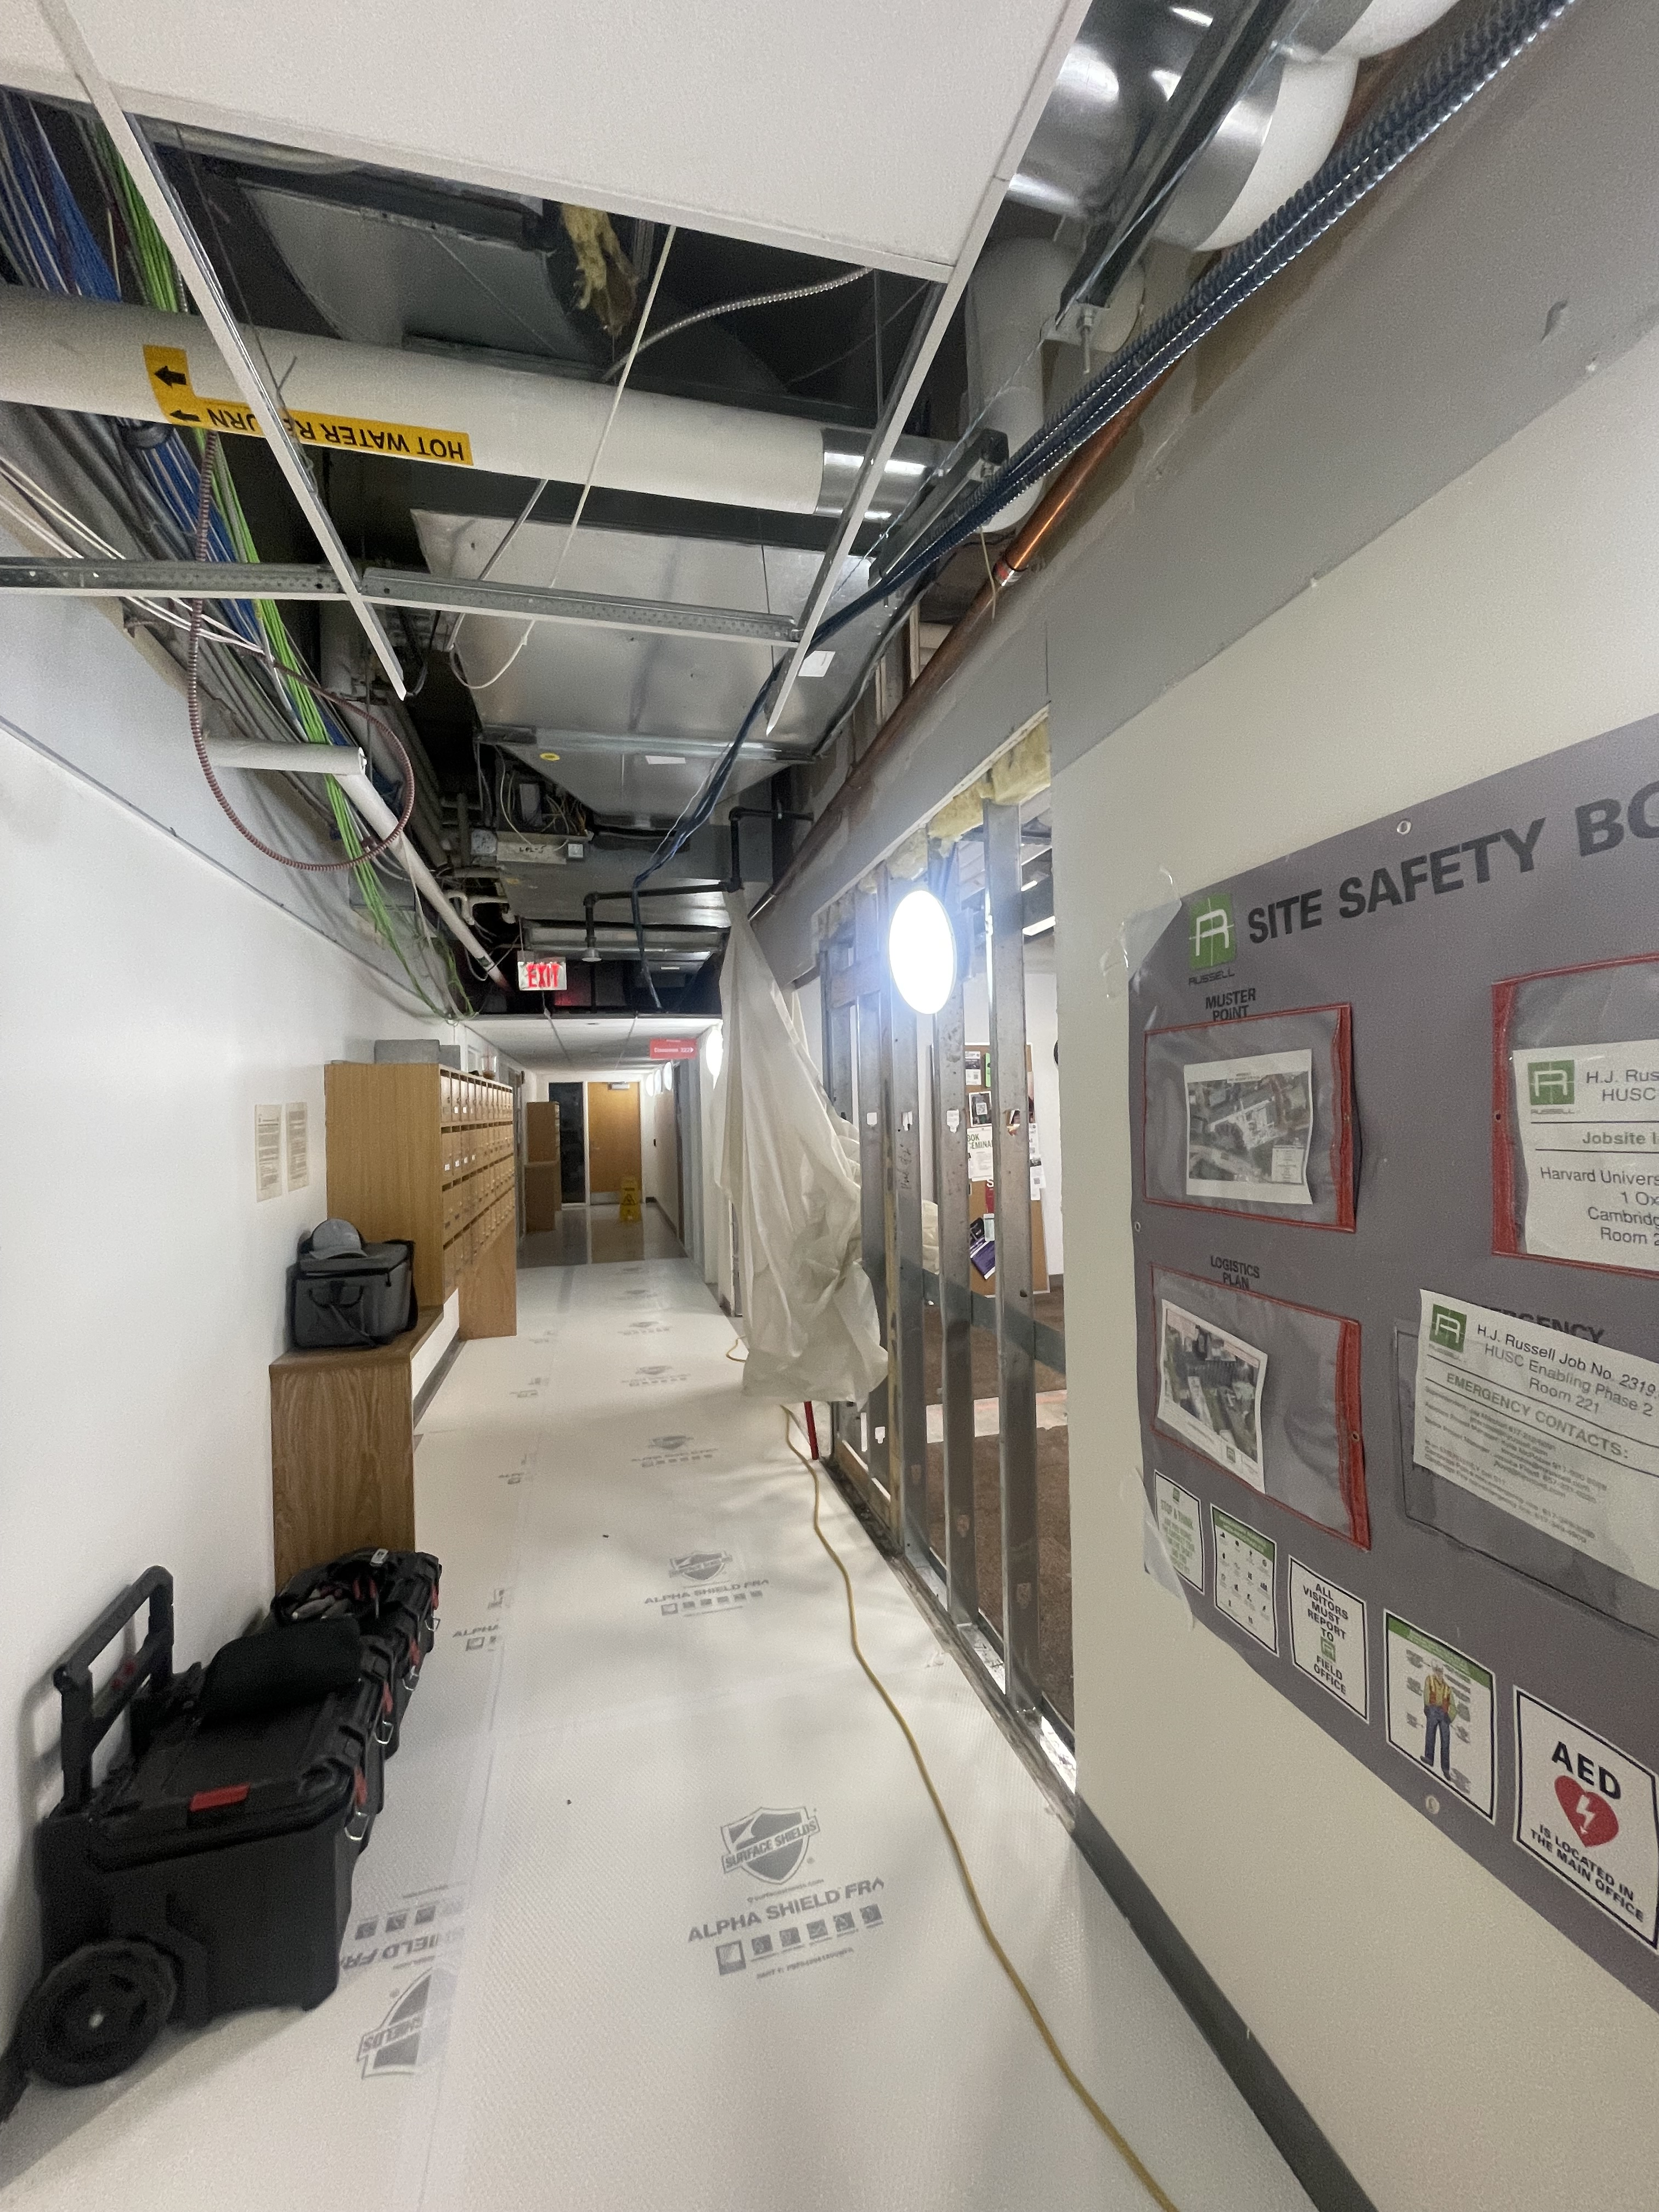
Room 221 Office Build

Slide 24
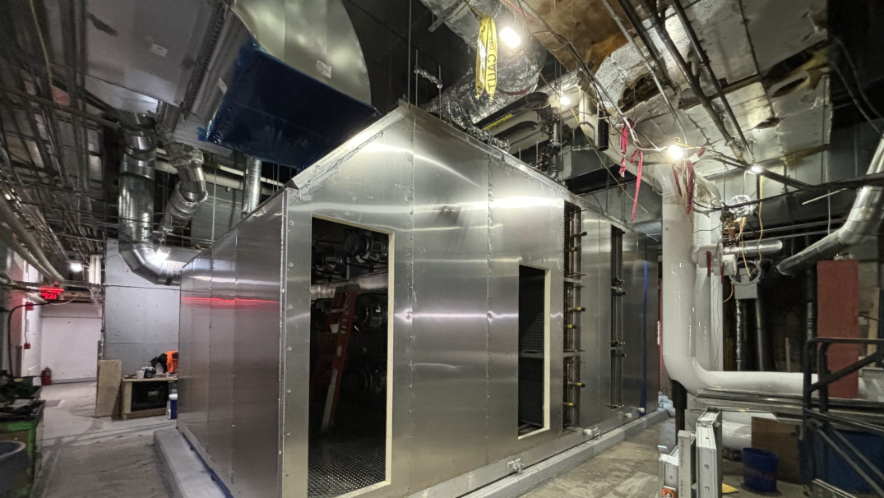

Slide 25
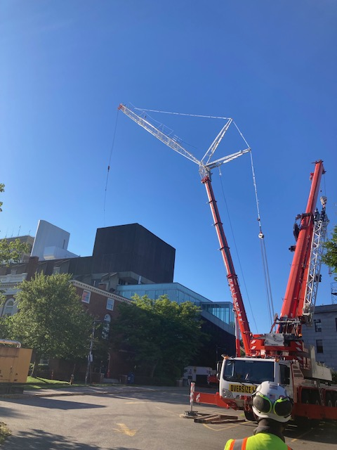
Crane Pick Scheduled for August 10th, 11th, & 12th
8/10
5am CSI to have parking lots and drive lanes clear to allow for crane and tractor trailer swing paths.
7am Crane and truck begins setup of 500 Ton crane.
6pm Complete setup of 500 Ton Crane
6pm Temp construction fencing to be erected around the crane.
8/11
6am Science Center and Music Buildings to be cleared of occupants from 6am-11am.
7am New load bank is lifted & installed
11am Re-open buildings to normal business and breakdown of 500 Ton Crane begins.
8/12
6am Breakdown of 500 Ton Crane continues.

Slide 26
WEBSITE & NOTIFICATIONS REMINDER!

Slide 27
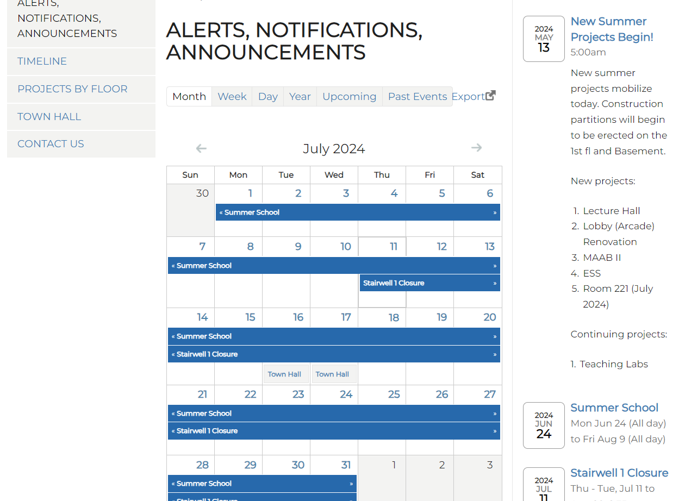


DON’T FORGET TO CHECK THE WEBSITE FREQUENTLY FOR NOTIFICATIONS!
https://projects.iq.harvard.edu/scictr-renovations

Slide 28
QUESTIONS?
https://projects.iq.harvard.edu/scictr-renovations

Slide 29
THANK YOU!
https://projects.iq.harvard.edu/scictr-renovations

